Slide 1

  G450 / G460
  Bump-test and Calibration Procedures
  GfG Instrumentation, Inc.
  1194 Oak Valley Drive, Suite 20
  Ann Arbor, Michigan 48108
  Toll free (USA and Canada): (800) 959-0329
  Direct: +1-734-769-0573
  Service e-mail: service@gfg-inc.com
  Internet: www.gfg-inc.com
  Technical documentation and download site: www.goodforgas.com

Slide 2
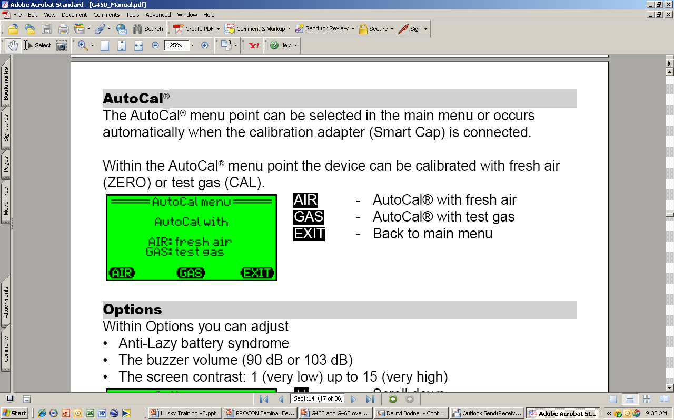
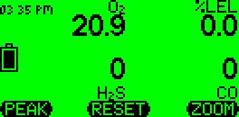
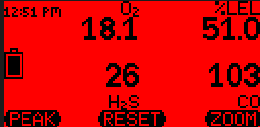
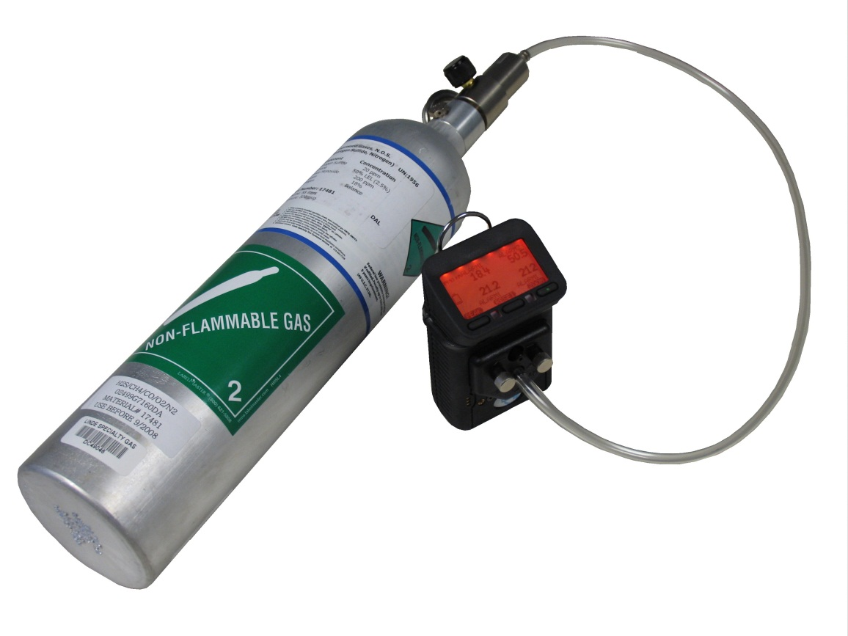
Bump Test (Manual Procedure)
Make sure the instrument is located in fresh air, turn on, and allow to warm up
Note readings, and perform fresh air zero if necessary
Attach calibration adapter; instrument will display "AutoCal menu"
Press "Exit" to show normal gas reading screen
Flow gas to sensors; alarms should activate, and readings should stabilize at expected values (if sensors fail to respond properly, instrument should be calibrated before further use)
Turn off gas, remove cal adapter and allow readings to stabilize at fresh air values

Slide 3
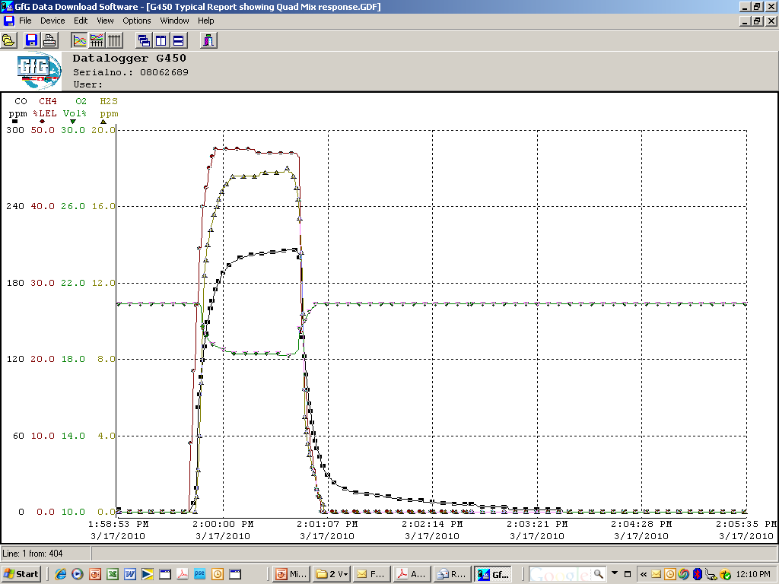
Bump Test
Response of sensors to Quad Mix (graphs)
Readings recorded while instrument operated in normal gas reading mode
Simultaneous response to all four gases, as well as match between cal gas concentrations and readings

Slide 4
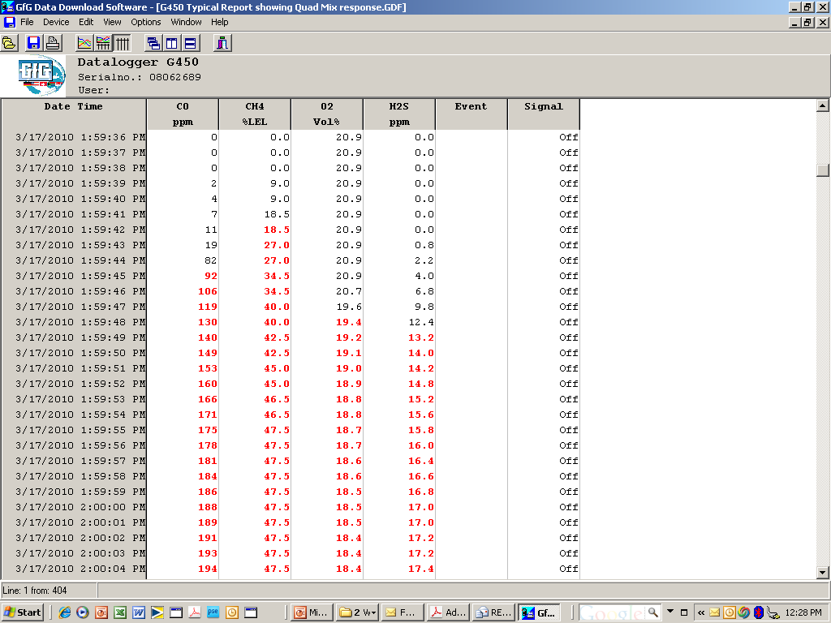
Bump Test
Response of sensors to Quad Mix (table)
Readings recorded while instrument operated in normal gas reading mode
When a sensor is in alarm readings are recorded in red

Slide 5
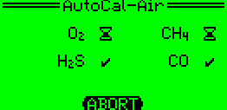
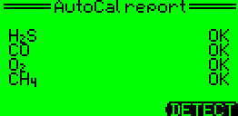
Manual AutoCal
AutoCal allows instrument to be “Fresh air” or “Calibration” (span) adjusted if needed

Slide 6
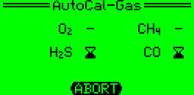
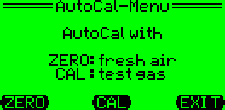
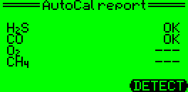
Attach Cal Cap to Enter Fresh Air and Span “AutoCal”
Choose ZERO or CAL and apply gas
(if calibrating), e.g. an H₂S/CO mix.
Adjustment is automatic
Display shows when cal adjust has been successfully completed
Attach cal cap to unit;
instrument automatically
enters “AutoCal” menu

Slide 7
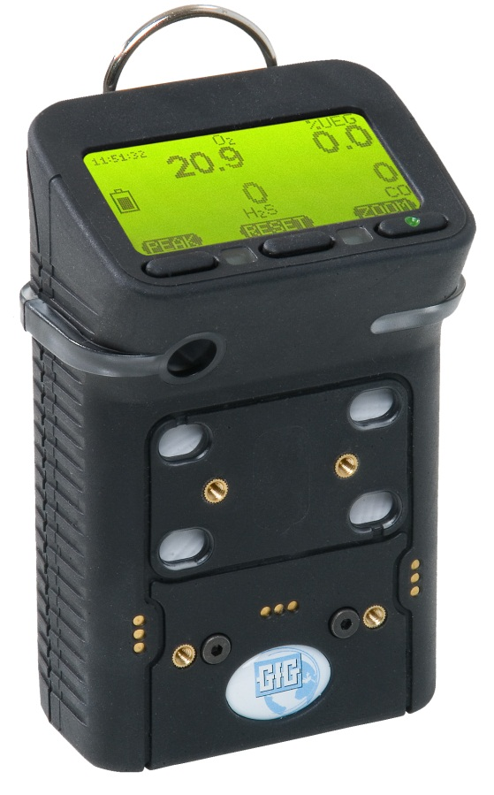

Can also enter “AutoCal” mode by pushing “Reset” and “Zoom” buttons at same time
Choose ZERO or CAL and apply gas
(if calibrating), e.g. an H₂S/CO mix.
Adjustment is automatic
Push “Reset” and “Zoom” at same time; instrument automatically enters “AutoCal” menu
Display shows when AutoCal adjust has been successfully completed

Slide 8
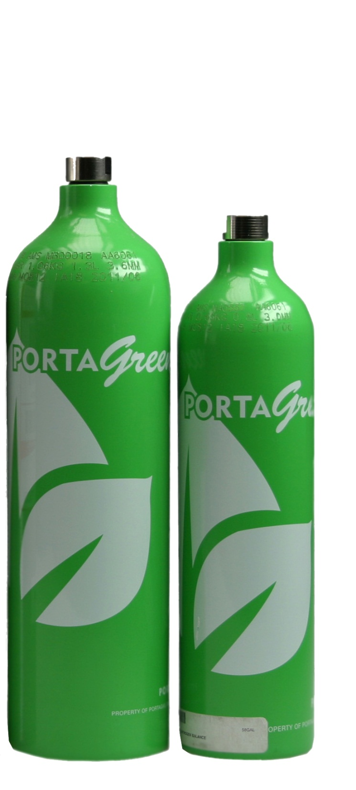
Calibration gas concentrations
Best to use the default cal gas concentrations
Default GfG concentrations used to calibrate instrument:
  200 ppm CO
  20 ppm H₂S
  50% LEL methane (CH₄)
If you use different concentrations you must change instrument settings!

Slide 9


What should you do if you fail AutoCal adjustment?
AutoCal adjusts all of the sensors that can be adjusted based on the calibration gas being used
The display will show an “Error” for any sensors that were not successfully adjusted
The most common reasons for failing AutoCal adjustment are:
  Forgetting to attach the cal adapter
  Forgetting to turn on the flow of gas
  Empty calibration gas cylinder
  Wrong cylinder / wrong concentration(s) in calibration gas
  Gas has expired dating and is no longer usable
Before giving up, check the gas and fittings and try again

Slide 10
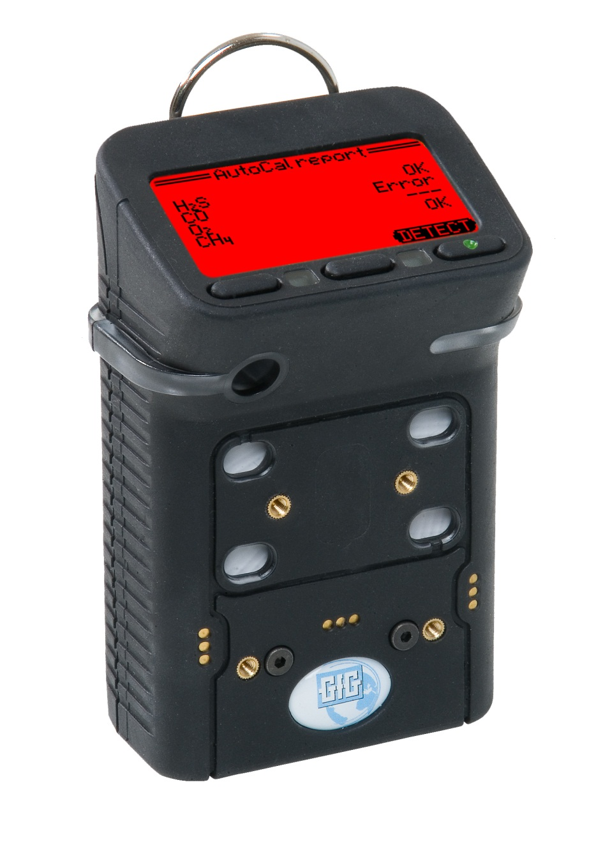
What if you check the gas and fittings but still fail AutoCal adjustment?
To avoid accidentally using the wrong cal gas, or zeroing the instrument in the presence of contaminants;
AutoCal has a maximum permitted change in adjustment between one fresh air zero, or one span calibration and the next
If the change between the zero or span setting exceeds this maximum, the instrument will not properly adjust
In this case you will need to perform a single-sensor calibration on the sensor or sensors that have failed to calibrate properly

Slide 11


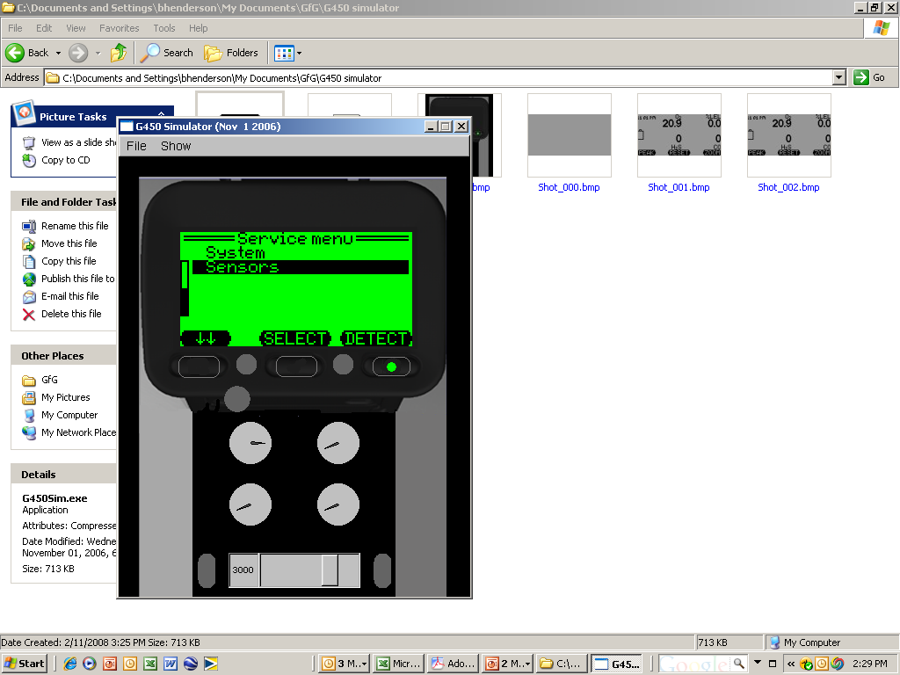
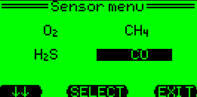
Single sensor calibration procedure (part 1)
Use single sensor calibration procedure whenever you need to calibrate one sensor at a time
Press and hold “Reset” button to show the “Main Menu” then chose “Service”
For “Security Code” use “1100” as the password
Choose “Sensors” then select the sensor that you intend to calibrate
Make sure to use “1100” as password.
“1100” is a special password that allows a wider maximum calibration adjustment window.

Slide 12
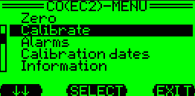
Single sensor calibration procedure (part 2)
A screen will show the menu choices for the selected sensor
If the sensor needs to be fresh air adjusted choose “Zero”
If the sensor does not need to be fresh air adjusted choose “Calibrate”

Slide 13
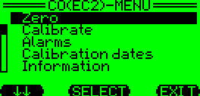
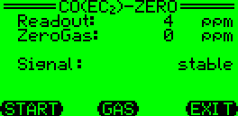
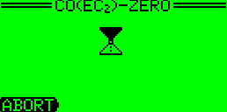


Single sensor calibration procedure (part 3)
To perform a fresh air zero:
  Make sure the sensor is exposed to fresh, contaminant free air
  Make sure to remove the cal adapter if you are using the surrounding air to adjust the sensor
  The “Zero” screen will show the current reading
  Press “Start” to begin the fresh air adjustment
  An “OK” indicates when the procedure is complete, after which the screen returns to the “Zero” screen
You MUST save the results of the fresh air or calibration adjustment or they will not be saved to the instrument’s memory!

Slide 14
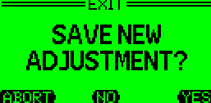
Saving single-sensor “Zero” and “Calibration” results (part 4)
If you do not deliberately save the results, after a few minutes the instrument will return to normal operation and the results will not be saved!
Press “Exit” to save the results and return to normal operation
Each time you press “Exit” you move up one level in the instrument program
The final screen will ask whether you want to “Save new adjustment?”
Press “Yes” to update the instrument memory

Slide 15
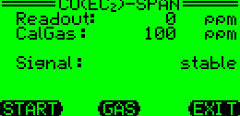
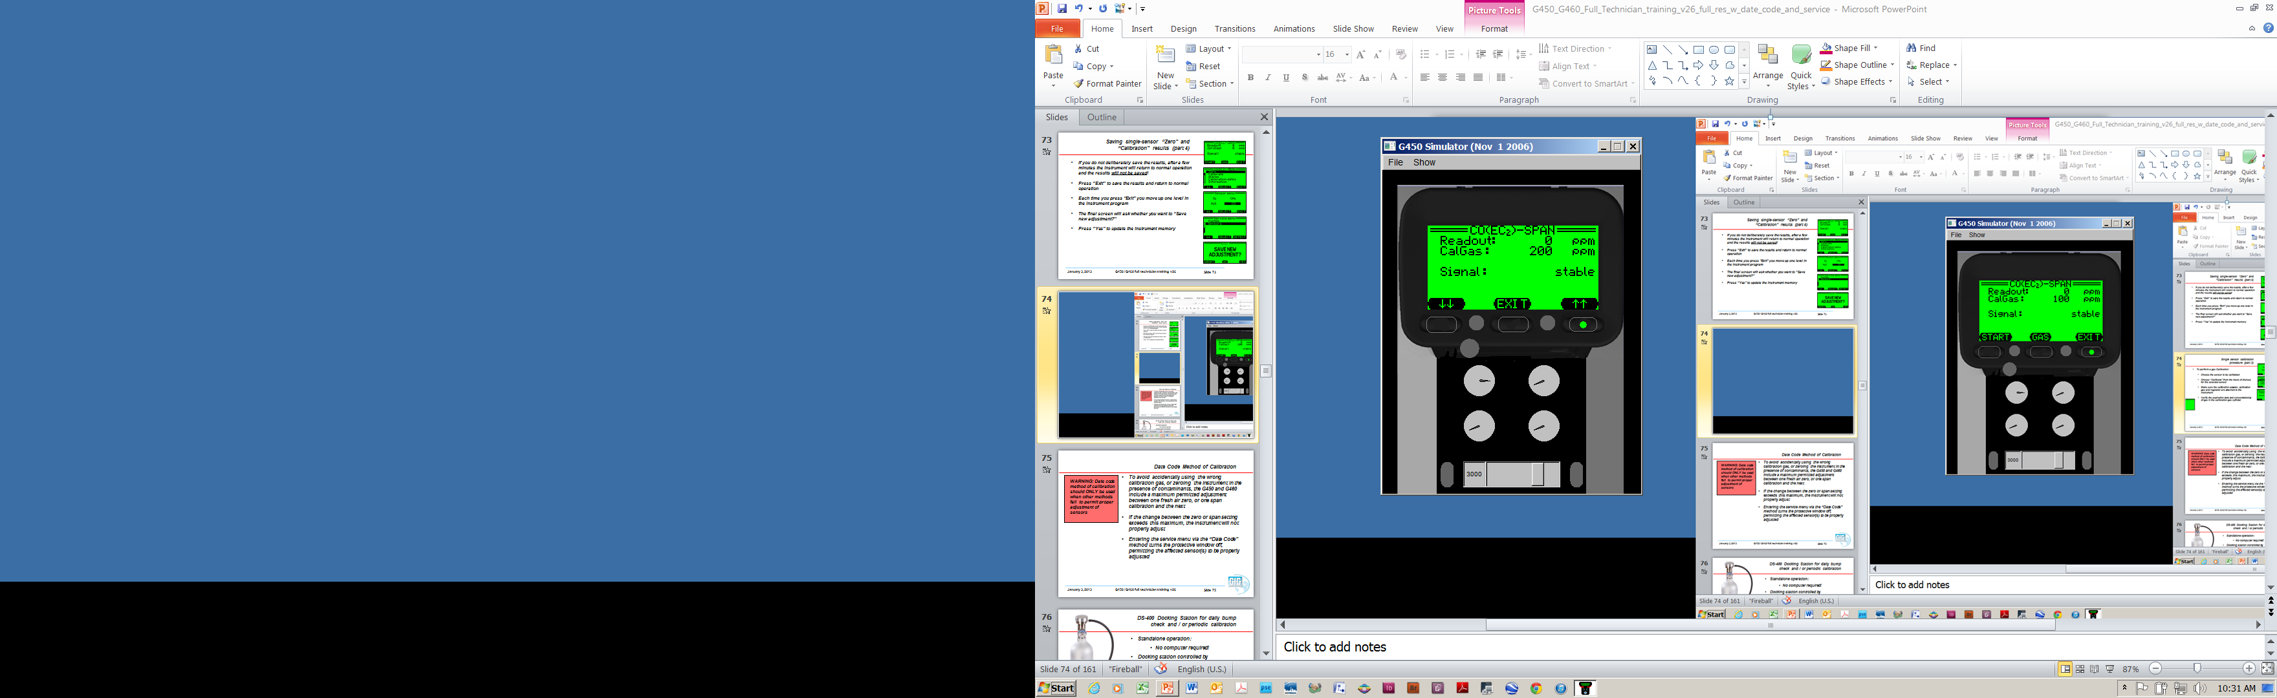
Single sensor calibration procedure (part 5)
To perform a span Calibration:
  Choose the sensor to be calibrated
  Choose “Calibrate” from the menu
  Make sure the calibration adapter, calibration gas and regulator are attached to the instrument
  The “Span” calibration screen shows the “CalGas” concentration that the instrument will use to adjust the sensor
  Verify the concentration of gas in the cylinder matches the “CalGas” value
  If needed, you can adjust the “CalGas” value by selecting “Gas” then using the arrow (↑↑ or ↓↓) buttons to change the concentration
  Press “Exit” after you finish adjusting the “CalGas” concentration

Slide 16
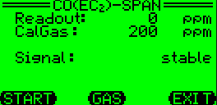
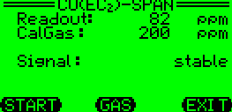
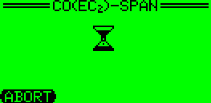
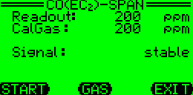
Single sensor calibration procedure (part 6)
To perform a span Calibration:
  The “Readout” shows the current sensor reading
  Open the regulator valve to begin flowing gas to the sensor
  The “Readout” number will begin to rise as the sensor is responds to the gas
  Press “Start” to begin the calibration adjustment
  The “Span” calibration screen will show an hour-glass icon while the sensor is being adjusted, then an “OK” message when the adjustment is complete
  Press “Exit” to return the instrument to normal operation.
  Remember to “Save” the new adjustment or the results of the calibration will not be updated to the instrument memory

Slide 17
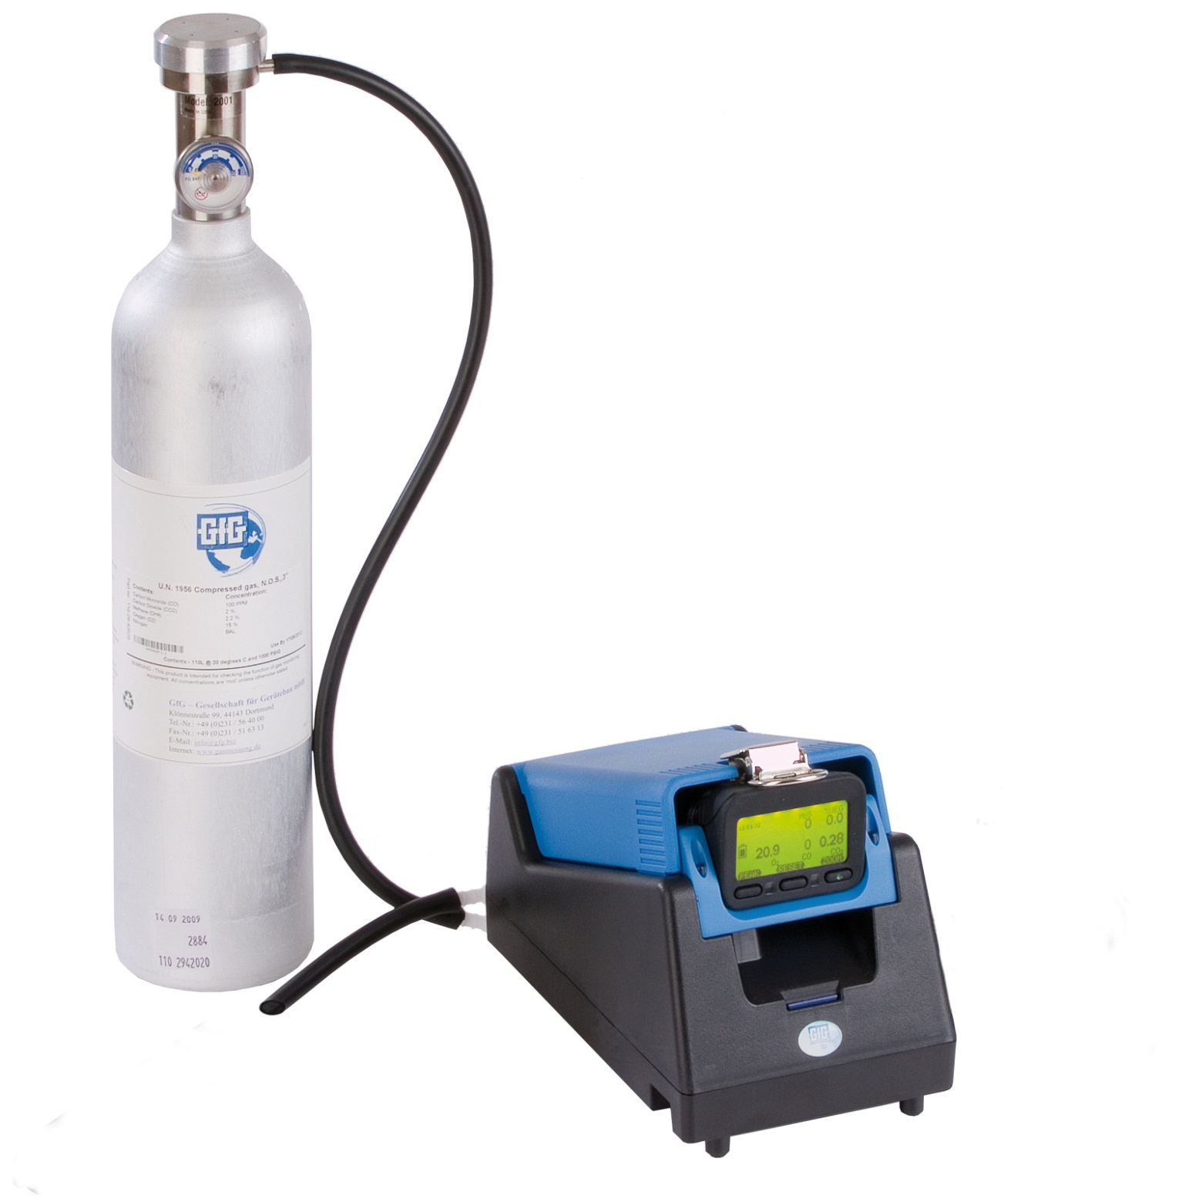
DS-400 Docking Station for daily bump check and / or periodic calibration
Standalone operation:
    No computer required!
Docking station controlled by instrument’s control buttons:
    Push "Test" for Bump Test
    Push "Cal" for Auto Cal
    Push "Cancel" to charge only

Slide 18
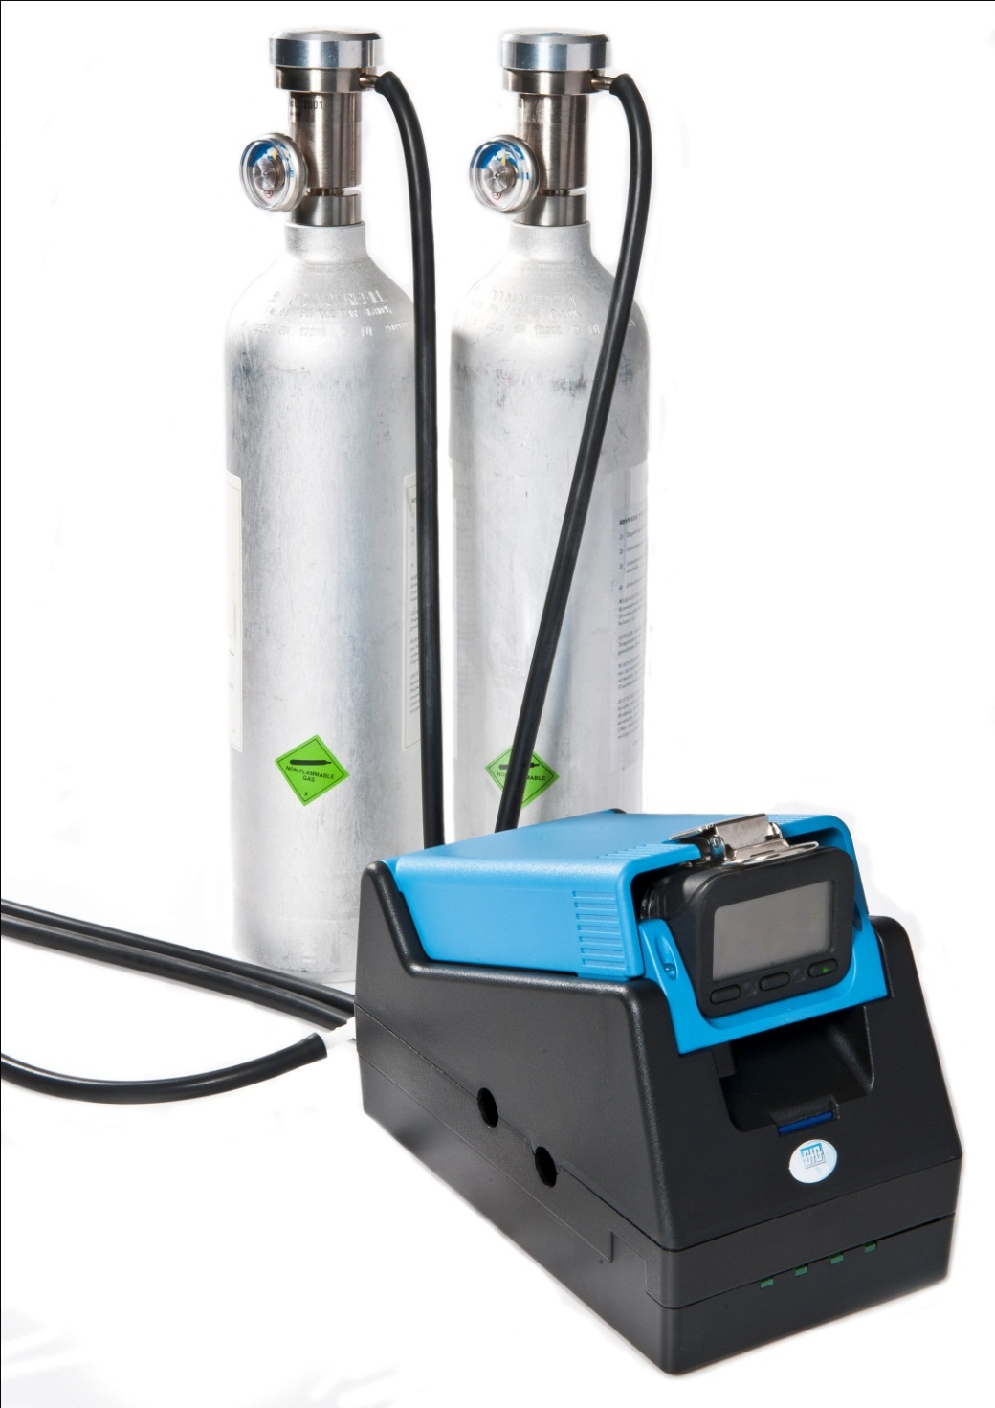
DS-404 Multi-inlet Docking Station for bump check and periodic calibration
Inlets for 4 cylinders of gas
Automatic Bump and Cal for 5, 6 and 7 channel instruments
Supports:
  Quad mix (O₂, LEL, CO, H₂S)
  5-mix with SO₂
  5-mix with CO₂
  Isobutylene
  HCN
  NO₂
  And other individual gases

Slide 19
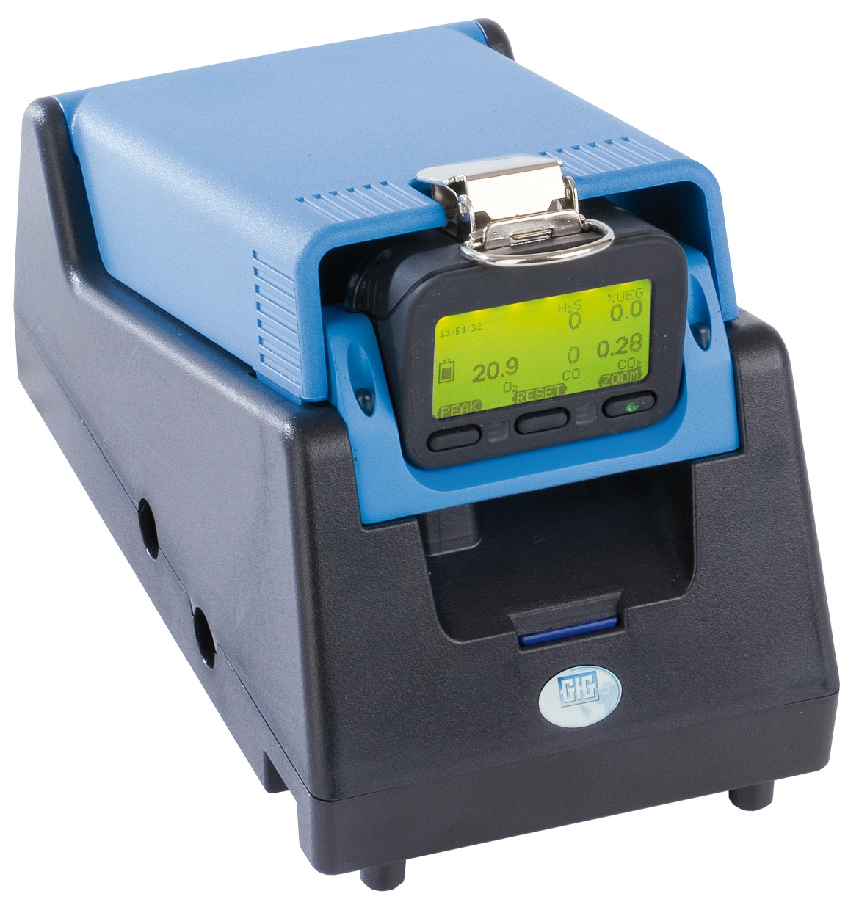
Using DS400 Docking Station for daily bump check and / or periodic calibration
Standalone operation: DS-400 does not require connection to an external computer
Test results and other messages displayed on instrument LCD

Slide 20
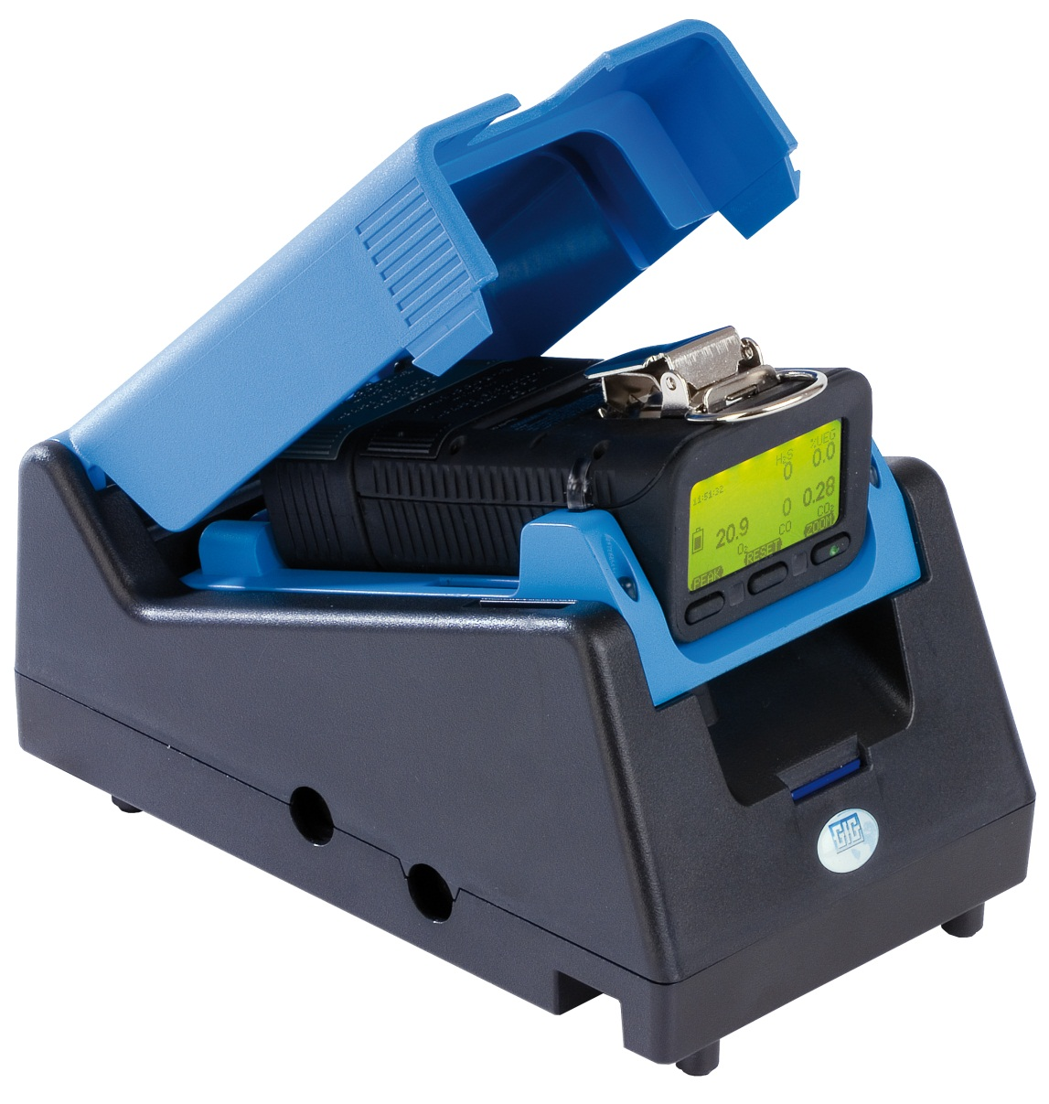
Using DS-400 Docking Station for daily bump check and / or periodic calibration
Using DS-400 allows instrument to record "Bump Test" as specific event in instrument's memory
It is possible to set a "Bump Test Due" date in the instrument's memory
Only way to reset next "Bump Test Due" date is by means of DS-400 Docking Station

Slide 21
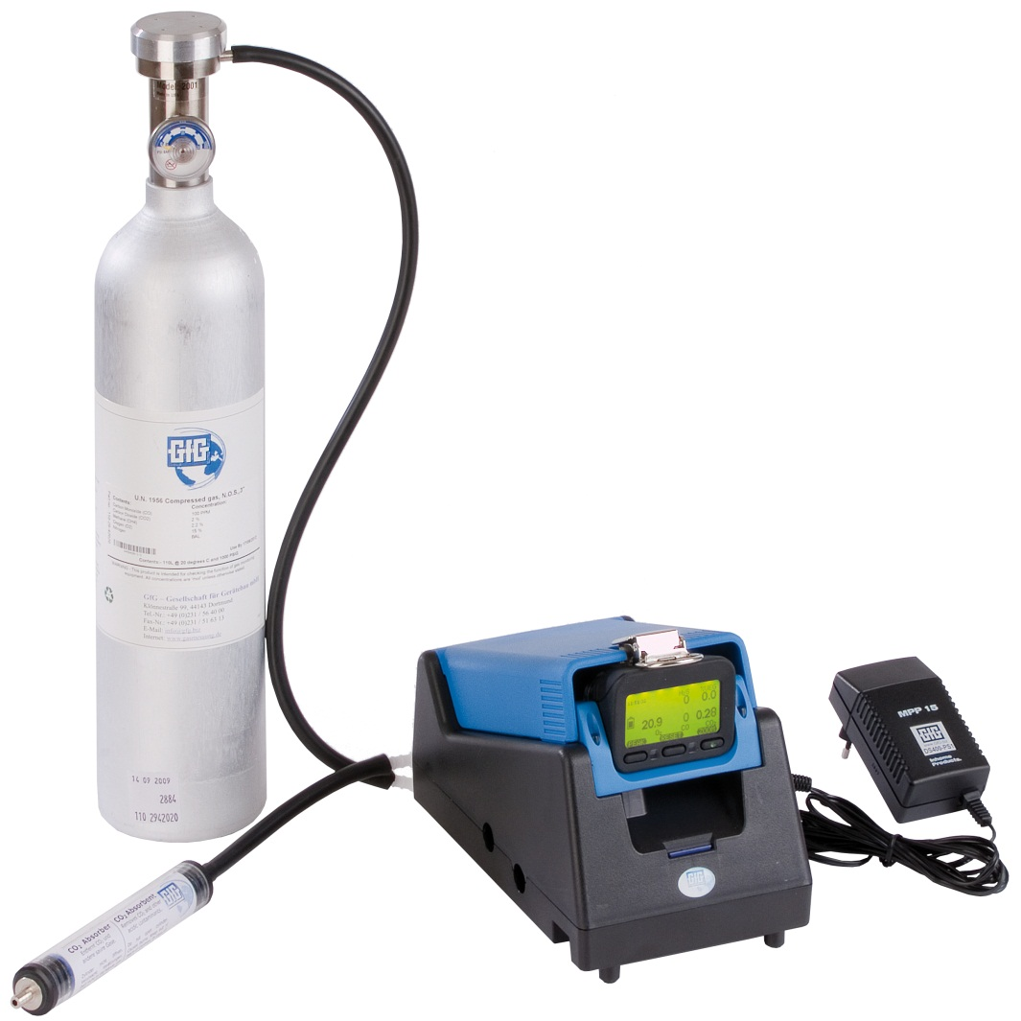
Using DS-400 Docking Station for daily bump check and / or periodic calibration
Make sure DS-400 attached to test gas and power
Make sure the instrument is located in fresh air, turn on, and allow to warm up
Note instrument readings, and perform fresh air zero if necessary
Place instrument in DS-400
Docking station controlled by instrument’s control buttons:
        Push "Test" for Bump Test
        Push "Cal" for Auto Cal
        Push "Cancel" to charge only

Slide 22
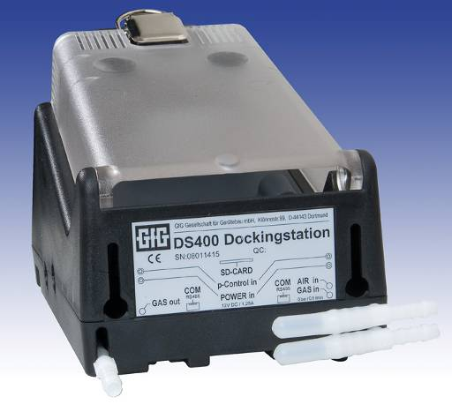
How to do bump test
Make sure instrument turned on
  Best if instrument allowed to warm-up at least 5 minutes before bump test
Make sure Docking Station plugged in and connected to gas
  Higher inlet is for fresh air
  Lower inlet is for span gas
Place instrument in Docking Station
Instrument display will indicate status and results of test

Slide 23
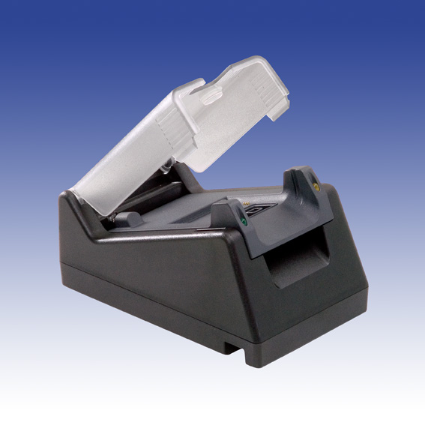
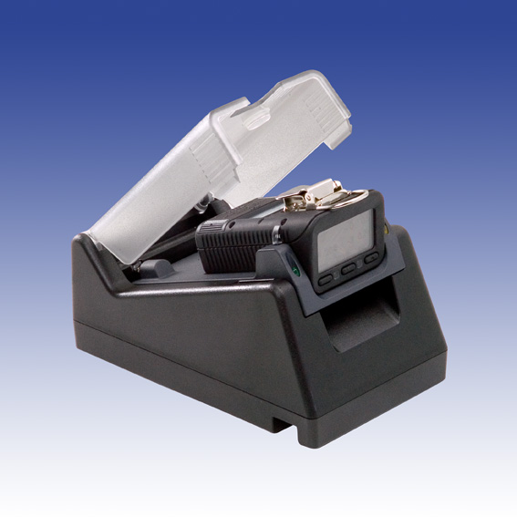
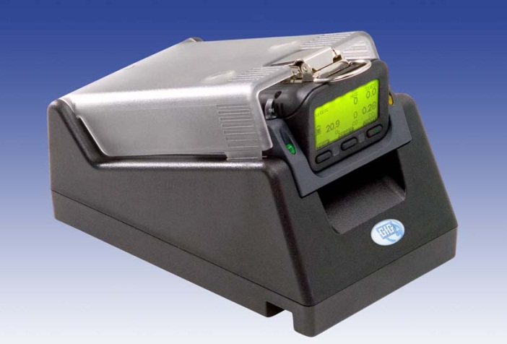
How to do bump test
After 10 second count-down; Docking Station automatically performs bump test
Instrument screen shows a check mark besides each sensor as bump check completed
If instrument is not removed from Docking Station; 5 minutes after test completed instrument automatically turns off and goes into charging mode

Slide 24
DS400 Docking Station
Bump-Test includes:
  Visual alarm function
  Audible alarm function
  Time for activation to alarm 1
  Time for activationto alarm 2
  Time to t50
Calibration Test Includes:
  Fresh air zero adjustment
  Span calibration adjustment
All test results:
  Stored to instrument memory
  Stored to flash memory card in Docking Station

Slide 25
What to do if instrument fails bump test
Red color warning screen and message indicates bump test failed
This means instrument needs to be “Autocal” adjusted before further use
Remove instrument from Dock, and press “Reset” (center) control button to clear alarm message
Place instrument back in Dock
Before end of count down press Autocal button

Slide 26
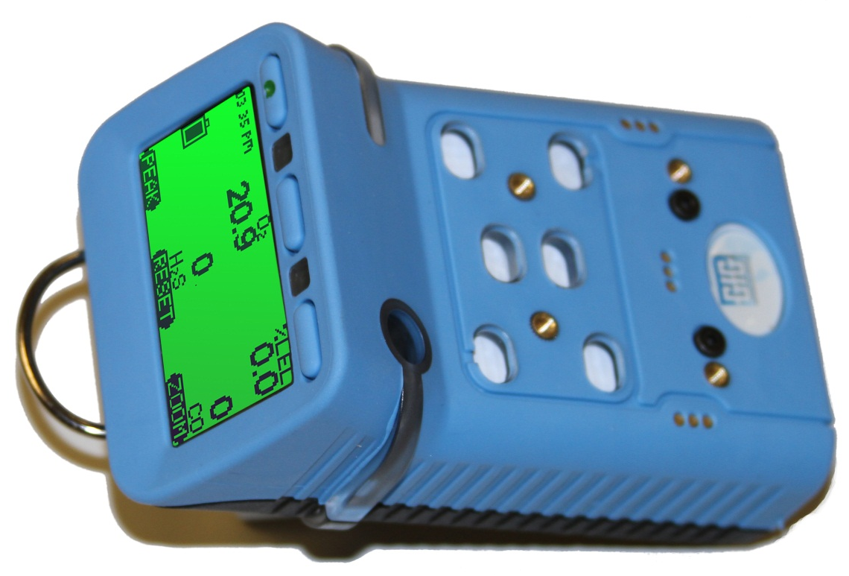
Questions?

