Slide 1

  G460 advanced confined space
  gas detector user training
  GfG Instrumentation, Inc.
  1194 Oak Valley Drive, Suite 20
  Ann Arbor, Michigan 48108
  Toll free (USA and Canada): (800) 959-0329
  Direct: +1-734-769-0573
  Service e-mail: service@gfg-inc.com
  Internet: www.gfg-inc.com
  Technical documentation and download site: www.goodforgas.com

Slide 2
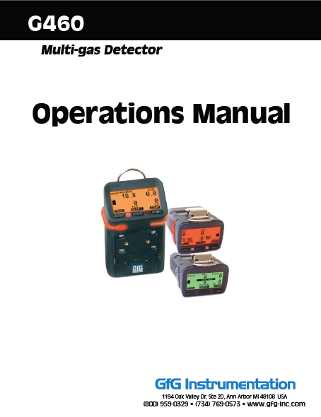
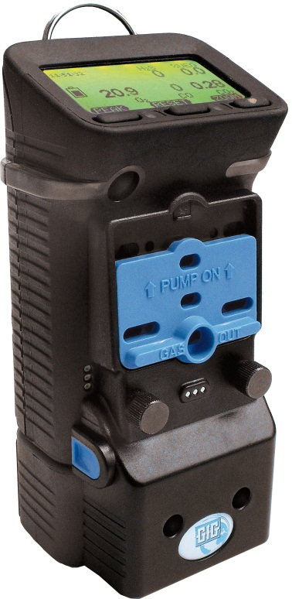
G460 confined space training
This training presentation does not replace the G460 Owner’s Manual
Make sure the G460 instrument is used and maintained in conformance with all confined space program requirements
Read and understand the G460 Owner’s Manual before use!

Slide 3
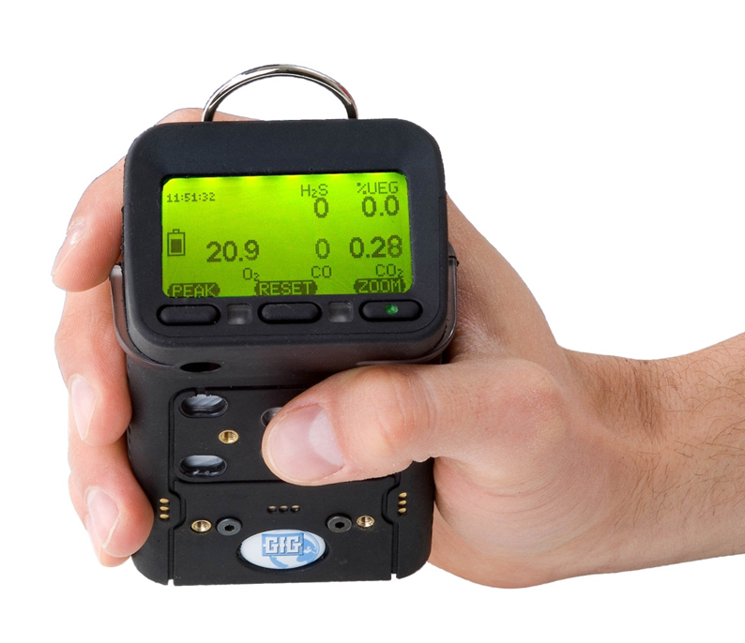
Confined space hazards
By the end of this lesson you should be able to:
Name and understand the common atmospheric hazards
Understand TWA, STEL, IDLH, ppm and % by volume
Understand basic user procedures for G460 multi-gas atmospheric monitor

Slide 4
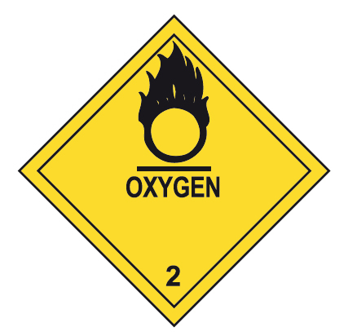



Common atmospheric hazards
Oxygen deficiency
Oxygen enrichment
Presence of toxic gases
Presence of combustible gases

Slide 5
Atmospheric Testing
OSHA Regulations (29 CFR 1910.146)
263(1) Where an employee is about to enter into a confined space, an employer shall appoint a competent person to verify by tests that
  the concentration of airborne chemical agents or airborne dust in the confined space is not hazardous to the health or safety of the employee,
  the concentration of an airborne chemical agent or mixture of chemical agents or airborne dust in the confined space does not exceed 50% of its lower explosive limit,
  the level of physical agents in the confined space is not hazardous to the health or safety of the employee,
  the percentage of oxygen in the atmosphere in the confined space is not less than 19.5% by volume and not more than 23% by volume,
  the concentration, level or percentage referred to in paragraphs (a) to (d) is able to be maintained during the period of proposed occupancy of the confined space by the employee,

Slide 6
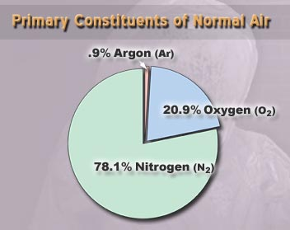
Composition of fresh air
78.1 % Nitrogen
20.9 % Oxygen
0.9 % Argon
0.1 % All other gases
  Water vapor
  CO2
  Other trace gases

Slide 7
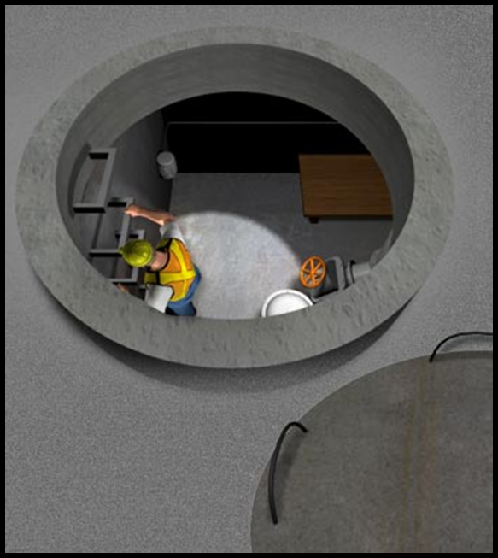
Oxygen Deficiency
Any area that has an oxygen level of less then 19.5% by volume is considered to be oxygen deficient
19.5%

Slide 8
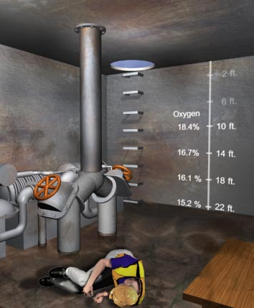
Causes of Oxygen Deficiency
Combustion
  Welding and cutting torches
  Internal combustion engines
Decomposing of organic matter
  Rotting foods, plant life and fermentation
Oxidation of metals
  Rusting
Inerting
Displacement
Absorption

Slide 9
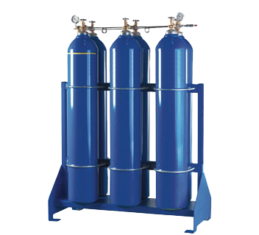
Oxygen displacement in an open topped confined space
Argon

Slide 10
Deliberate displacement of oxygen (inertion) in a fully enclosed vessel
For every 5% total volume displaced, O2 concentration drops by about 1%
If 5% of the fresh air in a closed vessel is displaced by methane, the O2 concentration would be about 19.9%
The atmosphere would be fully explosive while the O2 concentration would still be above the normal alarm setting!
N
N
CH
N
O₂
& N₂
N
O
2
2
N
N
4
2
2
2
N
O
2
2
N
N
O
2
2
Methane
N
2
2
N
2
N
N
CH
2
N
N
2
2
2
4
2
2
N
O
N
N
2
N
2
2
N
2
N
2
N
2
2
N
N
2
CH
N
2
2
4
2
N
O
O
O
N
N
CH
N
2
2
2
2
2
2
4
2

Slide 11
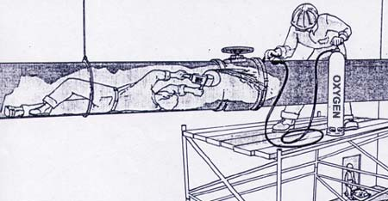
Oxygen Enrichment
Proportionally increases rate of many chemical reactions
Can cause ordinary combustible materials to become flammable or explosive
Any area with an O₂ level of more than 23.0% is dangerously enriched
23.0%

Slide 12
Effects of oxygen at various concentrations
Concentration | Effect
> 23% | Oxygen enrichment
20.90% | Normal air concentration
19.50% | Minimum “safe level”
16% | First sign of anoxia appears
16 – 12% | Breathing and pulse rate increase, muscular co-ordination is slightly impaired
14 – 10% | Consciousness continuous; emotional upsets, abnormal fatigue upon exertion, disturbed respiration
10 – 6% | Nausea and vomiting, inability to move freely and loss of consciousness may occur
< 6% | Convulsive movements and gasping occurs, respiration stops

Slide 13

Toxic Gases and Vapors
The two most common CS related toxic gases:
  Hydrogen sulfide (H₂S)
  Carbon monoxide (CO)
Many other toxic gases related to specific activities and industries including:
  Sulfur dioxide (SO₂)
  Nitrogen dioxide (NO₂)
  Chlorine (Cl₂)
  Chlorine dioxide (ClO₂)
  Ammonia (NH₃)
  Cyanide (HCN)
  Carbon dioxide (CO₂)
  Volatile organic chemicals (VOCs)

Slide 14
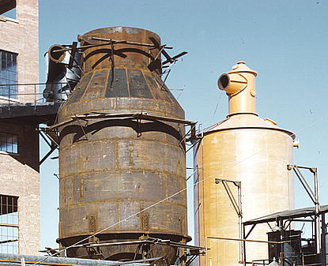
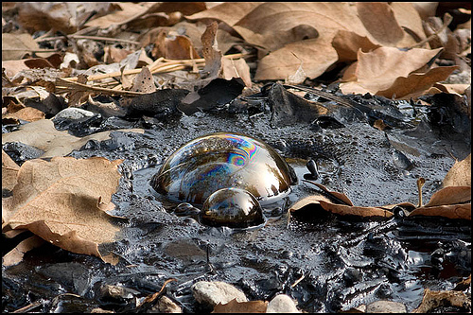
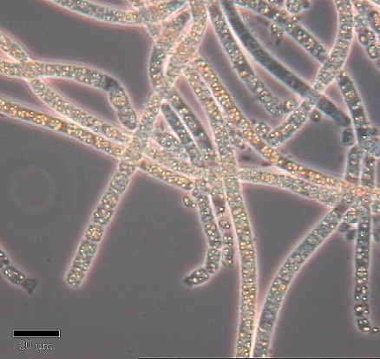
Common causes of toxic gases during CS work
Contents that were stored in the space
Compounds absorbed into walls of the space
Contents being disturbed upon entry
Work being done in the space
Decomposing materials in the space
Adjacent areas

Slide 15
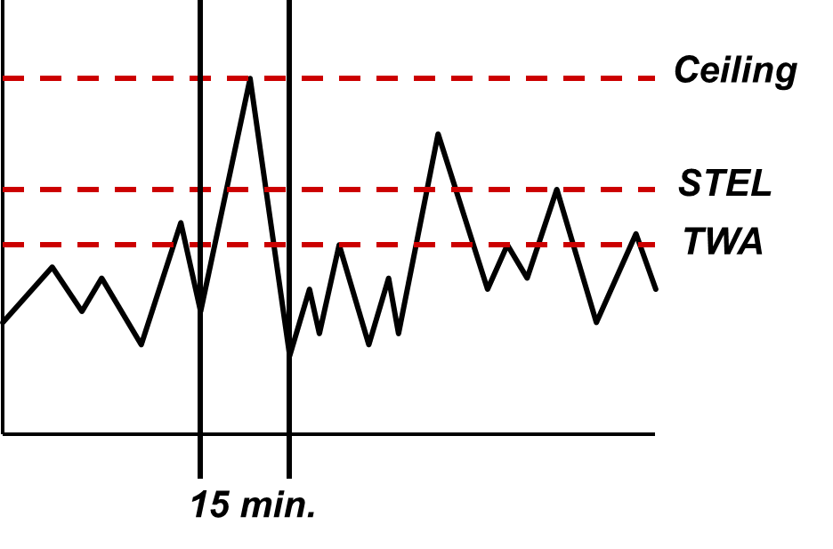
Toxic Exposure Limits
Toxic exposure limits are defined by means of:
  8-hour TWA
  15-minute STEL
  Ceiling
The exposure limit for a particular contaminant may include more than one part

Slide 16
Toxic Exposure Limit Terms: TWA
TWA: The Time Weighted Average (TWA) is the exposure averaged over a full 8-hour shift
When the monitoring session is less than eight hours, the TWA is projected for the full 8-hour shift

Slide 17
Toxic Exposure Limit Terms: STEL
Some gases and vapors have an allowable maximum Short Term Exposure Limit (STEL) which is higher than the 8-hour TWA
The STEL is the maximum average concentration to which an unprotected worker may be exposed during any 15-minute interval
The average concentration may never exceed the STEL during any 15-minute interval
Any 15-minute interval where the average concentration is higher than the TWA (but less than the STEL) must be separated by at least 1-hour from the next, with a maximum of 4 times a shift

Slide 18
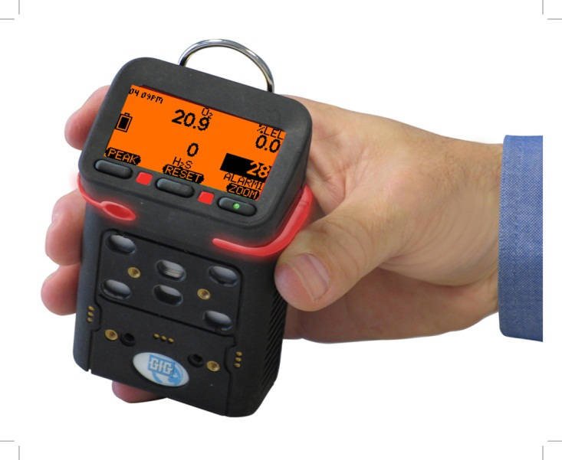
Ceiling Limit
Ceiling is the maximum concentration to which an unprotected worker may be exposed
Ceiling concentration should never be exceeded even for an instant
The “Low Peak” and “High Peak” alarms in the G460 are activated whenever the concentration exceeds the alarm setting for even a moment

Slide 19
Immediately Dangerous to Life and Health
IDLH is not part of permissible exposure limit
  IDLH is maximum concentration from which it is possible for an unprotected worker to escape without suffering injury or irreversible health effects during a maximum 30-minute exposure
  Primarily used to define the level and type of respiratory protection required
  Unprotected workers may NEVER be deliberately exposed to IDLH or ANY concentrations which exceed the permissible exposure limit

Slide 20

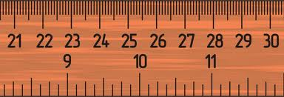
Meaning of parts-per-million (ppm)
100% by volume = 1,000,000 ppm
1% by volume = 10,000 ppm
1.0 ppm the same as:
    One centimeter in 10 kilometers
    One minute in two years
    One cent in $10,000

Slide 21

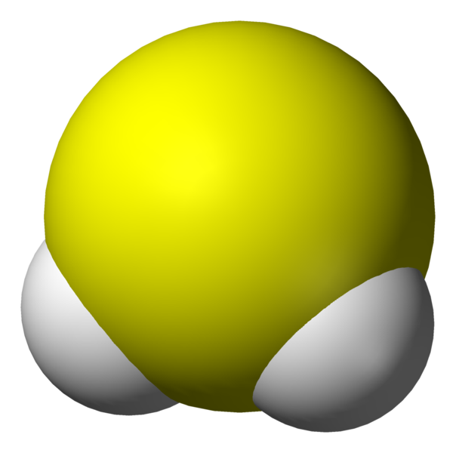

Characteristics of Hydrogen Sulfide
Colorless
Smells like “rotten eggs” (at low concentrations)
Heavier than air
Corrosive
Flammable (LEL is 4.3%)
Soluble in water
High concentrations kill sense of smell
Extremely toxic!
4
4
0

Slide 22
Toxic effects of H₂S
Toxic effects of H2S
Concentration | Symptoms
0.13 ppm | Minimal detectable odor
4.6 ppm | Easily detectable, moderate odor
10.0 ppm | Beginning eye irritation.
27 ppm | Strong unpleasant odor but not intolerable
100 ppm | Coughing, eye irritation, loss of smell after 2-5 min
200 – 300 ppm | Marked eye inflammation, rapid loss of smell, respiratory tract irritation, unconsciousness with prolonged exposure
500 – 700 ppm | Loss of consciousness and possible death in 30 to 60 min
700 – 1,000 ppm | Rapid unconsciousness, stopping or pausing of respiration and death
1,000 – 2,000 ppm | Immediate unconsciousness, death in a few minutes. Death may occur even if person is moved to fresh air

Slide 23
H₂S Exposure Limits

Slide 24
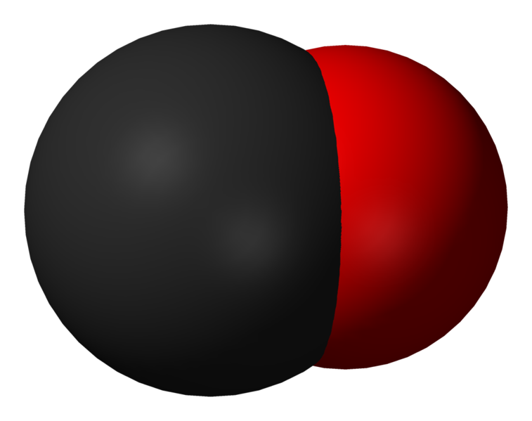
Characteristics of Carbon Monoxide
Colorless
Odorless
Slightly lighter than air
By-product of combustion
Flammable (LEL is 12.5%)
Toxic!
2
4
0

Slide 25
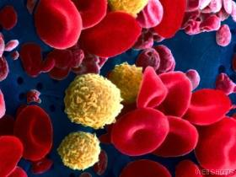
Carbon Monoxide
Bonds to hemoglobin in red blood cells
Contaminated cells can’t transport O2
Chronic exposure at even low levels harmful

Slide 26
Toxic Effects CO
Concentration of only 1,600 ppm fatal within hours
Even lower level exposures can result in death if there are underlying medical conditions, or when there are additional factors (such as heat stress)
2
4
0

Slide 27
Toxic effects of CO
Toxic effects of carbon monoxide
25 ppm | TLV exposure limit for 8 hours (TWA)
200 ppm | Possible mild frontal headaches in 2-3 hours
400 ppm | Frontal headaches and nausea after 1-2 hours.
800 ppm | Headache, dizziness and nausea in 45 min. Collapse and possibly death in 2 hours
1,600 ppm | Headache and dizziness in 20 min. Unconsciousness and danger of death in 2 hours
3,200 ppm | Headache and dizziness in 5-10 min. Unconsciousness and danger of death 30 min.
6,400 ppm | Headache and dizziness in 1-2 min. Unconsciousness and danger of death 10-15 min
12,800 ppm | Unconsciousness immediately, danger of death in 1-3 min.

Slide 28
Exposure Limits for Carbon Monoxide
OSHA PEL:
  50 ppm 8-hr. TWA
NIOSH REL:
  35 ppm 8-hr. TWA
  200 ppm Ceiling
TLV:
  25 ppm 8-Hr. TWA
2
4
0

Slide 29
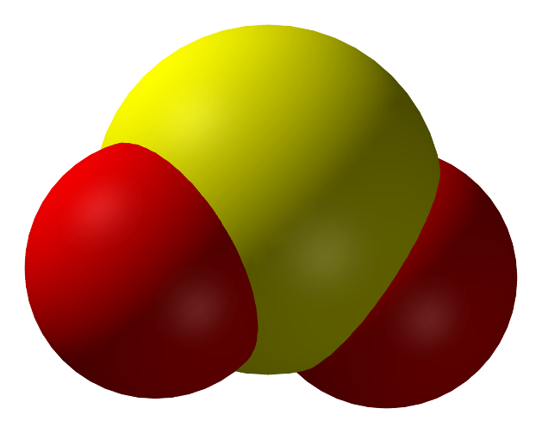
Characteristics of SO₂
Colorless gas
Irritating, pungent odor
Heavier than air
Reacts with H₂O to form sulfurous acid
Respiratory irritant
Toxic!
0
3
0

Slide 30
Exposure limits for SO₂
OSHA PEL:
  TWA = 5.0 ppm
NIOSH REL:
  TWA = 2.0 ppm
  STEL = 5.0 ppm
Old TLV :
  TWA = 2 ppm
  STEL = 5 ppm
New (2009) TLV:
  STEL = 0.25 ppm
0
3
0

Slide 31
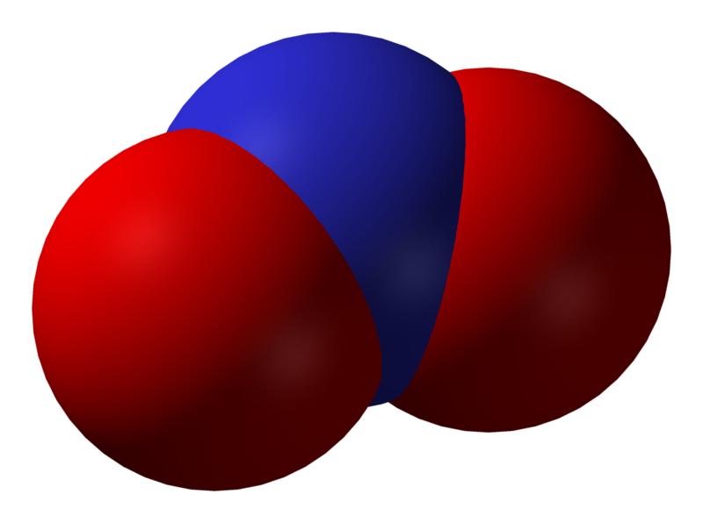
Exposure limits for NO₂
Old TLV:
  8 hr. TWA = 3 ppm
  5 min. STEL = 5 ppm
New 2012 TLV
  8 hr. TWA = 0.2 ppm
US OSHA PEL:
  Ceiling = 5 ppm
US NIOSH REL:
  15 min. STEL = 1 ppm
0
3
0
OX

Slide 32
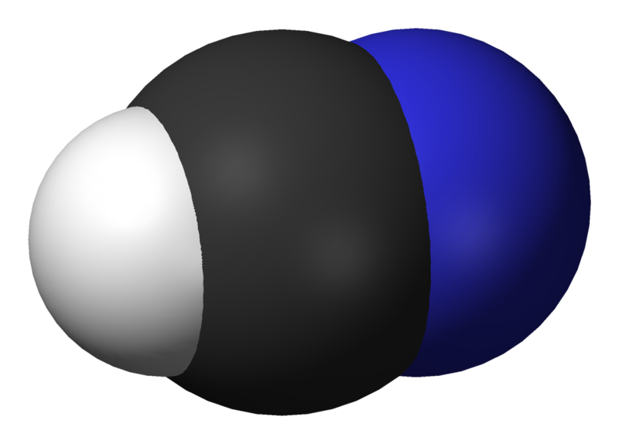
Exposure limits for HCN
US OSHA PEL:
  TWA = 10 ppm
US NIOSH REL:
  15 min. STEL = 4.7 ppm
TLV:
  Ceiling = 4.7 ppm
4
4
1

Slide 33
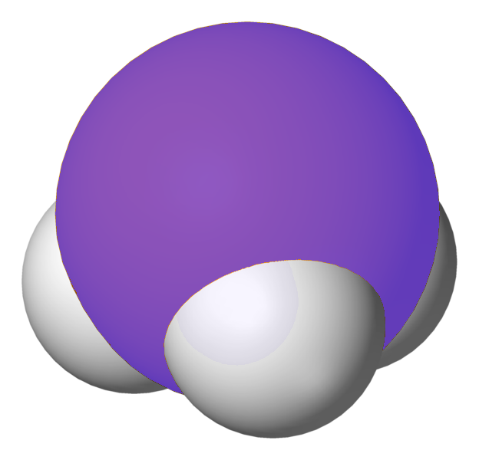
Exposure limits for NH₃
US OSHA PEL:
  TWA = 50 ppm
US NIOSH REL:
  8 hr. TWA = 25 ppm
  15 min. STEL = 35 ppm
TLV:
  8 hr. TWA = 25 ppm
  15 min. STEL = 35 ppm
1
3
0

Slide 34
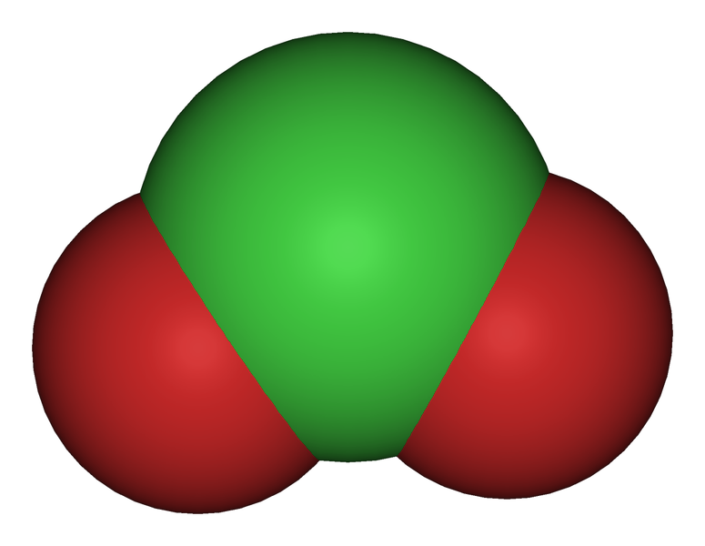
Characteristics of Chlorine Dioxide (ClO₂)
Yellow to reddish gas
Strong oxidizer
Odor similar to chlorine
Heavier than air
Used in water treatment and as bleaching agent (pulp and paper)
Extremely toxic!
0
3
4
OX

Slide 35
Exposure limits for Chlorine Dioxide (ClO₂)
OSHA PEL:
  0.1 ppm (8-hr. TWA)
NIOSH REL:
  0.1 ppm (8-hr. TWA)
  0.3 ppm STEL
TLV:
  0.1 ppm (8-hr. TWA)
  0.3 ppm STEL
0
3
4
Remember: it only takes 0.000001% by volume to exceed the exposure limit !!!
OX

Slide 36
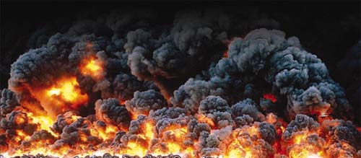
Explosive or Flammable Atmospheres

Slide 37
Fire Tetrahedron
Oxygen
Fuel
Chain reaction
Source of ignition

Slide 38
Explosive limits
Above UEL mixture too rich to burn
Lower Explosive Limit (LEL):
  Minimum concentration of a combustible gas or vapor in air which will ignite if a source of ignition is present
Upper Explosive Limit (UEL):
  Most but not all combustible gases have an upper explosive limit
  Maximum concentration in air which will support combustion
  Concentrations which are above the UEL are too “rich” to burn
Flammable range
Below LEL mixture too lean to burn

Slide 39
Flammability Range
The range between the LEL and the UEL of a combustible gas or vapor
Concentrations within the flammable range will burn or explode if a source of ignition is present
Gas Concentration
Flammability
Range
LEL
UEL

Slide 40
Different gases have different flammability ranges
Fuel Gas | LEL (%VOL) | UEL (%VOL)
Acetylene | 2.2 | 85
Ammonia | 15 | 28
Benzene | 1.3 | 7.1
Butane | 1.8 | 8.4
Carbon Monoxide | 12 | 75
Ethylene | 2.7 | 36
Ethylene oxide | 3.0 | 100
Ethyl Alcohol | 3.3 | 19
Fuel Oil #1 (Diesel) | 0.7 | 5
Hydrogen | 4 | 75
Isobutylene | 1.8 | 9
Isopropyl Alcohol | 2 | 12
Gasoline | 1.4 | 7.6
Kerosine | 0.7 | 5
Methane | 5 | 15
MEK | 1.8 | 10
Hexane | 1.1 | 7.5
Pentane | 1.5 | 7.8
Propane | 2.1 | 10.1
Toluene | 1.2 | 7.1
p-Xylene | 1.1 | 7.0
Gas Concentration
Flammability
Range
LEL
UEL

Slide 41

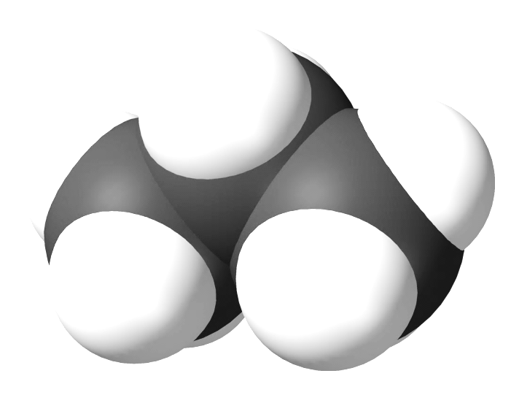

Explosive Limits
Propane (C₃H₈)
Propane
4
1
0
Upper Explosive Limit
Flammable range 2.2 – 9.0%
Lower Explosive Limit

Slide 42

Explosive Limits
Methane (CH₄)
Methane
4
1
0
Upper Explosive Limit
Flammable range 5.0 – 15.0%
Lower Explosive Limit

Slide 43
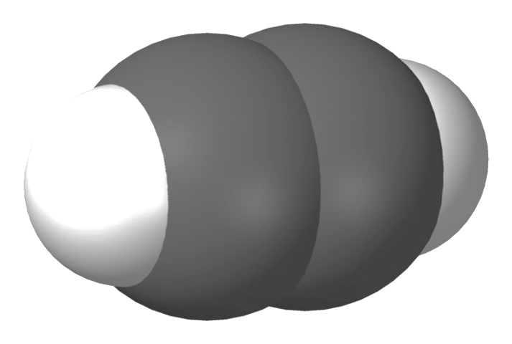
Explosive Limits
Acetylene (C₂H₄) has no Upper Explosion Limit!
Acetylene
4
1
0
Flammable range 2.3 – 100.0%
Lower Explosive Limit

Slide 44
Vapor density
Measure of a vapor’s weight compared to air
Gases lighter than air tend to rise; gases heavier than air tend to sink
Lighter than air
Carbon monoxide
Hydrogen
Ammonia
Methane
Propane
Hydrogen sulfide
Carbon dioxide
Gasoline
Heavier than air

Slide 45
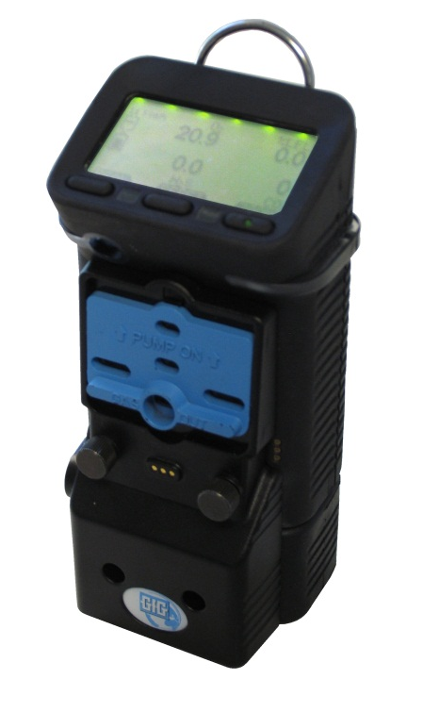
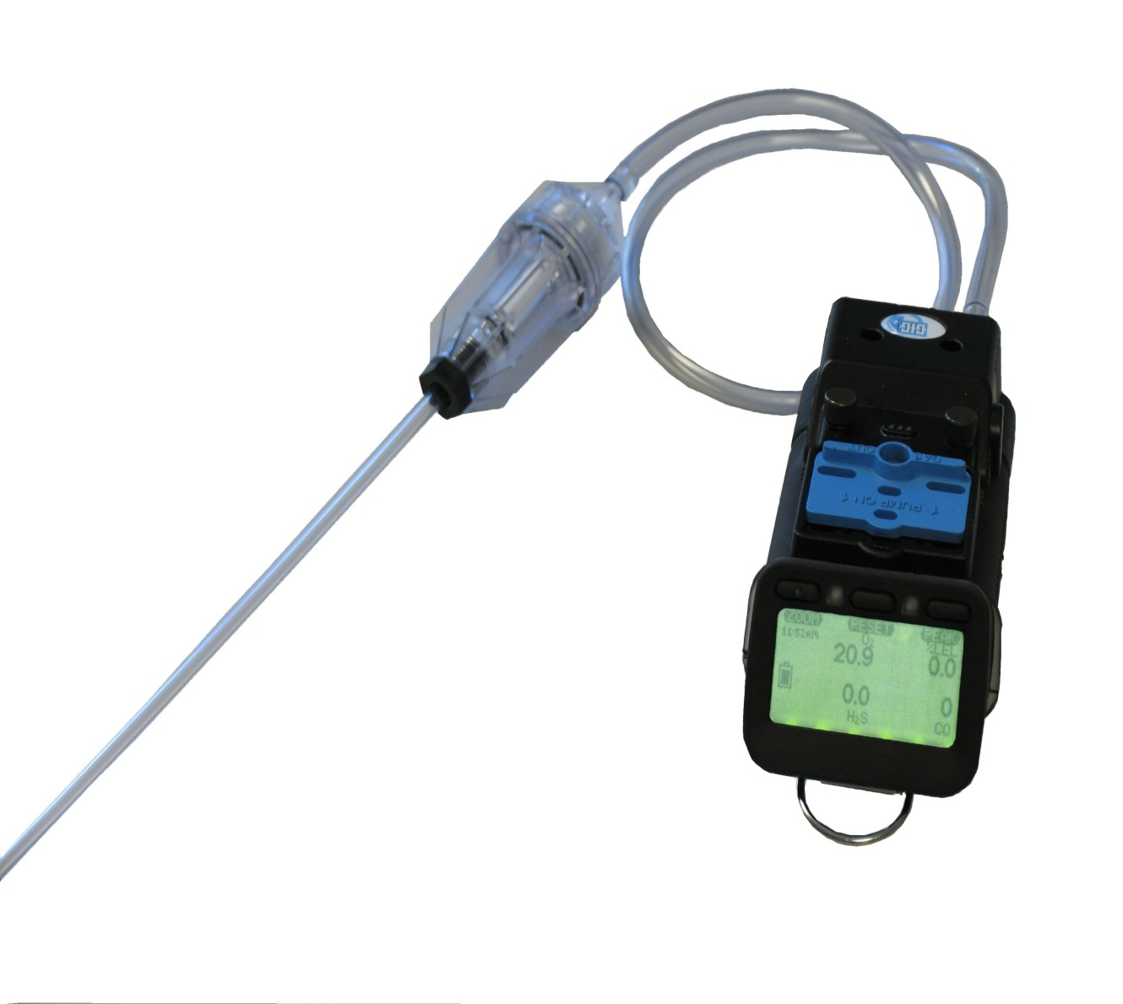
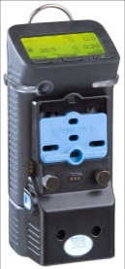
Stratification
Atmospheric hazards in confined spaces form layers
Check all levels!

Slide 46
Vaporization is a function of temperature
Vapors are the gaseous state of substances that are either liquids or solids at room temperatures
  Gasoline evaporates
  Dry ice (solid carbon dioxide) sublimates
Increasing the temperature of the combustible liquid increases the amount of vapor produced

Slide 47
Flashpoint Temperature
Temperature at which a combustible liquid gives off enough vapor to form an ignitable mixture
Degrees F
Degrees C
Gasoline (aviation grade)
- 50 °F (approx.)
- 45 °C (approx.)
Acetone
0 °F
- 18 °C
Methyl ethyl ketone
24 °F
- 4 °C
Ethanol (96 %)
62 °F
17 °C
Diesel oil
100 - 190 °F
38 - 88 °C

Slide 48
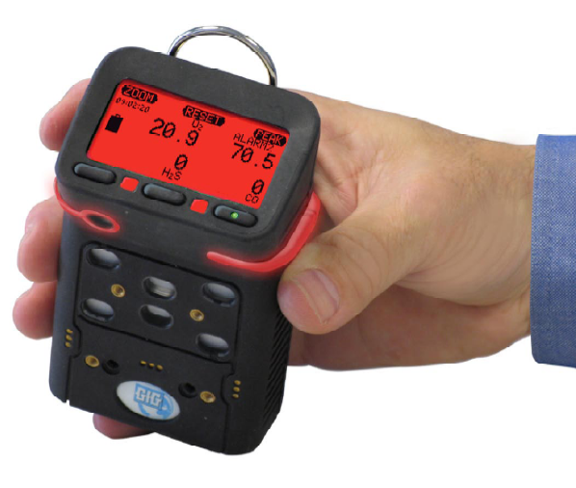
How combustible (percent LEL) gas detecting instruments detect gas

Slide 49
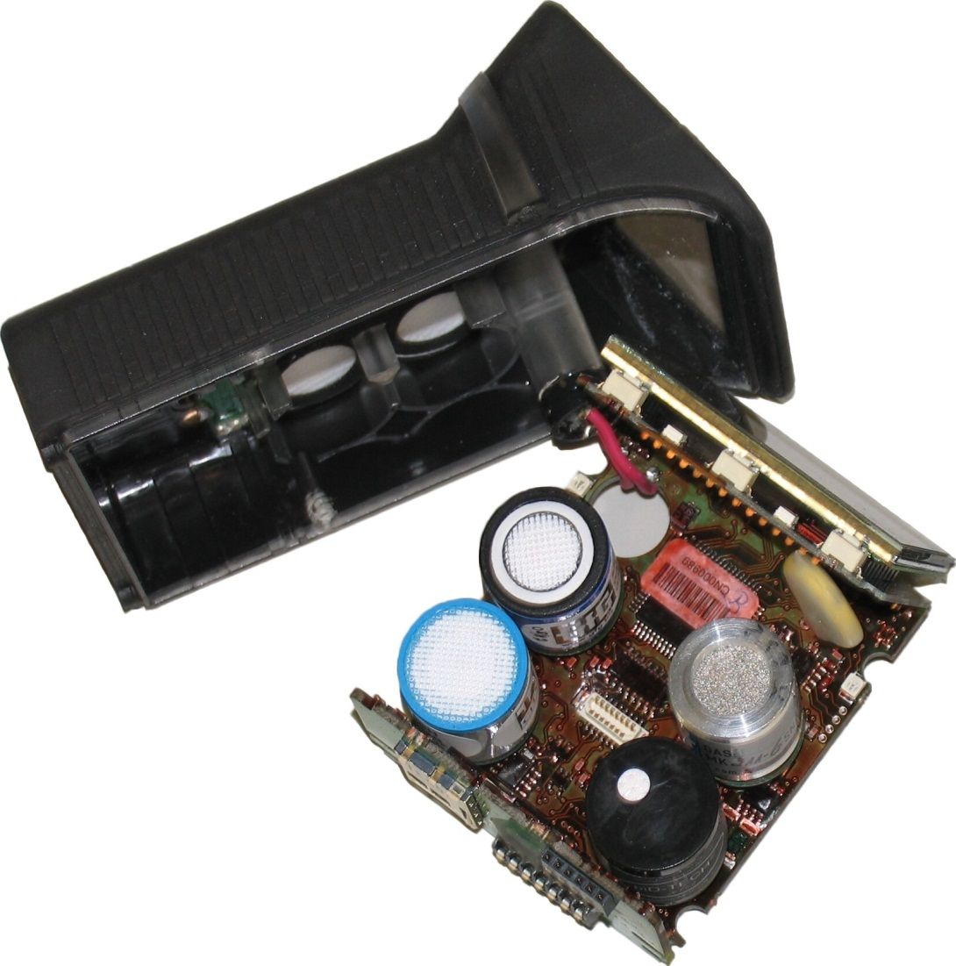
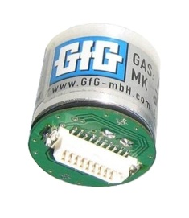
Catalytic “Hot Bead” Combustible Sensor
Detects combustible gas by catalytic oxidation
When exposed to gas oxidation reaction causes bead to heat
Requires oxygen to detect gas!

Slide 50
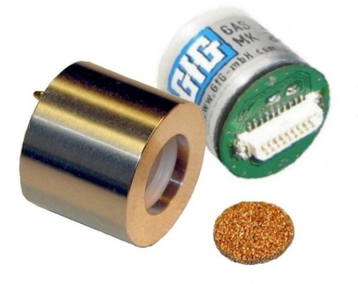
Catalytic “Hot Bead” Combustible Sensor
Detects combustible gas by catalytic oxidation
When exposed to gas oxidation reaction causes the active (detector) bead to heat
Requires oxygen to detect gas!
Output
-
+
Signal
+VS
Detector
R1
+
Trimming resistor
D.C. voltage supply
VR1
-
Compensator
R2
-VS

Slide 51
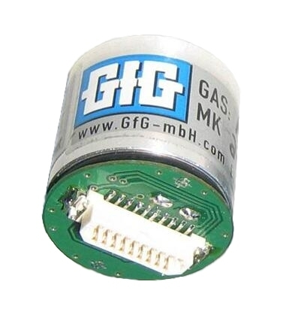
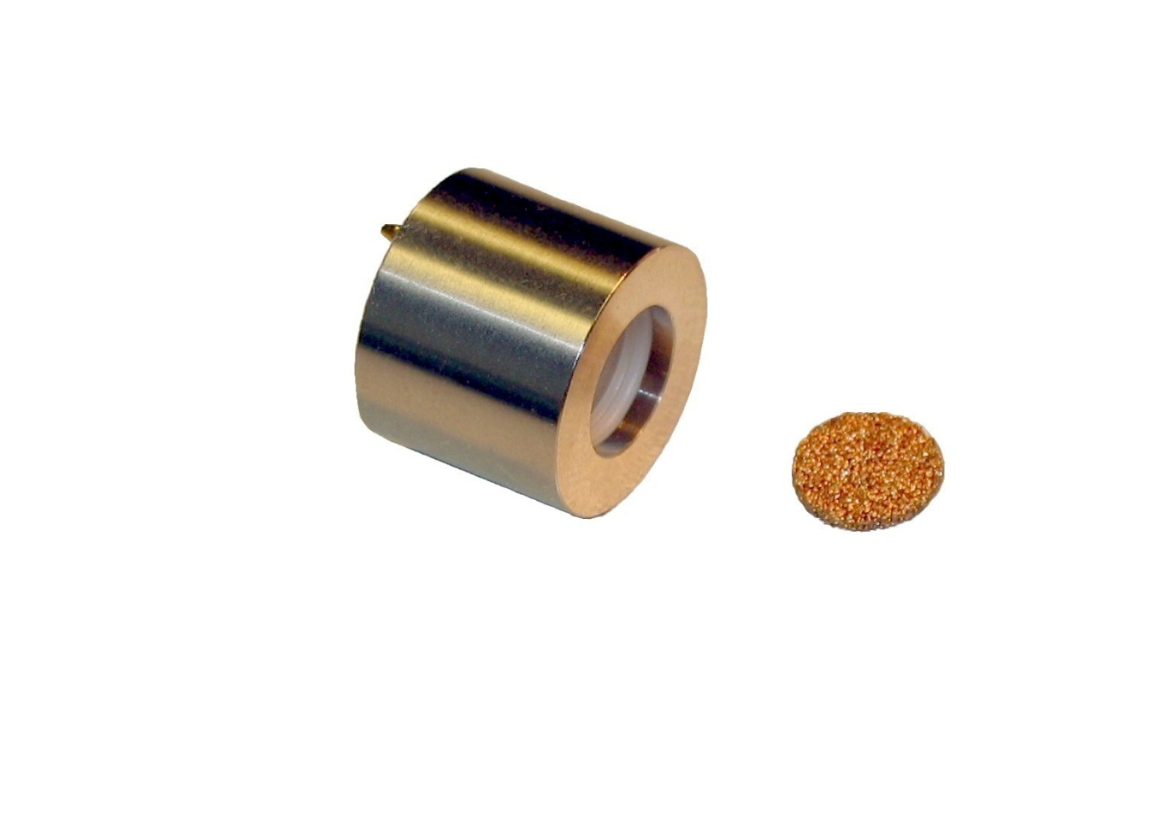
Traditional LEL sensors are “Flame proof” devices
Flame proof sensors depend on physical barriers such as stainless steel housings and flame arrestors to limit the amount of energy that can ever be released by the sensor
The flame arrestor can slow, reduce, or even prevent larger molecules from entering the sensor
The larger the molecule, the slower it diffuses through the flame arrestor into the sensor
The response of the sensor is so slow to molecules larger than nonane (C9) in size that they are effectively undetectable
Stainless steel housing
Flame arrestor (sinter)

Slide 52
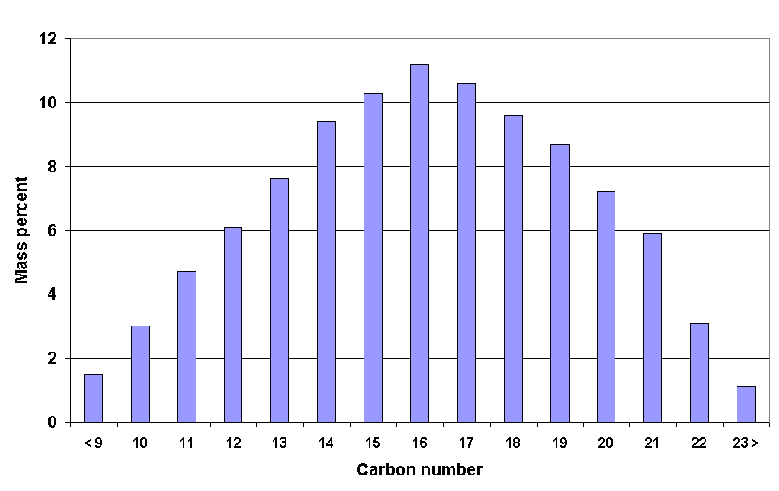
Typical carbon number distribution in No. 2 Diesel Fuel (liquid)
Less than 2% of molecules in diesel vapor are small enough to be measured by means of standard LEL sensor

Slide 53
Typical catalytic LEL sensor relative responses
Relative responses of 4P-75 catalytic LEL sensor
Combustible gas / vapor | Relative response when sensor calibrated on pentane | Relative response when sensor calibrated on propane | Relative response when sensor calibrated on methane
Hydrogen | 2.2 | 1.7 | 1.1
Methane | 2.0 | 1.5 | 1.0
Propane | 1.3 | 1.0 | 0.7
n-Butane | 1.2 | 0.9 | 0.6
n-Pentane | 1.0 | 0.8 | 0.5
n-Hexane | 0.9 | 0.7 | 0.5
n-Octane | 0.8 | 0.6 | 0.4
Methanol | 2.3 | 1.8 | 1.2
Ethanol | 1.6 | 1.2 | 0.8
Isopropanol | 1.4 | 1.1 | 0.7
Acetone | 1.4 | 1.1 | 0.7
Ammonia | 2.6 | 2.0 | 1.3
Toluene | 0.7 | 0.5 | 0.4
Gasoline (unleaded) | 1.2 | 0.9 | 0.6

Slide 54
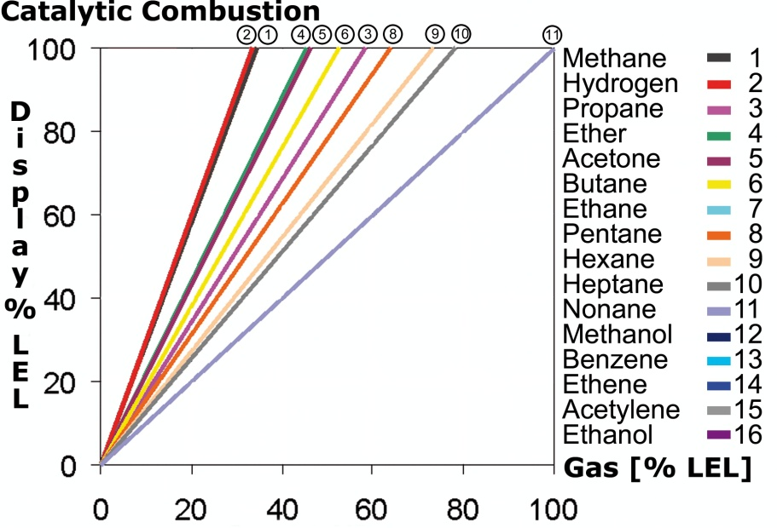
Catalytic pellistor combustible gas response curves
Reading % LEL
True LEL Concentration

Slide 55
Catalytic combustible LEL sensor correction factors
Correction factors for 4P-75 catalytic LEL sensor
Combustible gas / vapor | Relative response when sensor calibrated on pentane | Relative response when sensor calibrated on propane | Relative response when sensor calibrated on methane
Hydrogen | 0.45 | 0.59 | 0.91
Methane | 0.50 | 0.67 | 1.00
Propane | 0.77 | 1.00 | 1.54
n-Butane | 0.83 | 1.11 | 1.67
n-Pentane | 1.00 | 1.33 | 2.00
n-Hexane | 1.11 | 1.43 | 2.22
n-Octane | 1.25 | 1.67 | 2.50
Methanol | 0.43 | 0.57 | 0.87
Ethanol | 0.63 | 0.83 | 1.25
Isopropanol | 0.71 | 0.95 | 1.43
Acetone | 0.71 | 0.95 | 1.43
Ammonia | 0.38 | 0.50 | 0.77
Toluene | 1.43 | 2.00 | 2.86
Gasoline (unleaded) | 0.83 | 1.11 | 1.67

Slide 56
Using a lower alarm setting minimizes effect of relative response on readings
CH4 response new sensor
Propane response
Instrument
Reading
50% LEL
20% LEL
10% LEL
Response to nonane
5% LEL
True LEL Concentration

Slide 57
Limitations of catalytic pellistor LEL sensors
Flame arrestor limits molecules larger than nine carbons (nonane) from entering sensor
Even when molecules are able to diffuse into sensor: the larger the molecule the lower the relative response
Easily poisoned
Exposure to high concentration combustible gas damaging to sensor

Slide 58
Combustible sensor limitations
Contaminant
LEL (Vol %)
Flashpoint Temp (ºF)
OSHA PEL
NIOSH REL
TLV
5% LEL in PPM
Acetone
2.5%
-4ºF
(-20 ºC)
1,000 PPM TWA
250 PPM TWA
500 PPM TWA;
750 PPM STEL
1250 PPM
Diesel (No.2) vapor
0.6%
125ºF
(51.7ºC)
None Listed
None Listed
15 PPM
300 PPM
Ethanol
3.3%
55ºF
(12.8 ºC)
1,000 PPM TWA
1000 PPM TWA
1000 PPM TWA
1,650 PPM
Gasoline
1.3%
-50ºF
(-45.6ºC)
None Listed
None Listed
300 PPM TWA; 500 PPM STEL
650 PPM
n-Hexane
1.1%
-7ºF
(-21.7 ºC)
500 PPM TWA
50 PPM TWA
50 PPM TWA
550 PPM
Isopropyl alcohol
2.0%
53ºF
(11.7ºC)
400 PPM TWA
400 PPM TWA; 500 PPM STEL
200 PPM TWA; 400 PPM STEL
1000 PPM
Kerosene/ Jet Fuels
0.7%
100 – 162ºF
(37.8 – 72.3ºC )
None Listed
100 mg/M3 TWA (approx. 14.4 PPM)
200 mg/M3 TWA (approx. 29 PPM)
350 PPM
MEK
1.4%
16ºF
(-8.9ºC)
200 PPM TWA
200 PPM TWA; 300 PPM STEL
200 PPM TWA; 300 PPM STEL
700 PPM
Turpentine
0.8
95ºF
(35ºC)
100 PPM TWA
100 PPM TWA
20 PPM TWA
400 PPM
Xylenes (o, m & p isomers)
0.9 – 1.1%
81 – 90ºF
(27.3 – 32.3 ºC)
100 PPM TWA
100 PPM TWA; 150 PPM STEL
100 PPM TWA; 150 STEL
450 – 550 PPM

Slide 59



Effects of O₂ concentration on combustible gas readings
Look at O₂ readings first!
LEL readings may be affected if levels of O₂ are higher or lower than fresh air
Catalytic LEL sensors require a minimum level of 10% oxygen to read LEL
If the O₂ concentration is too low the LEL reading should be replaced with question marks
Readings in fresh air
Readings in O₂ deficient air
Readings when O₂ too low for LEL sensor

Slide 60

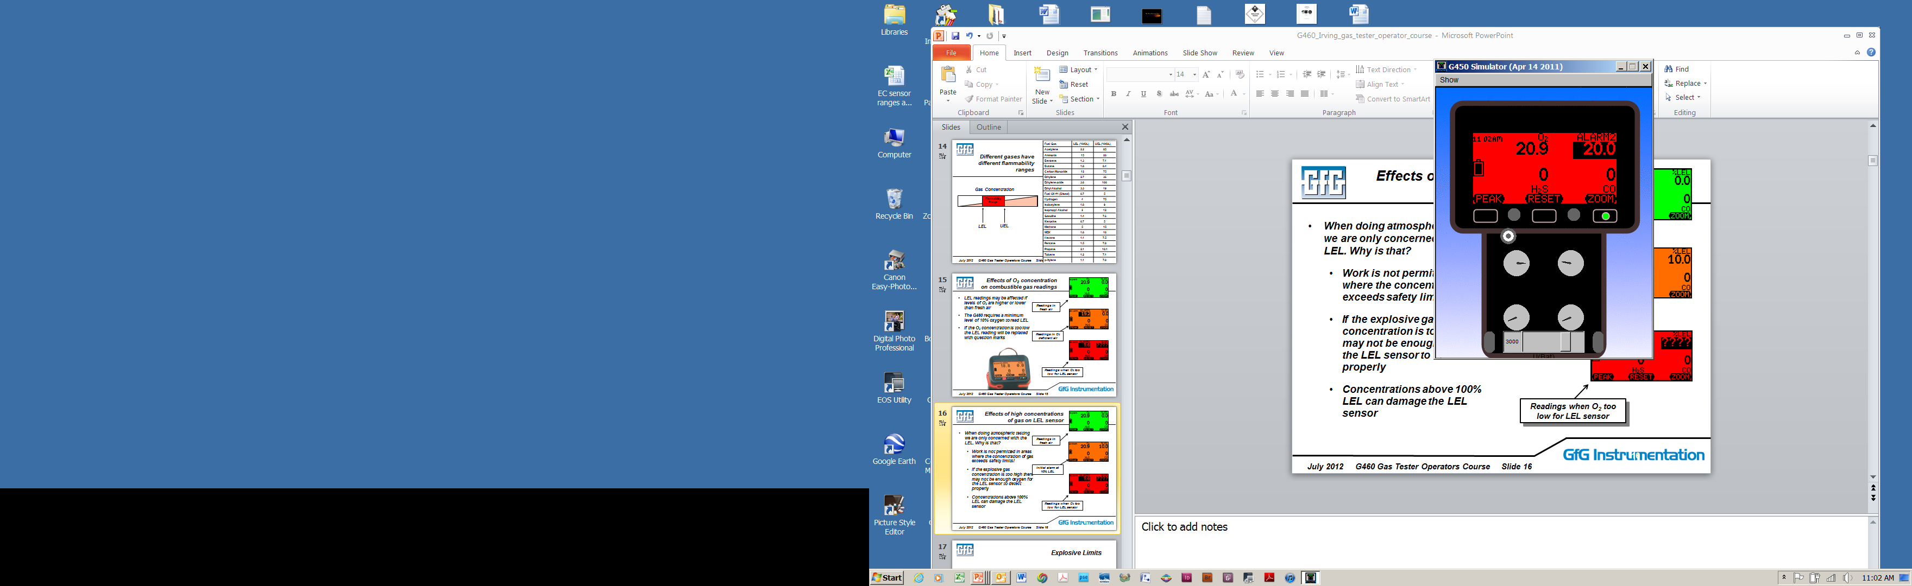
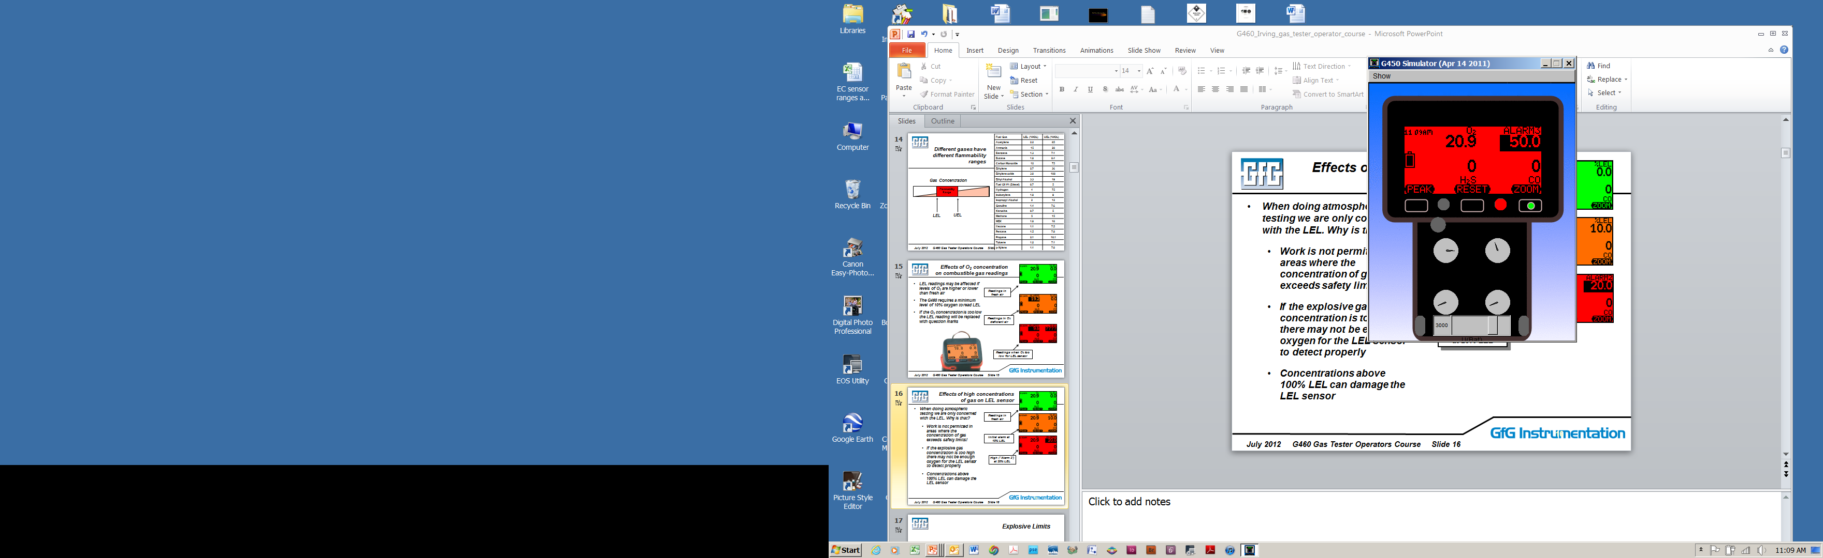
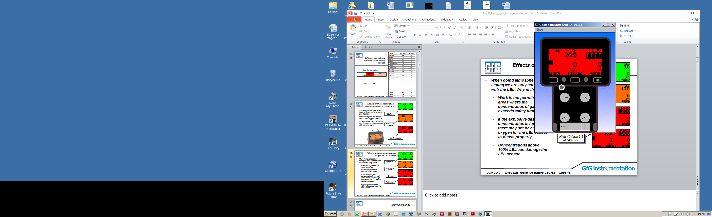
Effects of high concentrations of gas on LEL sensor
When doing atmospheric testing we are only concerned with the LEL. Why is that?
  Work is not permitted in areas where the concentration of gas exceeds safety limits!
  If the explosive gas concentration is too high there may not be enough oxygen for the LEL sensor to detect properly
  Concentrations above 100% LEL can damage the LEL sensor
Readings in fresh air
Initial alarm at 10% LEL
High (“Alarm 2”) at 20% LEL
High (“Alarm 3”) at 50% LEL
Over-limit alarm (arrows) at 100% LEL

Slide 61


Combustible Gas Sensor
The catalyst in the LEL sensor bead can be harmed if it is exposed to certain substances
LEL sensor poisons permanently reduce or destroy the sensor’s response to gas
The most common LEL sensor poisons are silicon containing vapors (like the silicones used in Armour All)
Sensors which may have been exposed to a poison must be tested before further use
Porous refractory bead with catalyst
Platinum wire coil
0.1 mm

Slide 62
Combustible sensor poisons
Combustible sensor poisons:
  Silicones (by far the most virulent poison)
  Hydrogen sulfide
    Note: The LEL sensor includes an internal filter that is more than sufficient to remove the H₂S in calibration gas. It takes very high levels of H₂S to overcome the filter and harm the LEL sensor
  Other sulfur containing compounds
  Phosphates and phosphorus containing substances
  Lead containing compounds (especially tetraethyl lead)
  High concentrations of flammable gas!
Combustible sensor inhibitors:
  Halogenated hydrocarbons (Freons®, trichloroethylene, methylene chloride, etc.)

Slide 63

“Silicone resistant” vs. “standard” pellistor type LEL sensors
"Silicone resistant" combustible sensors have an external silicone filter capable of removing most silicone vapor before it can diffuse into the sensor
  Silicone vapor is the most virulent of all combustible sensor poisons
  Filter also slows or slightly reduces response to heavier hydrocarbons such as hexane, benzene, toluene, xylene, cumene, etc.
  The heavier the compound, the greater the effect on response (should not be used on C8 – C9 hydrocarbons)

Slide 64
Combustible sensor advice
Whatever the brand, allow enough time for full stabilization prior to performing fresh air zero
  Do not perform auto-zero as part of automatic start-up sequence
  Wait at least 5 minutes after initially turning instrument on before performing a fresh air zero
Perform functional test before each day’s use!
Use methane based test gas mixture OR if you use a different gas (e.g. propane or pentane) challenge the sensor with methane periodically to verify whether the sensor has disproportionately lost sensitivity to methane
Notes:
64

Slide 65
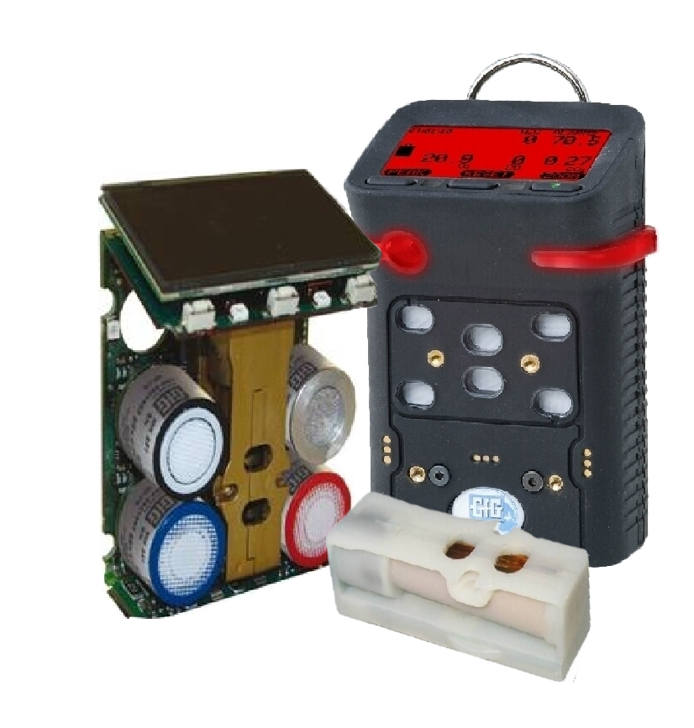
Non-dispersive infrared (NDIR) sensors
Many gases absorb infrared light at a unique wavelength (color)
In NDIR sensors the amount of IR light absorbed is proportional to the amount of target gas present
The longer the optical path through the sensor the better the resolution

Slide 66
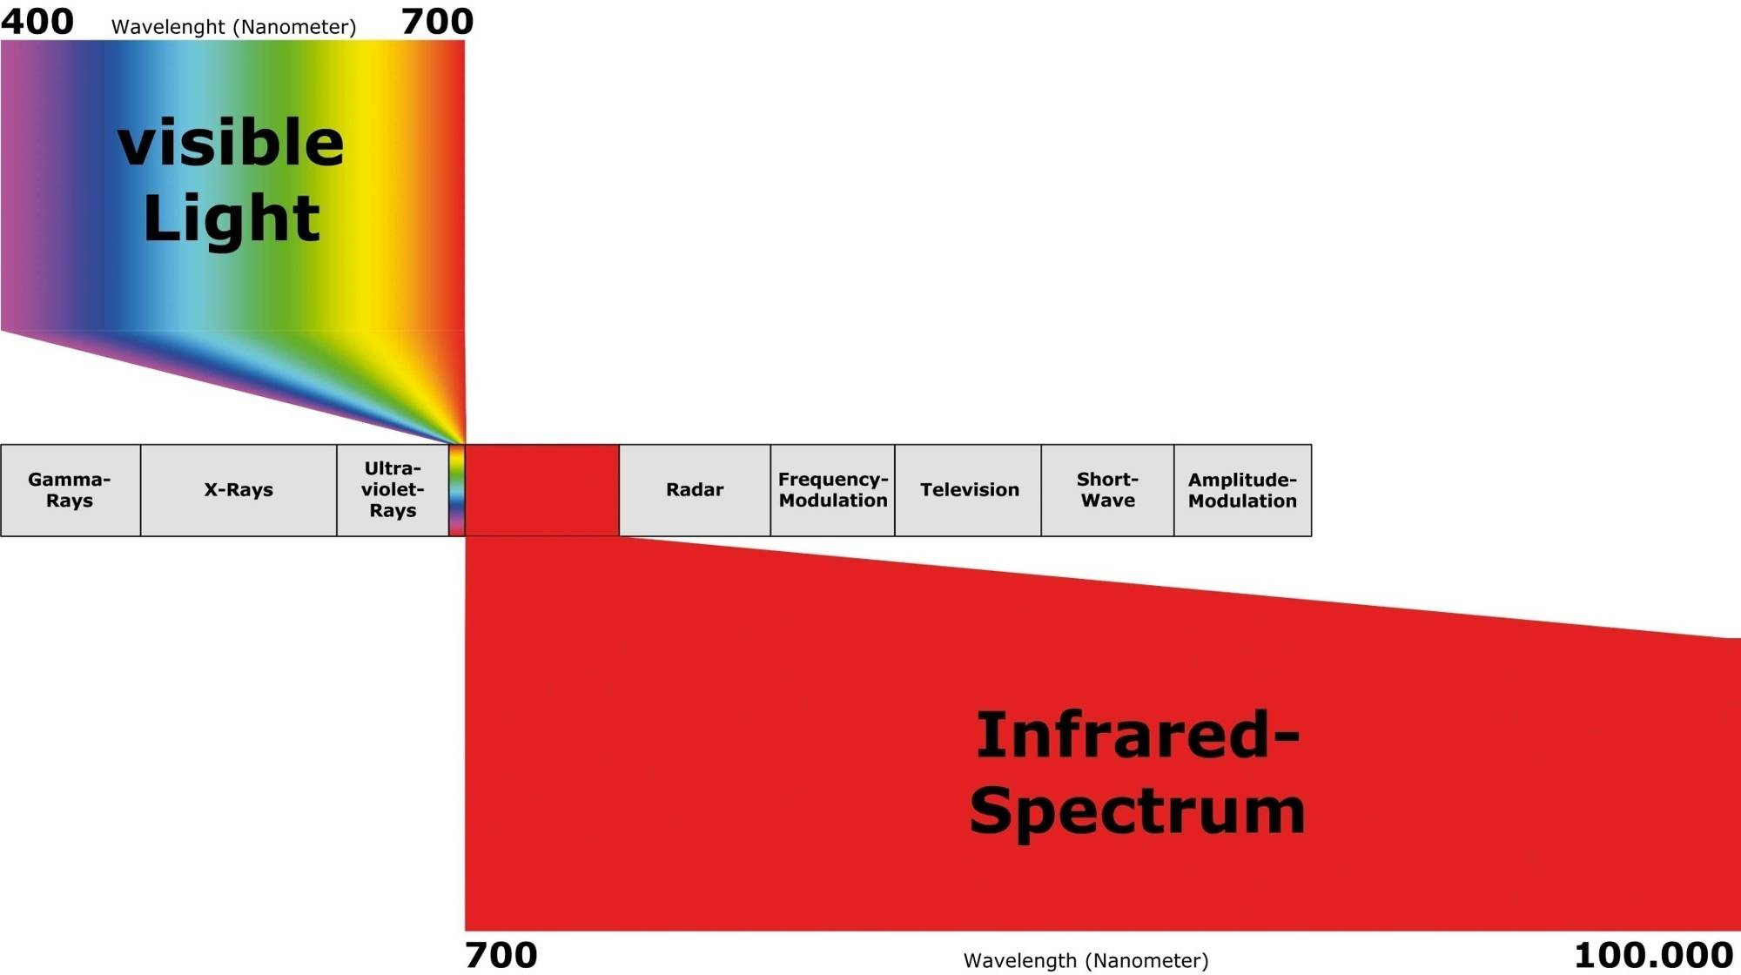
Electromagnetic radiation spectrum
Infrared (IR) region covers the wavelength range from approx. 0.7 µm to 100 µm
More than 100 times as wide as the visible portion!

Slide 67
Infrared Detectors
Chemical bonds absorb infrared radiation
For infrared energy to be absorbed (that is, for vibrational energy to be transferred to the molecule), the frequency must match the frequency of the mode of vibration
Thus, specific molecules absorb infrared radiation at precise frequencies

Slide 68
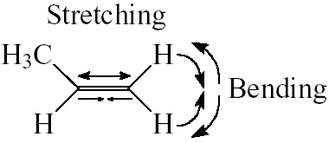
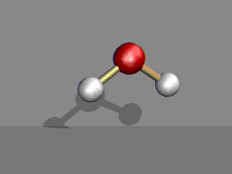
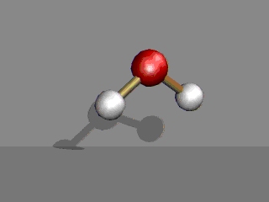

Energy Absorbed by “Bond Stretching” and “Bending” Vibration
Must have a COVALENT CHEMICAL BOND
Symmetric Asymmetric Bend
Stretch Stretch
S
O
Nonlinear Molecules
Linear molecules: SO

Slide 69
Infrared Detectors
When infra-red radiation passes through a sensing chamber containing a specific contaminant, only those frequencies that match one of the vibration modes are absorbed
The rest of the light is transmitted through the chamber without hindrance
The presence of a particular chemical group within a molecule thus gives rise to characteristic absorption bands

Slide 70
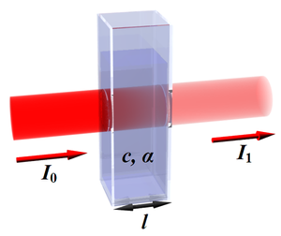

Beer-Lambert
Law
I₀ is the intensity of the incident light
I₁ is the intensity after passing through the material
L is the distance that the light travels through the material (the path length)
c is the concentration of absorbing species in the material
α is the absorption coefficient or the molar absorptivity of the absorber
I₁=I₀*e^{-αLc}
L
Size (length) matters...
August 2007 Principles of gas detection Slide 70

Slide 71
Requirements for IR Absorption
  Saturated hydrocarbon molecules like methane, propane, butane, pentane, hexane, octane, etc. and alcohols are highly detectable by IR
  Mixtures rich in saturated hydrocarbons such as gasoline, jet fuel, diesel and kerosene also readily detectable by IR
  CO₂ absorbs IR very well
  Molecules with double (C=C) or triple (C≡C) bonds do not absorb IR as readily as saturated hydrocarbon molecules
  Diatomic molecules such as ones on the following list DO NOT absorb IR at all:
      N₂
      O₂
      F₂
      Cl₂
      Hg₂
      Ar
IR sensors cannot be used to measure hydrogen (H₂) or acetylene!

Slide 72
Wavelengths used for NDIR measurement
LEL: 3.3 μm
CO₂: 4.3μm
Reference: 4.0μm
3.3μm 4.0 μm 4.3 μm

Slide 73
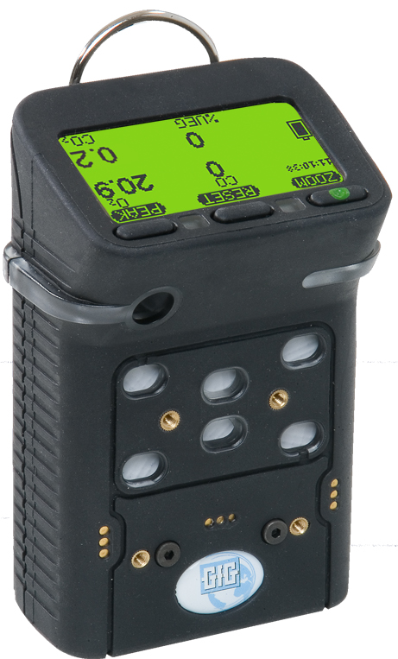
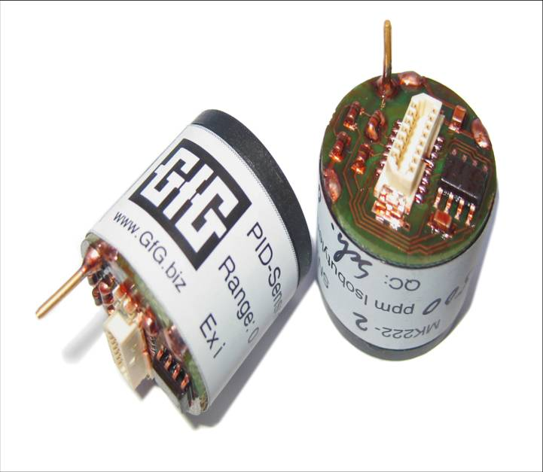
Photoionization Detectors
Used for measuring solvent, fuel and VOC vapors in the workplace environment

Slide 74
Volatile organic compounds (VOCs)
VOCs are organic compounds characterized by tendency to evaporate easily at room temperature
Familiar VOCs include:
    Solvent
    Paint thinner
    Nail polish remover
    Gasoline
    Diesel
    Heating oil
    Kerosene
  Jet fuel
  Benzene
  Butadiene
  Hexane
  Toluene
  Xylene
  Many others

Slide 75
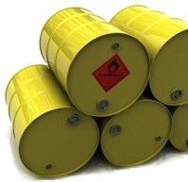
Volatile organic compounds (VOCs)
Solvent, fuel and other VOC vapors common in many workplace environments
Most have surprisingly low occupational exposure limits
Long before you reach a concentration sufficient to register on a combustible gas indicator, you will have easily exceeded the toxic exposure limits for most VOC contaminants
PID equipped instruments generally the best choice for measurement of VOCs at exposure limit concentrations

Slide 76

VOC Toxicity
VOCs present multiple potential threats in the workplace environment
Heavier than air, flammable and toxic
Increased awareness of toxicity is leading to lowered exposure limits
This leads in turn to increased need for direct measurement of VOCs at exposure limit concentrations
3
2
0

Slide 77
PID - Operating Principle
PIDs use ultraviolet light as source of energy to remove an electron from neutrally charged target molecules creating electrically charged fragments (ions)
This produces a flow of electrical current proportional to the concentration of contaminant
The amount of energy needed to remove an electron from a particular molecule is the ionization potential (or IP)
The energy must be greater than the IP in order for an ionization detector to be able to detect a particular substance

Slide 78
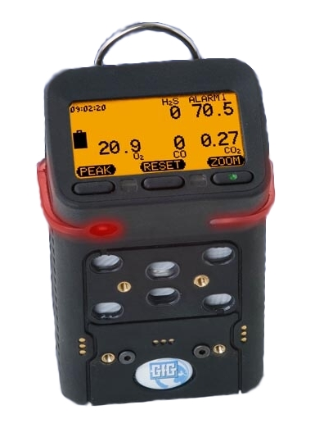
LEL vs. PID Sensors
Catalytic LEL and photoionization detectors are complementary detection techniques
Catalytic LEL sensors excellent for measurement of methane, propane, and other common combustible gases NOT detectable by PID
PIDs detect large VOC and hydrocarbon molecules that are undetectable by catalytic sensors
Best approach to VOC measurement is to use multi-sensor instrument capable of measuring all atmospheric hazards that may be potentially present

Slide 79

Operation of PID lamp, sensing and counter electrodes
Detection sequence:
Neutrally charged molecule diffuses into glow zone
Sensing electrode
Reading
Benzene molecule (neutrally charged)
Counter electrode

Slide 80
Operation of PID lamp, sensing and counter electrodes
Detection sequence:
Molecule is ionized
Sensing electrode
Reading
e⁻
Benzene molecule is ionized
+
Counter electrode

Slide 81
Operation of PID lamp, sensing and counter electrodes
Detection sequence:
Free electron is electrostatically accelerated to positively charged sensing electrode where it is counted
Sensing electrode
Reading
e⁻
Electron counted at sensing electrode
+
Counter electrode

Slide 82
Operation of PID lamp, sensing and counter electrodes
Detection sequence:
Positively charged fragment (ion) is electrostatically accelerated to counter electrode, where it picks up a replacement electron and regains neutral charge
Sensing electrode
Reading
e⁻
Neutrally charged molecule diffuses out of detector
Counter electrode

Slide 83
Ionization Energy
IE determines if the PID can detect the gas
If the IE of the gas is less than the eV output of the lamp the PID can detectthe gas
Ionization Energy (IE) measures the bond strength of a gas and does not correlate with the Correction Factor
Ionization Potentials are found in the NIOSH Pocket Guide and many chemical texts

Slide 84
Ionization Energy Values
Ionization energy values
Gas / vapor | Ionization energy (eV)
Carbon monoxide | 14.01
Carbon dioxide | 13.77
Methane | 12.98
Water | 12.59
Oxygen | 12.08
Chlorine | 11.48
Hydrogen sulfide | 10.46
n-Hexane | 10.18
Ammonia | 10.16
hexane (mixed isomers) | 10.13
acetone | 9.69
benzene | 9.25
butadiene | 9.07
toluene | 8.82

Slide 85






PID Components
Detector assembly
Electrodes: sensing, counter and (in some designs) fence
Lamp: most commonly 10.6EV, 11.7eV or 9.8 eV

Slide 86
PID lamp characteristics
Window material and the filler gas determine output characteristics as well as operational life of lamp
PID lamp characteristics
Nominal lamp photon energies | Primary gas in lamp | Major emission lines |  | Relative intensity | Window crystal | Crystal transmittance λ range (nm)
 |  | eV | λ (nm)
11.7 eV | Argon | 11.83 | 104.8 | 1000 | Lithium fluoride (LiF) | 105 - 5000
 |  | 11.62 | 106.7 | 500
10.6 eV | Krypton | 10.64 | 116.5 | 200 | Magnesium fluoride (MgF₂) | 115 - 7000
 |  | 10.03 | 123.6 | 650
9.8 eV | Krypton | 10.03 | 123.6 | 650 | Calcium fluoride (CaF₂) | 125 - 8000

Slide 87

Critical PID Performance Issues:
Effects of Humidity and Contamination
Condensation and contamination on lamp window and sensor surfaces can create surface conduction paths between sensing and counter electrodes
Buildup of contamination provides nucleation points for condensation, leading to surface currents
If present, surface currents cause false readings and / or add significant noise that masks intended measurement (sometimes called “moisture leakage”)
PID designs MAY require periodic cleaning of the lamp and detector to minimize the effects of contaminants and humidity condensation on PID readings

Slide 88
PID as “Broad-Range” Sensor
VOCs usually detected by means of broad-range sensors
Broad-range sensors provide overall reading for general class or group of chemically related contaminants
Cannot distinguish between different contaminants they are able to detect
Provide single total reading for all detectable substances present

Slide 89
PID instruments are nonspecific
Reading is sum of signals of all detectable substances present, also:
Reading is function of their varying ionization potentials and other physical properties
PID readings always relative to gas used to calibrate detector
Equivalent concentrations of gases other than the one used to calibrate the instrument may not produce equivalent readings!

Slide 90
Response is Relative to Gas Measured
Reading of 10 ppm only indicates ion current equivalent to that produced by 10 ppm concentration calibrant
Amount of different contaminant needed to produce same current may be larger or smaller than concentration of calibrant
Since PID readings always relative to calibrant, should be recorded as ppm-calibration gas equivalent units, or PID units, never as true concentrations unless:
    Contaminant being monitored is same as one used to calibrate instrument, or
    Reading is corrected to account for difference in relative response

Slide 91
PID Correction Factors
Correction factors are APPROXIMATE values
  Correction Factor (CF) is measure of sensitivity of PID to specific gas
  CFs do not make PID specific to a chemical, only correct the measurement scale to that chemical
  CFs allow calibration on inexpensive, non-toxic “surrogate” gas (like isobutylene)
  Most manufacturers furnish tables, or built-in library of CFs to correct or normalize readings when contaminant is known
  Instrument able to express readings in parts per million equivalent concentrations for the contaminant measured
Notes:
91

Slide 92
CF measures sensitivity
Low CF = high PID sensitivity to a gas
More toxic the gas, more desirable to have low correction factor:
    If Exposure limit is < 10 ppm, CF should be < 1
If chemical less toxic, higher CF may be acceptable
    If Exposure limit is > 10 ppm, CF < 10
When CF > 10 use PIDs as gross leak detectors only
    High correction factor magnifies effects of humidity effects, zero drift, and interfering gases and vapors

Slide 93
Decision making with a PID
Two sensitivities must be understood to make a decision with a PID
  Human Sensitivity: as defined by AGCIH, NIOSH, OSHA or corporate exposure limits
  PID Sensitivity: as defined through testing by the manufacturer of your PID
  ONLY USE A CORRECTION FACTOR FROM THE MANUFACTURER OF YOUR PID!

Slide 94
Correction Factors (10.6 eV Lamp)
Examples of manufacturer PID correction factors (10.6 eV lamp)
Gas / vapor | RAE | BW | Ion | GfG | IE (eV)
Acetaldehyde | 5.50 | 4.60 | 4.90 | 5.40 | 10.21
Acetone | 1.10 | 0.90 | 0.70 | 1.20 | 9.69
Ammonia | 9.70 | 10.60 | 8.50 | 9.40 | 10.20
Benzene | 0.50 | 0.55 | 0.50 | 0.53 | 9.25
Butadiene | 1.00 | 0.90 | 0.85 | 0.69 | 9.07
Diesel fuel | 0.80 | 0.93 | 0.75 | 0.90 | n/a
Ethanol | 12.00 | 13.20 | 8.70 | 10.00 | 10.48
Ethylene | 10.00 | 11.00 | 8.00 | 10.10 | 10.52
Gasoline | 0.90 | 0.73 | 1.10 | 1.10 | n/a
n-Hexane | 4.30 | 4.00 | 3.30 | 4.50 | 10.18
Jet fuel (JP-8) | 0.60 | 0.51 | 0.70 | 0.48 | n/a
Kerosene | n/a | 1.11 | 0.80 | n/a | 9.53
Methyl-ethyl-ketone (MEK) | 0.90 | 0.78 | 0.77 | 0.90 | 9.53
Naptha (iso-octane) | 1.20 | 1.20 | 1.10 | 1.30 | 9.82
Styrene | 0.40 | 0.45 | 0.45 | 0.40 | 8.47
Toluene | 0.50 | 0.53 | 0.51 | 0.53 | 8.82
Turpentine | 0.40 | 0.45 | 0.45 | 0.45 | n/a
Vinyl chloride | 2.00 | 2.19 | 2.20 | 1.80 | 10.00
Xylene (mixed isomers) | 0.40 | 0.50 | 0.43 | 0.50 | 8.50

Slide 95
Choosing the best sensor configuration
Multi-sensor instruments can include up to seven channels of real-time measurement
Available sensors for combustible gas and VOC measurement::
  CC %LEL
  IR %LEL
  IR %Vol
  Thermal Conductivity %Vol
  Electrochemical toxic
  PID

Slide 96

Test run# 1: PID, CC LEL, IR LEL and CO sensors exposed to diesel vapor

Slide 97

Selection matrix for Sensors for measurement of combustible gas and VOCs

Slide 98
Overview of G450 / G460 Features

Slide 99

G450 Confined Space Gas Detector
One to four sensors
Full 3-year warranty on all sensors
Optional 6-year warranty on all sensors
O2 sensor rated for continuous use in – 30°C temperatures
Interchangeable reechargeable (NiMH) or alkaline battery packs last 25 hours per charge
Super durable IP-67 water resistant design
  Only $695.00 USD list price (alkaline)
  Only $745.00 USD list price (rechargeable)

Slide 100

G460 Multi-gas Monitor
Up to SEVEN channels detection
Comprehensive range of interchangeable smart sensors:
  LEL, O2, CO, H2S: 3-year warranty
  Infrared combustible gas: 3-year warranty
  Infrared CO2: 3-year warranty
  Most other substance-specific EC toxic: 2-year warranty
  PID lamp: 1-year warranty

Slide 101

Easy to use!
Basic operation is extremely simple
Single on-off button all that is needed for most day to day use
Every instrument shipped complete with operations manual

Slide 102

Three color "Traffic Signal" display
Back lit three-color full graphics LCD
Top mounted display with wrap around (360º) LED alarm indicator
LCD includes flip and zoom functions

Slide 103

Rugged design
Rugged, double shot molded housing includes integral rubberized boot
Durable high tension steel alligator belt clip

Slide 104

G460 Multi-gas Monitor
Standard G460 housing color now “GfG Blue”
Optionally still available in “GfG Black”

Slide 105

G450 / G460 Multi-Gas Detector
Interchangeable rechargeable (NiMH) or alkaline battery packs last up to 25 hours per charge
Top-mounted, three color, full graphics LCD
Durable IP-67 water resistant design
O2 sensor rated for continuous use in –30°C temperatures

Slide 106


G450 / G460 battery packs
Interchangeable rechargeable (NiMH) and alkaline battery packs last up to 25 hours
NiMH batteries provide excellent cycle life and low temperature performance
NiMH battery packs warranted for 2-years
Typical run-time after two years for properly maintained NiMH battery packs is usually around 16 hours

Slide 107


Rechargeable battery pack
Available with optional built-in flashlight LEDs
LED location

Slide 108
Expected G450 / G460 run times
*All configurations include O2 and CO/H2S sensors as well as the listed “high power” sensors

Slide 109

Expected G450 run times as function of temperature

Slide 110

Datalogging Standard
Mode:
  Average
  Peak
  Instantaneous
Interval:
  1 sec. – 60 min.
Internal capacity:
  1,890 intervals
  63 hours continuous at 2 min. Interval
G460:
  Built-in expansion slot for 2GB additional data storage capacity

Slide 111


G460 Optional Extended Datalogging Storage Capacity
Built-in slot for optional high capacity extended memory card
Memory expansion card slot

Slide 112


G450 / G460 Motorized Pump
Powerful motorized "smart pump" with its own battery pack
Sliding up the shutter turns on the pump and covers the diffusion ports
Motorized pump can be attached or removed from instrument as needed

Slide 113



G450 / G460 Motorized Pump
"Smart" motorized pump directly monitored by instrument for proper performance
Low flow and pump malfunction alarms

Slide 114


G450 / G460 Drop-in Charger
Smart charger includes trickle charge mode to prevent damage to battery pack due to overcharging
Available in single and double versions
Available for use with 12 VDC vehicle charging system

Slide 115

Optional G450 / G460 Drop-in Charger for Pump Equipped Instruments
Charger simultaneously charges both pump AND instrument
Available for use with 12 VDC vehicle charging system

Slide 116

G450 / G460
Five-Unit Multi-Charger
Five instrument multi-charger

Slide 117


Five instrument multi-charger
Can be substituted in place of standard cradle chargers with orders of 5 or more instruments

Slide 118



Other accessories
Calibration adapters
Sampling probes
Leather holsters
Calibration kits

Slide 119


Use TS-400 Test Station for daily bump check
Standalone operation - No PC required!
Automatic bump-test only
Success / failure indication after each test
Economic use of test gas
Easy collection of unit test and logged data

Slide 120

Use DS400 Docking Station for daily bump check and / or periodic calibration
Standalone operation:
No PC required
Automatic bump-test
Automatic span calibration
Success / failure indication after each test
Economic use of test gas
Easy collection of unit test and logged data
Reduced maintenance cost

Slide 121


Comprehensive Test Reports
Easy to generate custom test reports

Slide 122


Automatically generate calibration and bump test certificates

Slide 123

Accessories included with every instrument
Instrument with CO, H₂S, LEL and O₂ sensors (installed)
Operations manual
Battery pack (installed)
  Rechargeable NiMH or
  Alkaline
Charging cradle (when instrument has rechargeable battery pack)
110 VAC wall-cube power source
Calibration adapter

Slide 124


Traditional Electrochemical Toxic Gas Sensors
More types of sensors available every year
Toxic gas sensors designed to detect target gases at ever lower concentrations

Slide 125

G460 Interchangeable
Plug-and-Play Smart Sensors
Available sensors include:
  O₂
  Catalytic LEL
  Infrared LEL
  Infrared CO₂
  CO
  H₂S
  COSH
  PID
  SO₂
  Cl₂
  ClO₂
  NH₃
  H₂
  PH₃
  HCN
  NO
  NO₂
  HCL
  HF
  EtO
  O₃
  COCl₂
  HBr
  THT
  and more!

Slide 126

G460 has the flexibility to support the right sensor technology for the job!

Slide 127

GfG wins hands down when it comes to features AND three year cost of ownership!

Slide 128

Sales Support: www.Goodforgas.com
Data sheets
Price lists
Manuals
Application Notes
Product images
Print ads
...and more!

Slide 129
G450 / G460 Basic Operation

Slide 130
Basic operation
Basic operation is extremely simple
Single on-off button all that is needed for most day to day use
  Read and understand the operations manual before use!

Slide 131

External features and controls
Control buttons
D-ring for carrying strap
LCD
On / Off button
Wrap-around 360° alarm light bar
Alarm LEDs
Audible alarm port
Diffusion inlets
Cal adapter screws
Battery pack screws
Charging contacts

Slide 132


Battery Pack Location
Battery pack
Battery pack screws

Slide 133

Turning the instrument on
Verify proper performance by performing bump test before each day’s use
Make sure instrument located in fresh air before turning on
Press the right hand button to turn on
On / Off button (one with green indented dot)

Slide 134

Verifying firmware version
The first screen in the start-up sequence shows the software version (firmware) currently installed

Slide 135

Startup sequence
After turning on instrument will display sequence of screens
  Status of sensors
  Alarm settings
  Calibration and bump test due dates
Audible and visual alarms will briefly activate
Count-down indicates when G460 ready to use
Instrument will display alarm notification if bump test or calibration is overdue

Slide 136

Instrument start up
If the instrument displays a “Bump test” or “Calibration” warning during startup, press “NEXT” to acknowledge and continue
    Do not use the instrument to monitor for gas until the required procedure is completed!
Check battery status when startup is complete
Verify that the readings stabilize at fresh air values (20.9% O₂, 0% LEL, 0 ppm toxic gas) and perform a fresh air Autocal adjustment if needed
Use the Docking Station or manually perform the required Bump Test or Calibration procedure
BUMP TEST overdue

Slide 137
“Bump test” and “Calibration” overdue alarms
The audible and LED alarms are activated and a warning message indicates the “Bump test” or “Calibration” due date has been exceeded
The warnings can be acknowledged by pressing the “NEXT” button, in which case the instrument continues the startup sequence
The alarms will continue to be displayed every time the instrument is turned on until they are cleared
The “Bump test” overdue alarm can only be cleared by using a Docking Station
The “Calibration” alarm can be cleared either by using a Docking Station, or performing a full manual calibration on the instrument
overdue

Slide 138

Turning the instrument off
Press and hold down the right hand “Zoom” button for 5 seconds to turn off
LCD will count down (3…2…1)
Release button when steady tone indicates shut-down is complete
On / Off (“Zoom”) button

Slide 139



Function of buttons
The “name” and function of the control buttons change depending on what you are doing or seeing on the display

Slide 140


LCD features
Pressing any button will causes display backlight to be activated
Press the “Zoom” button once to magnify readings, press “Zoom” again to see next gas
Pressing “Peak” and “Zoom” at same time will “flip” display

Slide 141

LCD features
Pressing “Reset” and “Zoom” at same time puts instrument directly into “AutoCal” mode

Slide 142
Rechargeable battery pack
Available with optional built-in flashlight LEDs
LED location

Slide 143

To turn on LED flashlight
From normal operation:
  Press and hold "Peak" until the soft key changes name to "Lamp" and lamp icon shows in display
  LEDs will remain lit for 60 seconds, then turn off
  Press "Lamp" to turn off sooner

Slide 144
Instrument readings and alarms
LEL:
  Readings in 0.5% LEL increments
H₂S:
  Standard H₂S sensor:
    Readings in 0.1 ppm increments
  COSH sensor:
    H₂S readings in 0.2 ppm increments
CO:
  Readings in 1.0 ppm increments
O₂:
  Readings in 0.1% volume increments

Slide 145

G450 / G460 alarms

Slide 146
Effects of O₂ concentration on combustible gas readings
LEL readings may be affected if levels of O₂ are higher or lower than fresh air
The standard catalytic LEL sensor requires a minimum level of 10% oxygen to read LEL
If the O₂ concentration is too low the LEL reading will be replaced with question marks
Readings in fresh air
Readings in O₂ deficient air
Readings when O₂ too low for LEL sensor

Slide 147
Effects of high concentrations of gas on LEL sensor
Additional concerns when using standard catalytic LEL sensors:
  Work is not permitted in areas where the concentration of gas exceeds safety limits!
  If the explosive gas concentration is too high there may not be enough oxygen for the LEL sensor to detect properly
  Concentrations above 100% LEL can damage the LEL sensor
Readings in fresh air
Initial alarm at 10% LEL
High (“Alarm 2”) at 20% LEL
High (“Alarm 3”) at 50% LEL
Over-limit alarm (arrows) at 100% LEL

Slide 148

Peak Reading Mode
Main screen shows the current gas concentrations
Press “Peak” once put instrument into “Peak” reading mode
Icon in display indicates when in peak reading mode
Press “Reset” to clear the peak readings
Press “Peak” to return to normal operation
Note: after 15 minutes G450 returns to normal gas reading screen

Slide 149
Clearing "Peak Mode" readings
"Peak Hold" function shows most significant values ONLY between the time "Peak" button is first pushed and the next time it is pushed to clear the "Peak" readings
Pushing "Peak" again clears the displayed "Peak Mode" readings and returns instrument to normal operation
Clearing "Peak Hold" readings DOES NOT clear or reset the Max, STEL or TWA readings in the instrument memory

Slide 150



Viewing Peak, STEL and TWA readings for entire monitoring interval
The instrument can also display Peak, STEL and TWA readings for the entire monitoring interval (the period of time that the instrument has been turned on)
Press "Zoom" to make numbers larger, then press and hold "Zoom" for approximately 2 seconds (till instrument beeps)
Display will now show Max, STEL, TWA for toxic sensors; Max combustible gas, and Min O2
Press "Zoom" to advance from one sensor to the next

Slide 151
G450 / G460 battery packs
Interchangeable rechargeable (NiMH) and alkaline battery packs last up to 25 hours
NiMH batteries provide excellent cycle life and low temperature performance
NiMH battery packs warranted for 2-years
Typical run-time after two years for properly maintained NiMH battery packs is usually around 16 hours

Slide 152
G450 / G460 Drop-in Charger
Smart charger includes trickle charge mode to prevent damage to battery pack due to overcharging
Available in single and double versions
Available for use with 12 VDC vehicle charging system

Slide 153
Optional G450 / G460 Drop-in Charger for Pump Equipped Instruments
Charger simultaneously charges both pump AND instrument
Available for use with 12 VDC vehicle charging system

Slide 154
G450 / G460 Charging Cycle
GfG smart chargers begin the charging cycle in the “fast charging mode”, then switch to “trickle charge mode” when the battery is charged to 90% of its full capacity
Completely discharged batteries may require up to 6 hours to reach the trickle charge stage
  Note: If possible, leave the instrument in the charger for an additional one or two hours after reaching the trickle charge stage to reach 100% of the charge capacity of the battery

Slide 155

G450 / G460 Charging Cycle
The green LED in the “single” charger cradle indicates power
A solid amber LED indicates fast charging
A flashing amber LED indicates trickle charging
The instrument display indicates how long the instrument has been in each stage of the cycle
Solid amber indicates fast charging, flashing amber indicates trickle

Slide 156

Changing battery packs
NiMH: Black
Alkaline: Gray

Slide 157



Changing battery packs
Use the hex wrench tool to loosen and remove the two screws securing the battery pack to front of the instrument housing
GENTLY remove the battery pack from the instrument
  NOTE: USE YOUR FINGERS TO REMOVE THE BATTERY PACK FROM THE INSTRUMENT
  NEVER USE A SCREWDRIVER OR OTHER HARD TOOL TO REMOVE THE BATTERY PACK

Slide 158

Changing battery packs
Make sure that the vibrator (the flat disc on the top of the battery pack is) is at the top when the battery pack is reinserted into the instrument
  DO NOT FORCE WHEN INSERTING THE PACK INTO THE HOUSING!
Reinstall and tighten the screws
  MAKE SURE SCREWS ARE SECURE BUT DO NOT OVERTIGHTEN!
Vibrator

Slide 159
Voltage depression due to over-charging
NIMH batteries do not develop “memories”, however, if they are not exercised they may become “lazy”
Even though the normal amount of power is stored the battery, the peak voltage in “lazy” batteries drops more quickly than usual
Voltage depression is caused by the formation of small crystals of electrolyte on the plates, increasing resistance and lowering the voltage of some individual cells in the battery
To the user it appears the battery is not holding its full charge; to the instrument the rapid drop in voltage indicates that the batteries are about to run out of energy
Exercising the battery by putting it through a deep-discharge cycle can break down the crystals, and improve or restore the run time of the instrument

Slide 160
“Anti-lazy battery” deep-discharge cycle
Fully charged instruments that fail to operate for the expected time should be exercised by means of the “anti lazy battery” deep discharge cycle
  Note: Instruments that are left on the charger for prolonged periods between use may benefit from being exercised by being deep discharged on a quarterly basis

Slide 161


Charger cradle hardware compatibility
G450 and G460 instruments with version 3.41 and higher firmware have enhanced “anti-lazy battery” as well as other features
GfG recommends updating your instrument firmware to take advantage of these enhanced features
To take full advantage of the latest anti-lazy battery options it is also necessary to have the latest version charger cradle and power adapter
  Note: Charger cradle and power adapters sold prior to October, 2011 can be updated at the GfG factory in Ann Arbor to the latest configuration
Cradle serial numbers ending in “D” indicate the latest version
Power adapter must be equipped with “stereo” type jack with two black stripes

Slide 162


Main menu screen
Press and hold down “Reset” button until “Main menu” choices appear:
  Location (use to enter a location name)
  User (use to enter a user ID number)
  Datalogger (use to adjust datalog interval)
  Alarm clock (use to activate a periodic alarm based on the clock time)
  Service (use to access the “Service Menu”)
  AutoCal® (use to make either fresh air or span calibration adjustment)
  Options (use to adjust display contrast, alarm loudness, confidence beep, or activate “Anti Lazy Battery” option)
  Pump (use to review pump status of motorized pump)

Slide 163




One-time deep discharge cycle for NiMH battery pack
From “Option Menu” choose “Anti-Lazy-Battery”
Press “Change” to turn on the one-time deep discharge feature
Display will show “1X” instead of “Off”
Press “Exit” to return G450 to normal operation
  DO NOT TURN THE INSTRUMENT OFF!
Allow to run until battery completely drained, then recharge normally, OR
When down to last 10% of battery place instrument in charger
  Do not place in charger until battery icon shows it is down to the last 10% remaining voltage
Instrument will complete anti-lazy battery deep discharge, then charge normally

Slide 164




Automatic deep discharge cycle
It is possible to program the instrument so the deep discharge cycle is always automatically activated whenever the instrument is placed in the charger when the battery is below 10% remaining voltage
From “Options” choose “Anti-Lazy-Battery” then press “Change” to activate the one-time deep discharge cycle (display will show “1X” )
Press “Change” again to choose “Days”
Anytime the instrument is placed in the charger when there is less than 10% remaining voltage the deep discharge cycle will be activated automatically

Slide 165



Limiting automatic deep discharge cycle to certain days
Since deep-discharge can take up to 20 hours to complete, it may be advisable to limit automatic deep-discharge to certain days of the week (i.e. enabling the feature for Fridays to give the instrument a full weekend to complete discharging and recharging)
Press the “down arrow” key to highlight the “Anti-Lazy days” choice, then press “Change”
The instrument will display the days of the week
Select the desired days for the automatic activation of this feature, then “Exit” to return to normal operation

Slide 166
Automatic deep discharge cycle
Pressing “Off” while the instrument is in the charger immediately ends the deep-discharge cycle, and returns the instrument to normal charging
Press “Off” to immediately end deep discharge

Slide 167


Bump Test (Manual Procedure)
Make sure the instrument is located in fresh air, turn on, and allow to warm up
Note readings, and perform fresh air zero if necessary
Attach calibration adapter; instrument will display "AutoCal menu"
Press "Exit" to show normal gas reading screen
Flow gas to sensors; alarms should activate, and readings should stabilize at expected values (if sensors fail to respond properly, instrument should be calibrated before further use)
Turn off gas, remove cal adapter and allow readings to stabilize at fresh air values

Slide 168

Bump Test
Response of sensors to Quad Mix (graphs)
Readings recorded while instrument operated in normal gas reading mode
Simultaneous response to all four gases, as well as match between cal gas concentrations and readings

Slide 169

Bump Test
Response of sensors to Quad Mix (table)
Readings recorded while instrument operated in normal gas reading mode
When a sensor is in alarm readings are recorded in red

Slide 170


Manual AutoCal
AutoCal allows instrument to be “Fresh air” or “Calibration” (span) adjusted if needed

Slide 171



Attach Cal Cap to Enter Fresh Air and Span “AutoCal”
Choose ZERO or CAL and apply gas
(if calibrating), e.g. an H₂S/CO mix.
Adjustment is automatic
Display shows when cal adjust has been successfully completed
Attach cal cap to unit;
instrument automatically
enters “AutoCal” menu

Slide 172


Can also enter “AutoCal” mode by pushing “Reset” and “Zoom” buttons at same time
Choose ZERO or CAL and apply gas
(if calibrating), e.g. an H₂S/CO mix.
Adjustment is automatic
Push “Reset” and “Zoom” at same time; instrument automatically enters “AutoCal” menu
Display shows when AutoCal adjust has been successfully completed

Slide 173

Calibration gas concentrations
Best to use the default cal gas concentrations
Default GfG concentrations used to calibrate instrument:
  200 ppm CO
  20 ppm H₂S
  50% LEL methane (CH₄)
If you use different concentrations you must change instrument settings!

Slide 174


What should you do if you fail AutoCal adjustment?
AutoCal adjusts all of the sensors that can be adjusted based on the calibration gas being used
The display will show an “Error” for any sensors that were not successfully adjusted
The most common reasons for failing AutoCal adjustment are:
  Forgetting to attach the cal adapter
  Forgetting to turn on the flow of gas
  Empty calibration gas cylinder
  Wrong cylinder / wrong concentration(s) in calibration gas
  Gas has expired dating and is no longer usable
Before giving up, check the gas and fittings and try again

Slide 175

What if you check the gas and fittings but still fail AutoCal adjustment?
To avoid accidentally using the wrong cal gas, or zeroing the instrument in the presence of contaminants;
AutoCal has a maximum permitted change in adjustment between one fresh air zero, or one span calibration and the next
If the change between the zero or span setting exceeds this maximum, the instrument will not properly adjust
In this case you will need to perform a single-sensor calibration on the sensor or sensors that have failed to calibrate properly

Slide 176




Single sensor calibration procedure (part 1)
Use single sensor calibration procedure whenever you need to calibrate one sensor at a time
Press and hold “Reset” button to show the “Main Menu” then chose “Service”
For “Security Code” use “1100” as the password
Choose “Sensors” then select the sensor that you intend to calibrate
Make sure to use “1100” as password.
“1100” is a special password that allows a wider maximum calibration adjustment window.

Slide 177

Single sensor calibration procedure (part 2)
A screen will show the menu choices for the selected sensor
If the sensor needs to be fresh air adjusted choose “Zero”
If the sensor does not need to be fresh air adjusted choose “Calibrate”

Slide 178





Single sensor calibration procedure (part 3)
To perform a fresh air zero:
  Make sure the sensor is exposed to fresh, contaminant free air
  Make sure to remove the cal adapter if you are using the surrounding air to adjust the sensor
  The “Zero” screen will show the current reading
  Press “Start” to begin the fresh air adjustment
  An “OK” indicates when the procedure is complete, after which the screen returns to the “Zero” screen
You MUST save the results of the fresh air or calibration adjustment or they will not be saved to the instrument’s memory!

Slide 179

Saving single-sensor “Zero” and “Calibration” results (part 4)
If you do not deliberately save the results, after a few minutes the instrument will return to normal operation and the results will not be saved!
Press “Exit” to save the results and return to normal operation
Each time you press “Exit” you move up one level in the instrument program
The final screen will ask whether you want to “Save new adjustment?”
Press “Yes” to update the instrument memory

Slide 180


Single sensor calibration procedure (part 5)
To perform a span Calibration:
  Choose the sensor to be calibrated
  Choose “Calibrate” from the menu
  Make sure the calibration adapter, calibration gas and regulator are attached to the instrument
  The “Span” calibration screen shows the “CalGas” concentration that the instrument will use to adjust the sensor
  Verify the concentration of gas in the cylinder matches the “CalGas” value
  If needed, you can adjust the “CalGas” value by selecting “Gas” then using the arrow (↑↑ or ↓↓) buttons to change the concentration
  Press “Exit” after you finish adjusting the “CalGas” concentration

Slide 181




Single sensor calibration procedure (part 6)
To perform a span Calibration:
  The “Readout” shows the current sensor reading
  Open the regulator valve to begin flowing gas to the sensor
  The “Readout” number will begin to rise as the sensor is responds to the gas
  Press “Start” to begin the calibration adjustment
  The “Span” calibration screen will show an hour-glass icon while the sensor is being adjusted, then an “OK” message when the adjustment is complete
  Press “Exit” to return the instrument to normal operation.
  Remember to “Save” the new adjustment or the results of the calibration will not be updated to the instrument memory

Slide 182

DS-400 Docking Station for daily bump check and / or periodic calibration
Standalone operation:
    No computer required!
Docking station controlled by instrument’s control buttons:
    Push "Test" for Bump Test
    Push "Cal" for Auto Cal
    Push "Cancel" to charge only

Slide 183

DS-404 Multi-inlet Docking Station for bump check and periodic calibration
Inlets for 4 cylinders of gas
Automatic Bump and Cal for 5, 6 and 7 channel instruments
Supports:
  Quad mix (O₂, LEL, CO, H₂S)
  5-mix with SO₂
  5-mix with CO₂
  Isobutylene
  HCN
  NO₂
  And other individual gases

Slide 184

Using DS400 Docking Station for daily bump check and / or periodic calibration
Standalone operation: DS-400 does not require connection to an external computer
Test results and other messages displayed on instrument LCD

Slide 185

Using DS-400 Docking Station for daily bump check and / or periodic calibration
Using DS-400 allows instrument to record "Bump Test" as specific event in instrument's memory
It is possible to set a "Bump Test Due" date in the instrument's memory
Only way to reset next "Bump Test Due" date is by means of DS-400 Docking Station

Slide 186

Using DS-400 Docking Station for daily bump check and / or periodic calibration
Make sure DS-400 attached to test gas and power
Make sure the instrument is located in fresh air, turn on, and allow to warm up
Note instrument readings, and perform fresh air zero if necessary
Place instrument in DS-400
Docking station controlled by instrument’s control buttons:
        Push "Test" for Bump Test
        Push "Cal" for Auto Cal
        Push "Cancel" to charge only

Slide 187

How to do bump test
Make sure instrument turned on
  Best if instrument allowed to warm-up at least 5 minutes before bump test
Make sure Docking Station plugged in and connected to gas
  Higher inlet is for fresh air
  Lower inlet is for span gas
Place instrument in Docking Station
Instrument display will indicate status and results of test

Slide 188



How to do bump test
After 10 second count-down; Docking Station automatically performs bump test
Instrument screen shows a check mark besides each sensor as bump check completed
If instrument is not removed from Docking Station; 5 minutes after test completed instrument automatically turns off and goes into charging mode

Slide 189
DS400 Docking Station
Bump-Test includes:
  Visual alarm function
  Audible alarm function
  Time for activation to alarm 1
  Time for activationto alarm 2
  Time to t50
Calibration Test Includes:
  Fresh air zero adjustment
  Span calibration adjustment
All test results:
  Stored to instrument memory
  Stored to flash memory card in Docking Station

Slide 190
What to do if instrument fails bump test
Red color warning screen and message indicates bump test failed
This means instrument needs to be “Autocal” adjusted before further use
Remove instrument from Dock, and press “Reset” (center) control button to clear alarm message
Place instrument back in Dock
Before end of count down press Autocal button

Slide 191


DS-400 charging tray options
DS-400 Docking Stations can be equipped with a "single" or "double" charging tray for recharging the instrument and pump battery pack at the same time
The trays are designed to be easily interchanged
The charging tray is secured in the Docking Station housing by a single Phillips screw

Slide 192


Removing or changing the DS-400 charging tray
Charging tray screw
Remove the charging tray screw;
Lift the tray from the front and pull up and forward

Slide 193


Pump Start-up
Make sure the pump is properly attached to the instrument
Attach the tubing and sample probe assembly
Turn the instrument on
After the instrument has completed the self test and warm-up sequence, use the on / off slide switch turn the pump on
The instrument will display pump battery status
Block the inlet to verify that the low flow alarm activates properly

Slide 194
Using the motorized sample pump
Sampling Rules
  Maximum recommended sampling distance 300 feet (100 meters) with
    1 second per foot of tubing (3 seconds per meter)
    2 minutes sample time (sensor response)
Confined Space sampling:
  Top, Middle, Bottom (at a minimum, sample at every 4 ft. interval )

Slide 195

Performing a gas test
Perform proper instrument start up
Make sure instrument has been properly bump-tested before use
Perform proper pump start up (if applicable)
Make sure sample probe assembly is used whenever using the motorized sampling pump
Make sure sample probe assembly is equipped with hydrophobic barrier and particulate filters – replace if discolored or dirty, or if the flow is being blocked
Test all areas as required
Fill in Gas Test Sheet

Slide 196
Time required for proper testing
  Wait until the sensor readings have completely stabilized!
Remember that you may need up to 2-minutes – or even longer – for the sensors to finish stabilizing
If tubing or a wand is used as well you have to add an additional 1-sec per foot of tubing for the gas to reach the sensors
  So, if you were testing a vessel that was 10 feet deep and using 10 feet of tubing, how long would it take to sample and test the atmosphere in the bottom of the vessel?
  2 minutes + (1 sec. x 10 feet) = 2.17 minutes
The time it takes for the pump to pull the sample through a 3.5 meter length of tubing
Time required for each test
The time it takes for the sensors to finish stabilizing after the gas begins to reach the sensors

Slide 197
G450 / G460 Advanced Operation
WARNING: Advanced user options and setup choices should only be accessed or changed by authorized personnel

Slide 198


Advanced user options: Service Mode
From “Main menu” screen choose “Service”
The LCD will ask you for a security code
Enter “0 0 1 1”
The “Service menu” screen should appear with the following choices: “System” and “Sensors”

Slide 199



Making a change and leaving "Service Mode"
Use arrow keys to select (highlight) option or setting you intend to change
Press "Edit", then use arrow keys to change setting
Press "Exit" to return to normal operation (you may need to press "Exit" several times)
You MUST press "Yes" to save the changes

Slide 200

Advanced user options:
Service Mode “System” menu
Use “System” choice to:
  Set “Bump test” due date
  Set “Calibration” due date
  Set interval for “Inspection” due date
  Set “Time”
  Set system “Options” (language, vibrating alarm, alarm latch, SD card check, display zoom, auto-save setup changes)
  “Sensor-Enable” to turn sensors off or on
  “AutoCal – Air” specify which sensors adjusted during the “AutoCal – Air” procedure
  “Autocal – Gas” specify which sensors adjusted during the “AutoCal – Gas” procedure
  “Information” verify firmware version currently installed

Slide 201

Advanced user options:
Service Mode “Sensor” menu
Use the “Sensors” choice to change settings for individual sensors
Each sensor has unique list of options and setting choices

Slide 202


Advanced user options:
Oxygen “Sensor” menu
“Adjust Zero Point”
WARNING: In the “Adjust Zero Point” procedure readings of the O₂ sensor are adjusted while the sensor is exposed to pure nitrogen (0.0% oxygen). Never attempt to “Adjust Zero Point” while the sensor is located in fresh air

Slide 203

Advanced user options:
Oxygen “Sensor” menu
“Calibration”
  In this step oxygen sensor readings are span adjusted to match the concentration of oxygen in fresh air (20.9%)
  This is the same procedure as the “AutoCal – air” adjustment normally used to adjust sensor readings to match the expected concentrations in fresh air

Slide 204

Advanced user options:
Oxygen “Sensor” menu
Oxygen sensors have three user adjustable alarm settings
  Alarms 1 and 2 are normally “descending” alarms that are activated by the concentration falling below the alarm value
  Alarm 3 is an “ascending” alarm that is activated by the concentration rising above the alarm value
  Highlight the desired alarm, then press “Edit” to change the value
  Press “Exit” to accept the new value and return to the O2 sensor menu
  WARNING: Setting an alarm value to ( – – ) turns the alarm off. When the alarm is turned off the user will not be notified in the event of an alarm. This could result in injury or death.

Slide 205


Advanced user options:
LEL “Sensor” menu
LEL sensor menu choices:
  Zero: Perform fresh air zero adjustment
  Calibrate: Perform span calibration adjustment
  Alarms: Change current alarm settings for LEL sensor
  Calibration dates: Most recent three dates
  Information: Display sensor ID information
  Gas and unit: Choose correction factor for new gas from library
Calibrate
Alarms
Calibration dates
Information
Unit and gas
Unit and Gas
%LEL H2
%LEL C3H8
%LEL C4H10
%LEL C5H12
%LEL nHexane
%LEL nHexane
%LEL CH4O

Slide 206
Selecting a new gas from the "Gas and Unit" library
LEL readings are displayed in measurement units for gas selected
Name of gas selected will appear in the sensor menu LEL position
In normal operation screen will show name of new gas selected in place of "% LEL"
%LEL nHexane
nHx

Slide 207
CC LEL sensor “Gas and Unit” library choices
The following CC LEL sensor “gas and unit” choices are available as setup choices in the on-board library:
CC LEL Gas List | Common Name
CH4 | Methane
H2 | Hydrogen
CH4O | Methanol
C3H8 | Propane
C2H6O | Dimethylether
Acetone | Acetone
C3H8O | Isopropyl Alcohol
C3H6O2 | Methyl Acetate
C4H10 | Butane
EtActat | Ethyl Acetate
n-Butanol | n-Butyl alcohol
C5H12 | Pentane
MEK | Methyl Ethyl Ketone
MIBK | Methyl Isobutyl Ketone
n-Hexane | n-Hexane

Slide 208
Additional catalytic LEL sensor response factors
Gas | Relative response (compared to CH4) | Correction factor
Acetone | 0.70 | 1.43
Acetylene | 0.900 | 1.11
Ammonia | 1.40 | 0.71
1, 3-Butadiene | 0.60 | 1.67
n-Butane | 0.65 | 1.54
Carbon monoxide | 1.20 | 0.83
Cyclohexane | 0.50 | 2.00
Ethyl acetate | 0.55 | 1.82
Ethyl alcohol | 0.85 | 1.18
Ethylene | 0.90 | 1.11
Gasoline (unleaded) | 0.60 | 1.67
Gasoline (leaded) | 0.60 | 1.67
n-Heptane | 0.45 | 2.22
n-Hexane | 0.55 | 1.82
Hydrogen | 1.10 | 0.91
Isobutylene | 0.80 | 1.25
Isopropyl alcohol | 0.65 | 1.54
Methane | 1.00 | 1.00
Methyl alcohol | 0.85 | 1.18
Methylethylketone | 0.55 | 1.82
n-Octane | 0.35 | 2.86
n-Pentane | 0.55 | 1.82
Propane | 0.65 | 1.54
Propylene | 0.87 | 1.15
Toluene | 0.40 | 2.50
Listed responses are for guidance only
Relative response ratios may differ from sensor to sensor, and may shift over the life of the sensor
Cumulative exposure to sensor poisons and / or inhibitors may also affect the relative response ratios
The relative response values have been rounded to the nearest 5%

Slide 209


Advanced user options:
Toxic “Sensor” menus
Toxic sensor menu choices include:
  Zero: Perform fresh air zero adjustment
  Calibrate: Perform span calibration adjustment
  Alarms: Change current alarm settings for LEL sensor
  Calibration dates: Most recent three dates
  Information: Display sensor ID information

Slide 210
PID sensor menu
PID sensor choices include "Range and Gas"
Use to choose correction factor for new gas from PID library
PID readings displayed in measurement units of gas selected
Name of gas selected will appear in the sensor menu PID position
In normal operation screen will show name of new gas
CH4
iButyln
CO
Range and Gas
0-2000ppm iButyln
0-2000ppm Gasolin
0-2000ppm MIBK
0-2000ppm Acetone
0-2000ppm Deether
0-2000ppm Propyln
0-2000ppm iButyln

Slide 211
PID sensor “Gas and Unit” library choices
PID Gas List Abbreviations | Common Name | Range with 0 – 2000 ppm full range PID (ISO) | Range with 0 – 500 ppm full range PID (ISO)
iButyln | Isobutylene | 0 – 2000 | 0 – 500
VOC | Generic VOC with user assigned CF | 0 – 2000 | 0 – 500
Gasolin | Gasoline | 0 – 2000 | 0 – 500
MIBK | Methyl-iso-butyl-ketone | 0 – 2000 | 0 – 500
Acetone | Acetone | 0 – 2000 | 0 – 500
Deether | Diethylether | 0 – 2000 | 0 – 500
Propyln | Propylene | 0 – 2000 | 0 – 500
MEK | Methyl-ethyl-ketone | 0 – 1500 | 0 – 375
Diesel | Diesel | 0 – 1500 | 0 – 375
TrClEyn | Trichloroethylene | 0 – 1000 | 0 – 250
Benzene | Benzene | 0 – 1000 | 0 – 250
Toluene | Toluene | 0 – 1000 | 0 – 250
Xylene | Xylene | 0 – 1000 | 0 – 250
Styrene | Styrene | 0 – 800 | 0 – 200
Jetfuel | Jet fuel (JP-8) | 0 – 800 | 0 – 200
nButnol | n-Butyl-alcohol | 0 – 6000 | 0 – 1500
EtActat | Ethyl acetate | 0 – 6000 | 0 – 1500
nHexane | n-Hexane | 0 – 6000 | 0 – 1500
NH3 | Ammonia | 0 – 6000 | 0 – 1500
cHexane | Cyclo hexane | 0 – 3000 | 0 – 750
VyChlrd | Vinyl chloride (VCM) | 0 – 3000 | 0 – 750
MeBromd | Methyl bromide | 0 – 3000 | 0 – 750
nNonane | n-Nonane | 0 – 3000 | 0 – 750
Octane | Octane | 0 – 3000 | 0 – 750
Heptane | Heptane | 0 - 3000 | 0 – 750

Slide 212

PID range and resolution
Two versions of the PID sensor available for G460:
  “Standard” PID provides 0.5 ppm resolution over 0 – 2000 ppm (isobutylene scale)
  “High Resolution” PID provides 0.1 ppm resolution over 0 – 500 ppm (isobutylene scale)
“VOC” choice allows the user to specify custom correction factor for a gas not included in the standard on-board library
The full range for the gas selected depends on the relative response of the sensor to the target gas compared to isobutylene
  For instance, when “NH3” (ammonia) is selected, because of the lower relative response to ammonia compared to isobutylene, the full range is expanded from 0 – 2000 (iso scale) to 0 – 6000 ppm (NH3 scale)

Slide 213

Advanced user options:
Viewing or changing span gas values
G450 / G460 instruments automatically adjust sensor readings during the AutoCal® process
  Fresh "Air" AutoCal® adjusts sensor readings to match those expected in uncontaminated air that contains 20.9% O₂
  "Gas" AutoCal® adjusts sensor readings to match the concentrations in the calibration gas used for this procedure
  The factory default "span" gas values used by the instrument to adjust sensor readings are:
      LEL Sensor: 50% LEL
      CO Sensor: 200 ppm
      H₂S Sensor: 20 ppm

Slide 214


Advanced user options:
Viewing or changing span gas values
In order to use gas with a different concentration to calibrate the instrument, you will need to change the span "Gas" value for that sensor
From the "Sensor Menu" choose the sensor with the span gas values you want to view or change, then choose "Calibrate", then "Gas"
Use the arrow keys to adjust the gas value, then "Exit"
Old value
New value

Slide 215



Advanced user options:
Viewing or changing alarms
From the "Sensor Menu" choose the sensor with the alarm values you want to view or change, then choose "Alarms",
Use the arrow keys to select the alarm to adjust, then "Edit"
Use the arrow keys to adjust the alarm, the "Exit" when finished
NOTE: Setting the value to zero turns the alarm off. The display will show a dashed line.
STEL alarm off
STEL alarm on

Slide 216

Questions?

