Slide 1

  GfG Instrumentation, Inc.
  1194 Oak Valley Drive, Suite 20, Ann Arbor, Michigan 48108
  Toll free (USA and Canada): (800) 959-0329
  Local: 734-769-0573
  Internet: www.goodforgas.com

Slide 2
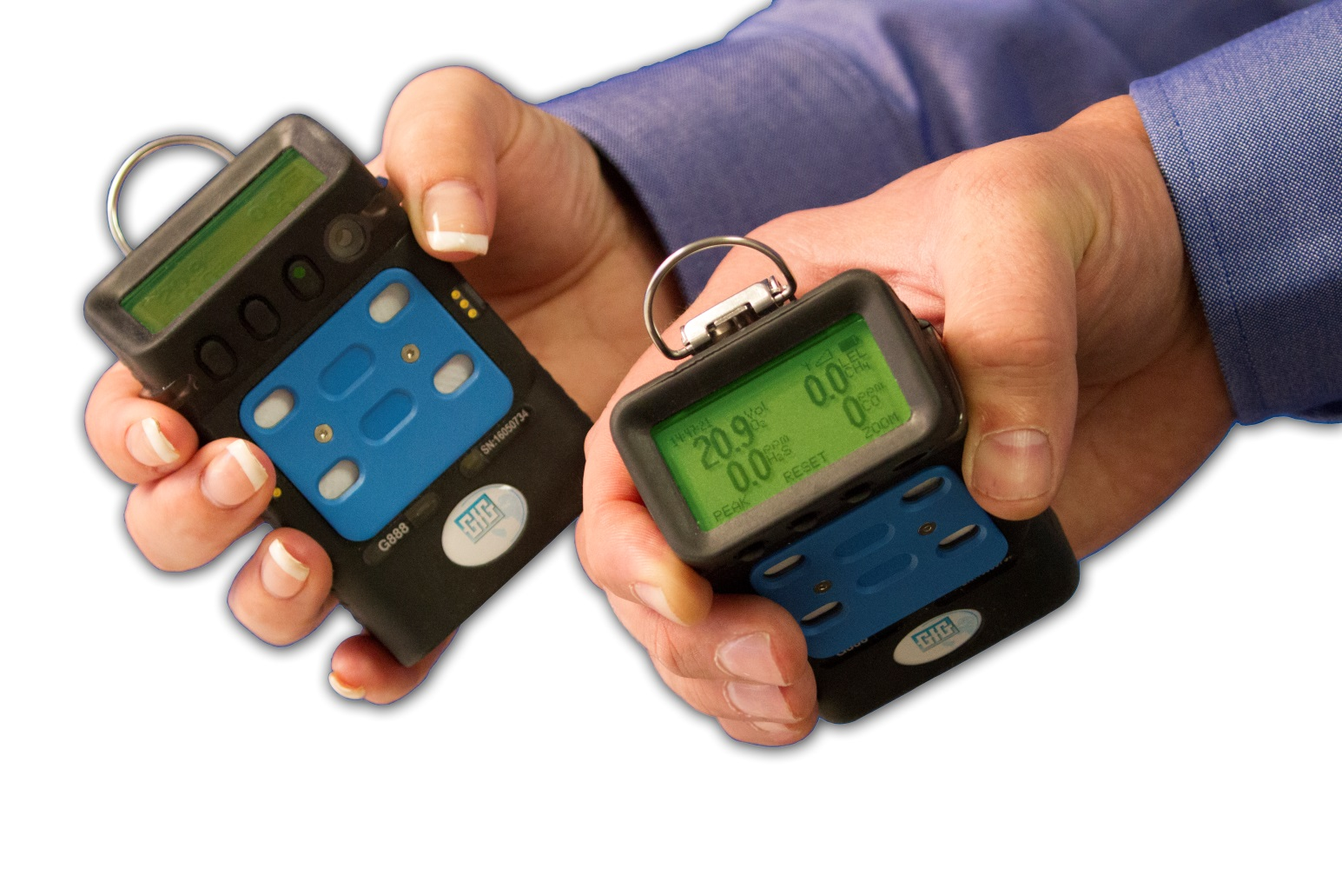


GfG Instrumentation
World-wide manufacturer of gas detection solutions

Slide 3
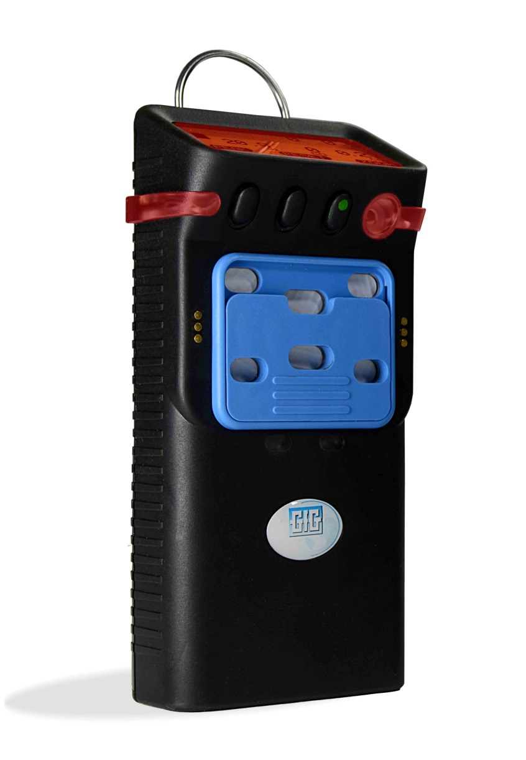
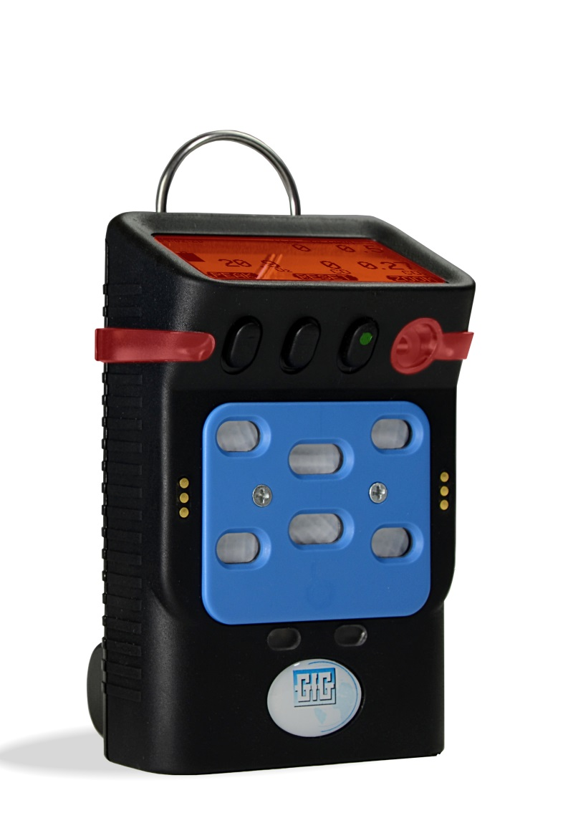
GfG Instrumentation
Exceptional designs with best cost of ownership in the gas detection industry

Slide 4



Introducing the latest multigas detectors from GfG Instrumentation
G888: compact, one-to-six gas atmospheric monitor
G999: compact, one-to-six gas atmospheric monitor with internal motorized pump

Slide 5
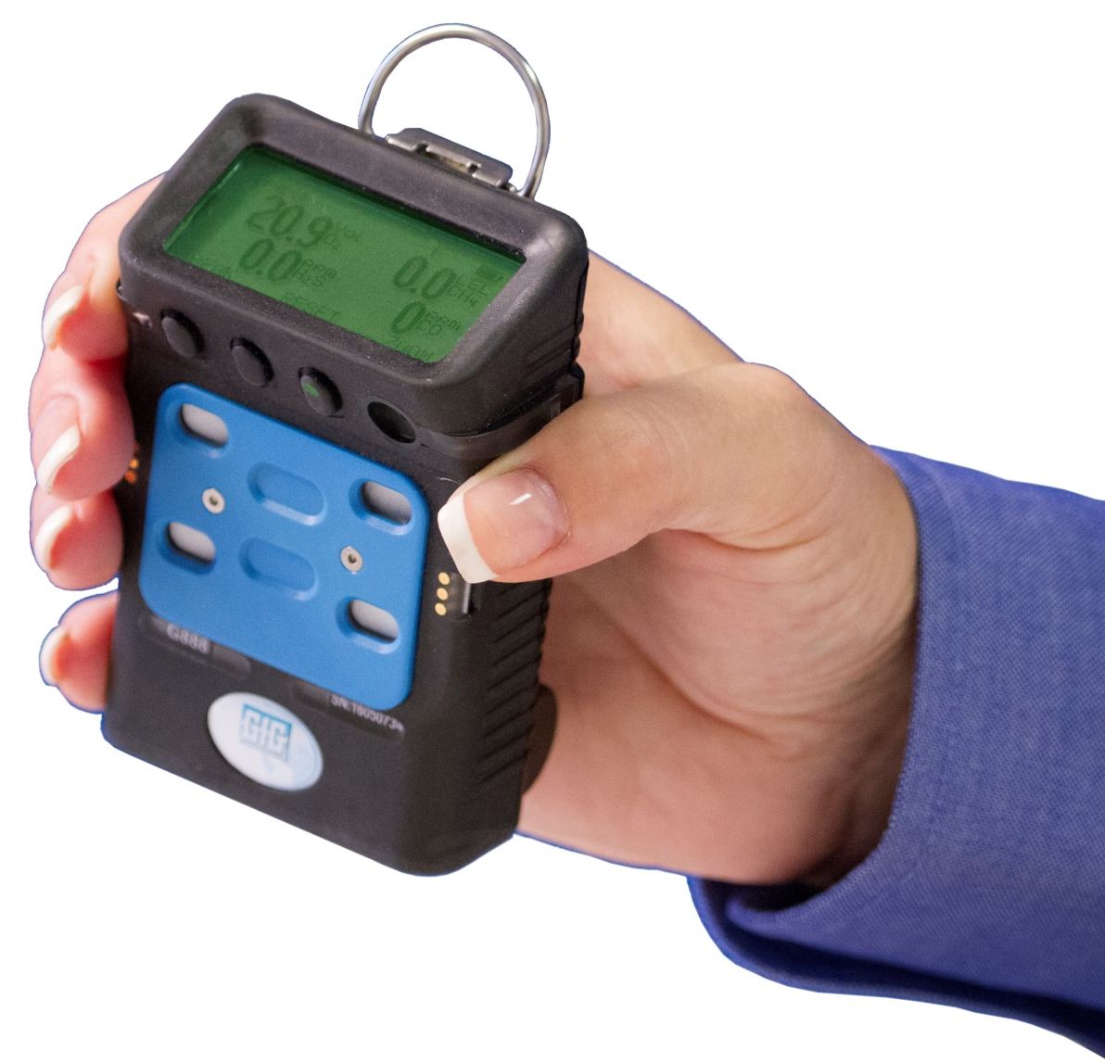
Introducing the G888 personal atmospheric monitor
Compact size!
  Up to 6 gases in an instrument smaller than most 4 gas personal instruments
Rechargeable battery pack provides up to 24 hours continuous operation
  Safe and dependable nickel metal hydride (NiMH) battery technology
  No concerns from dangerous Li-ion batteries

Slide 6
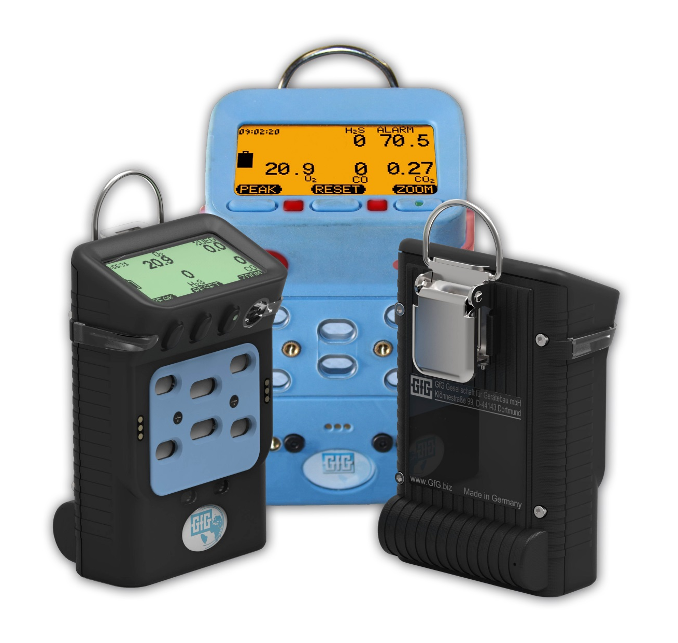
Compact size!
Almost one third smaller than G450 and G460
Smaller than most 4 gas personal instruments!

Slide 7
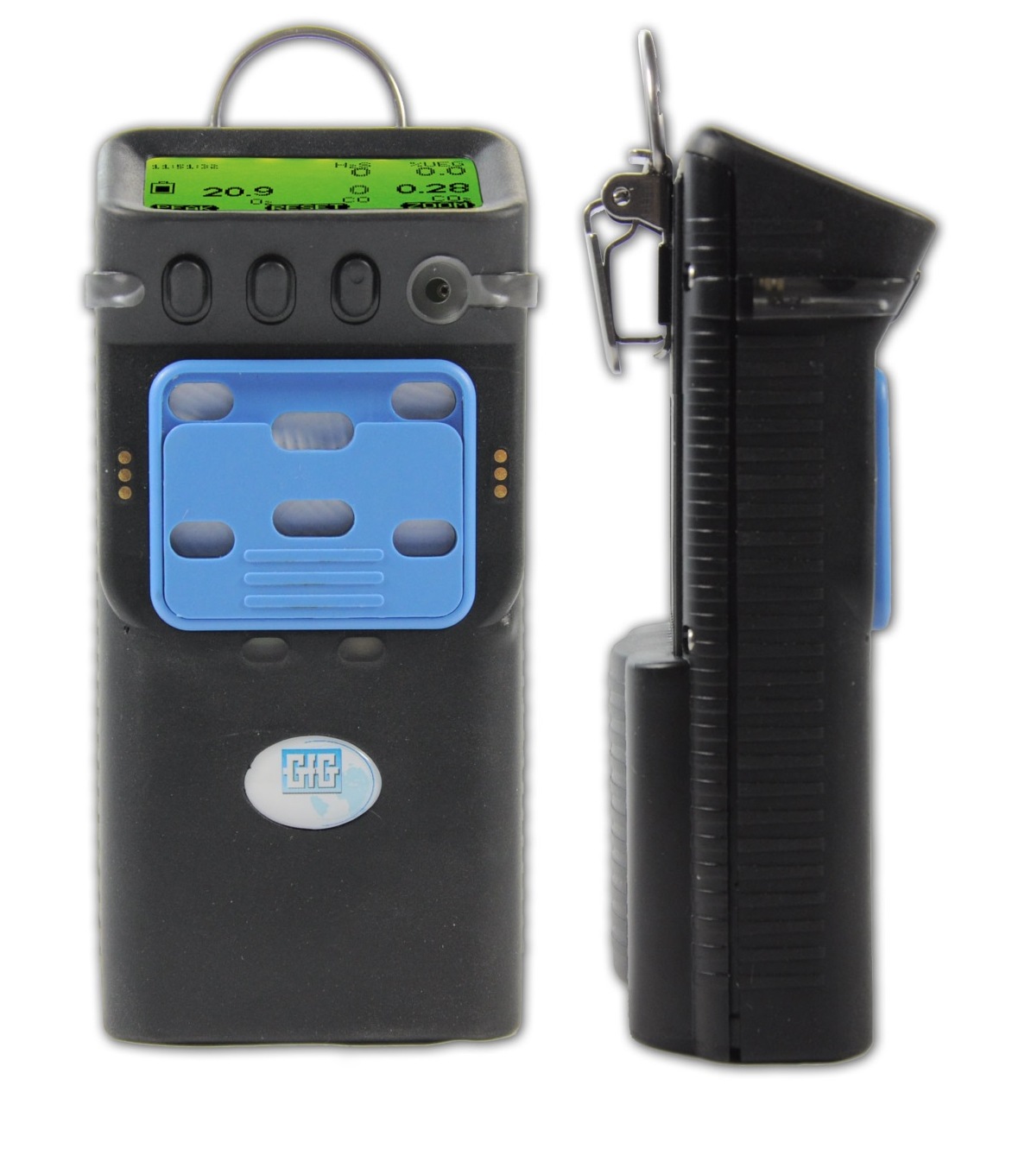
Introducing the G999 atmospheric monitor
Internal motorized pump for continuous sampling from remote locations
  Sample from locations up to 100m or more away from instrument
Slide on-off pump switch allows instrument to be operated in either diffusion or pumped operation
Compact size means G999 can be used as personal monitor

Slide 8
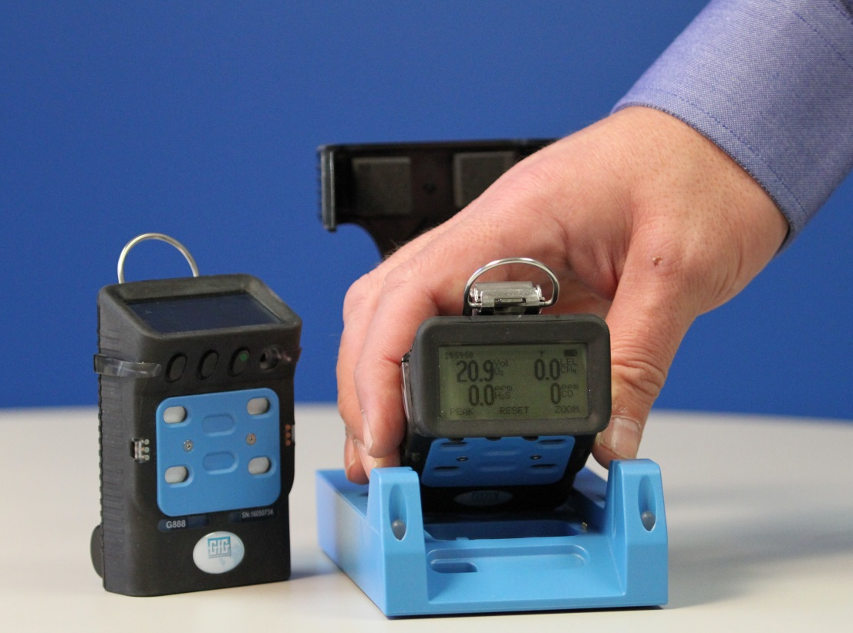
G888 battery packs based on safe and proven nickel metal hydride (NiMH) technology
NiMH batteries provide up to 24 hours of continuous operation
NiMH batteries provide excellent cycle life and low temperature performance
Typical run-time after two years for properly maintained NiMH battery packs is usually around 16 hours
No concerns due to dangerous Li-ion batteries
No runaway charging or flammability issues

Slide 9
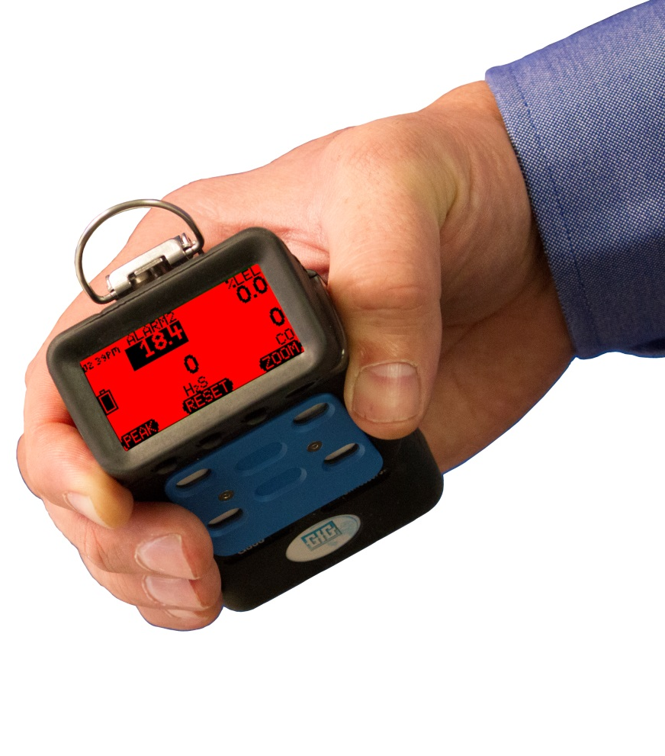

Three color "Traffic Signal" display
Back lit, three-color, full graphics LCD
Top mounted display with wrap around (360º) LED alarm indicator
LCD includes flip and zoom function
Rugged, double shot molded housing includes integral rubberized boot
Durable high tension steel alligator belt clip

Slide 10
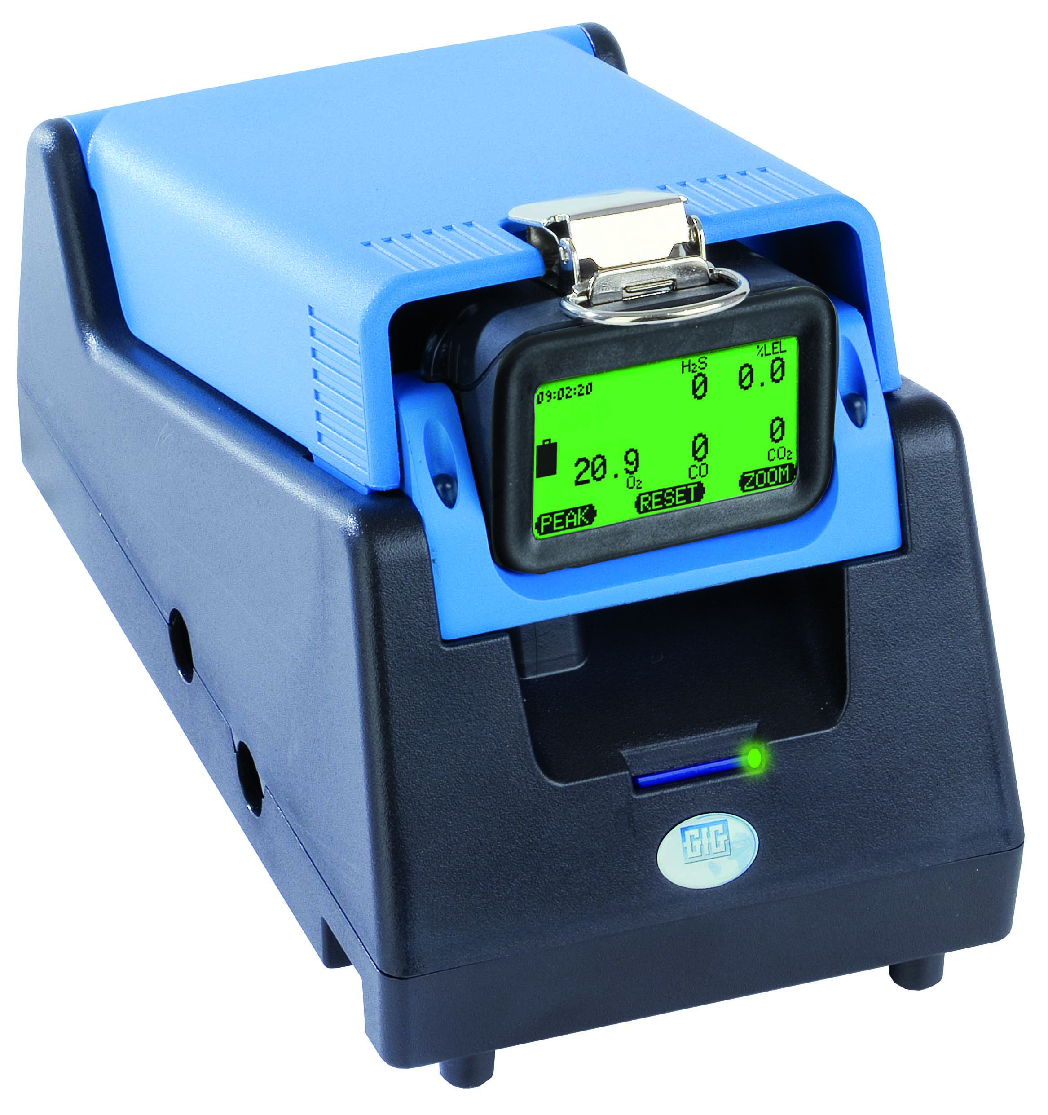
Easy to use!
Operation identical to other GfG instruments
Calibration easy and automatic
DS-400 Docking Station works with new G888 and G999
  All you need to do is install a new cradle and update the firmware in your existing docking station
  Same cradle works for both G888 and G999

Slide 11
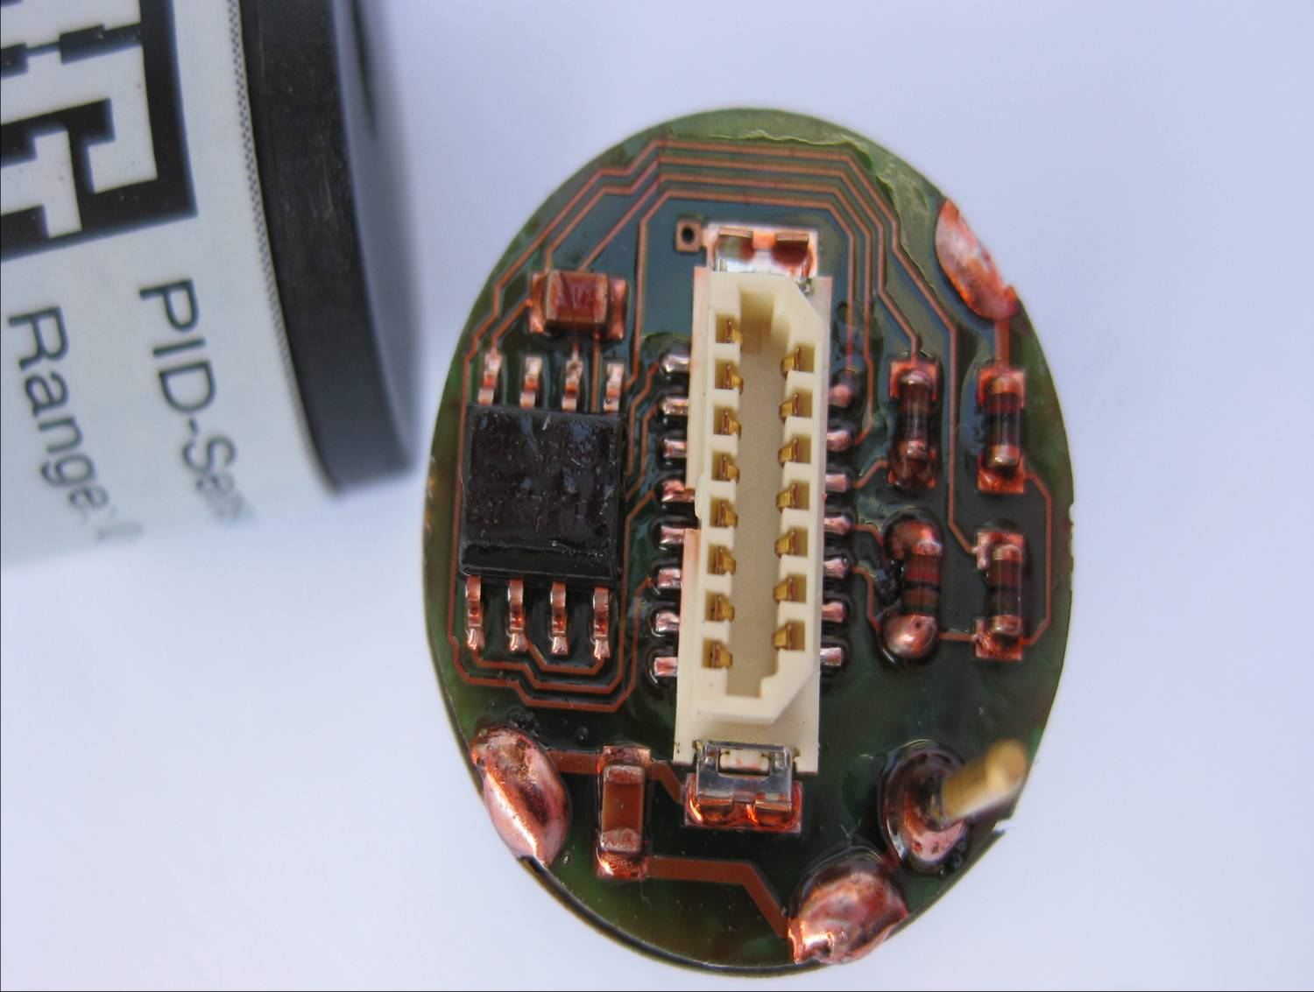
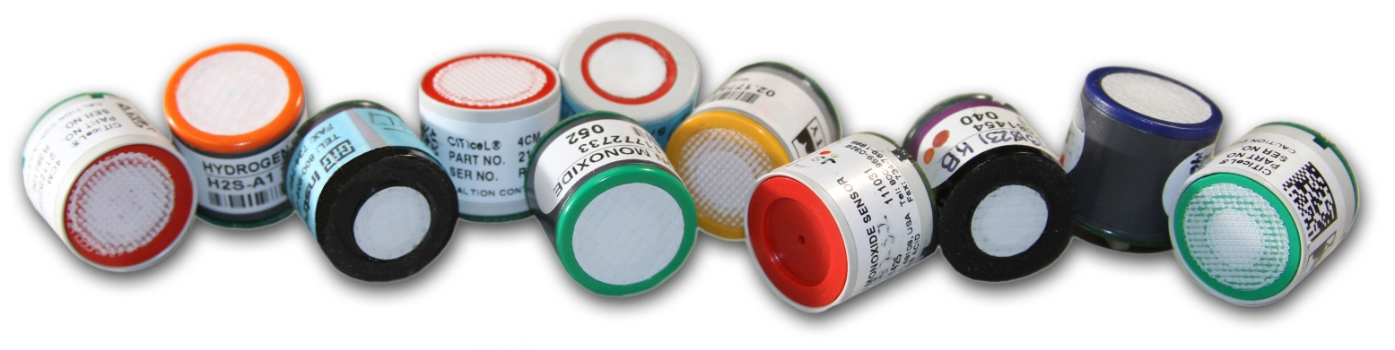
GfG “Smart Sensors”
Flexible “smart sensor” approach allows use of widest range of available sensors from multiple sensor manufacturers
GfG proprietary combustible (pellistor) and infrared sensors offer unrivalled accuracy, stability and longevity

Slide 12
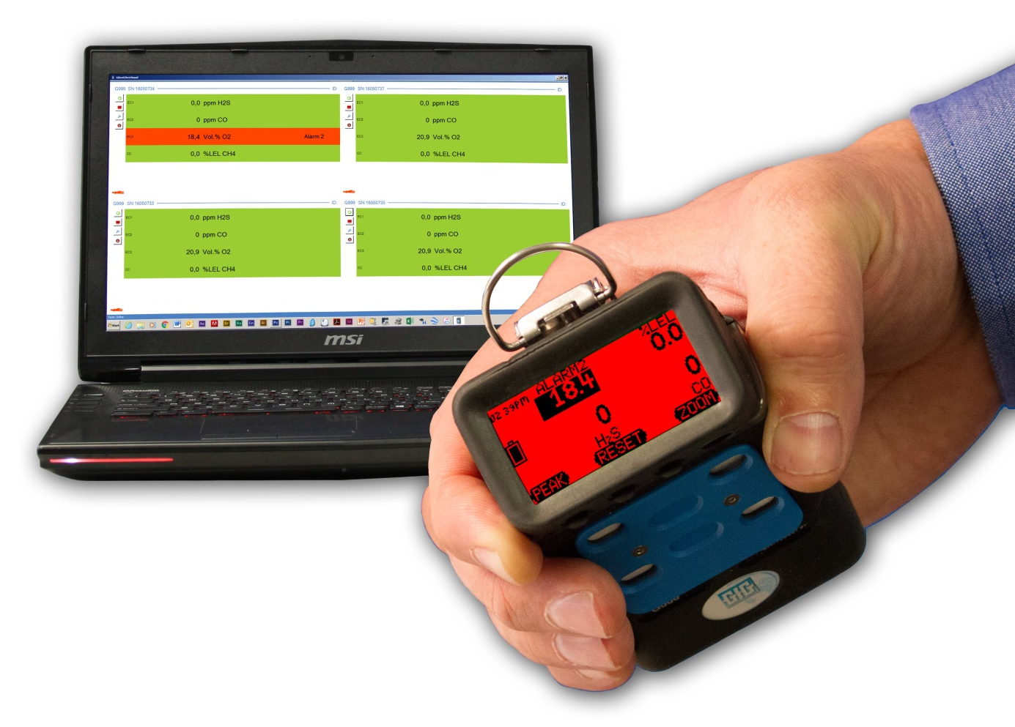
Realtime wireless communication
Optional radio frequency (RF) transmitter
Realtime wireless communication of readings and alarms
Sophisticated wireless “Man down” alarm provides immediate information of movement and horizontal attitude of worker
Powerful transmitter provides over 1km direct line of sight communication
License free ISM band operation
Digital repeater transmitters allow extended transmission distance

Slide 13
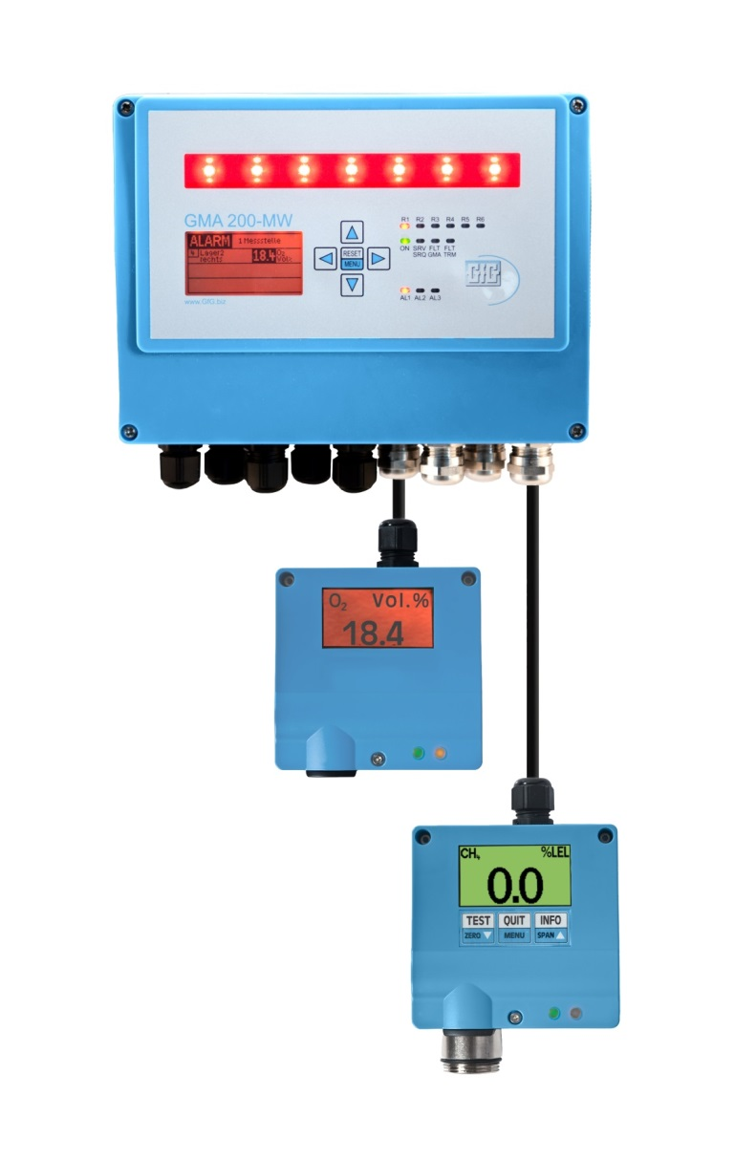
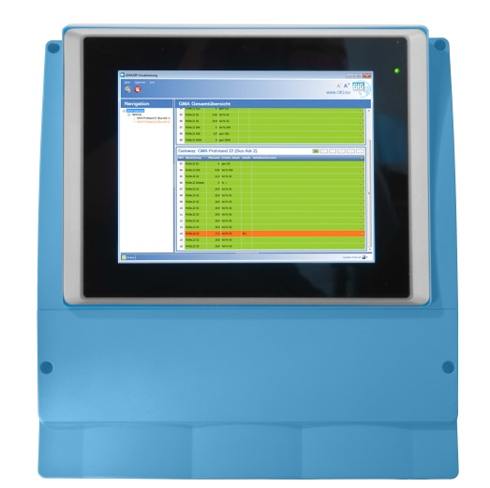
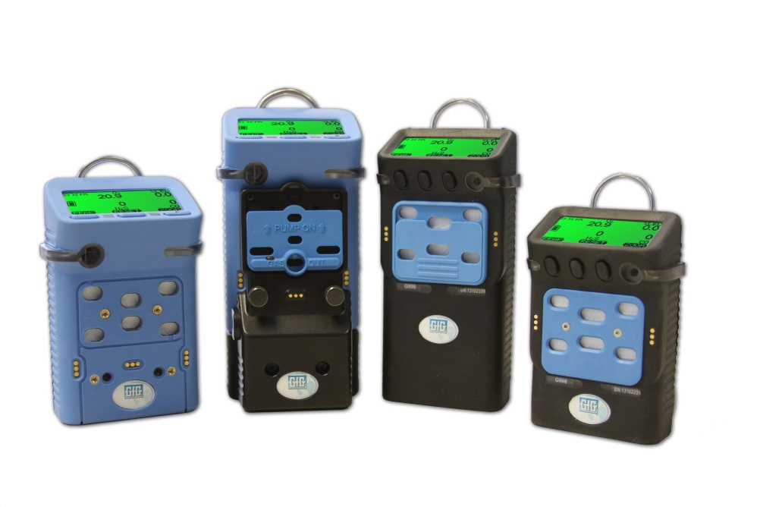
Wirelessly integrated fixed and portable systems
Fixed gas transmitters equipped with WILAN or ISM RF gateways
Realtime readings from fixed and portable instruments displayed on same monitor or PLC

Slide 14
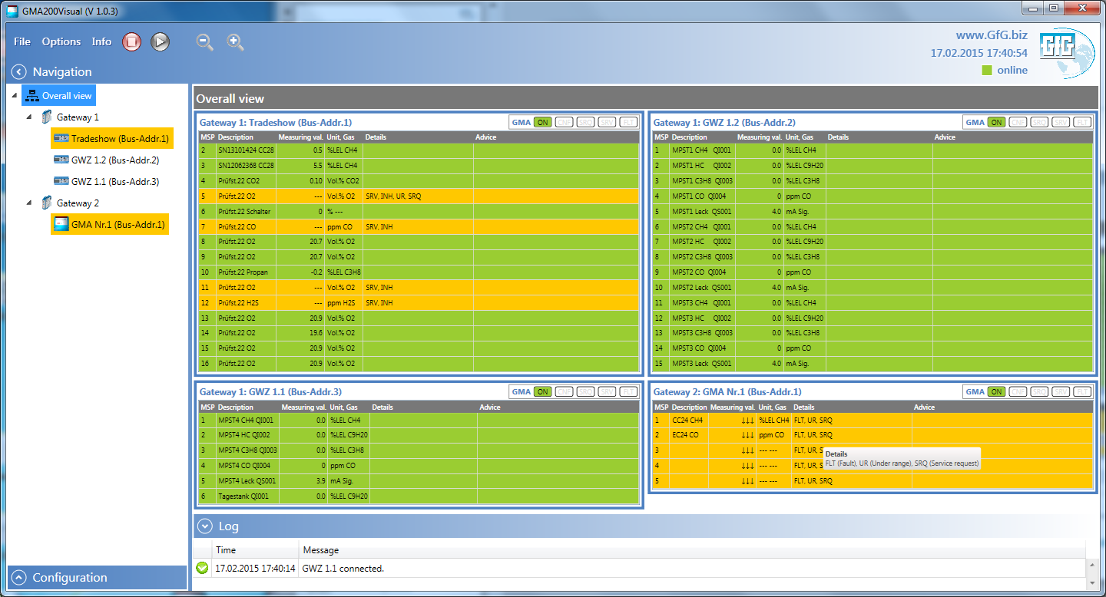
GMA200 Visualization Software
Comprehensive system information via digital gateway – Overall system view

Slide 15
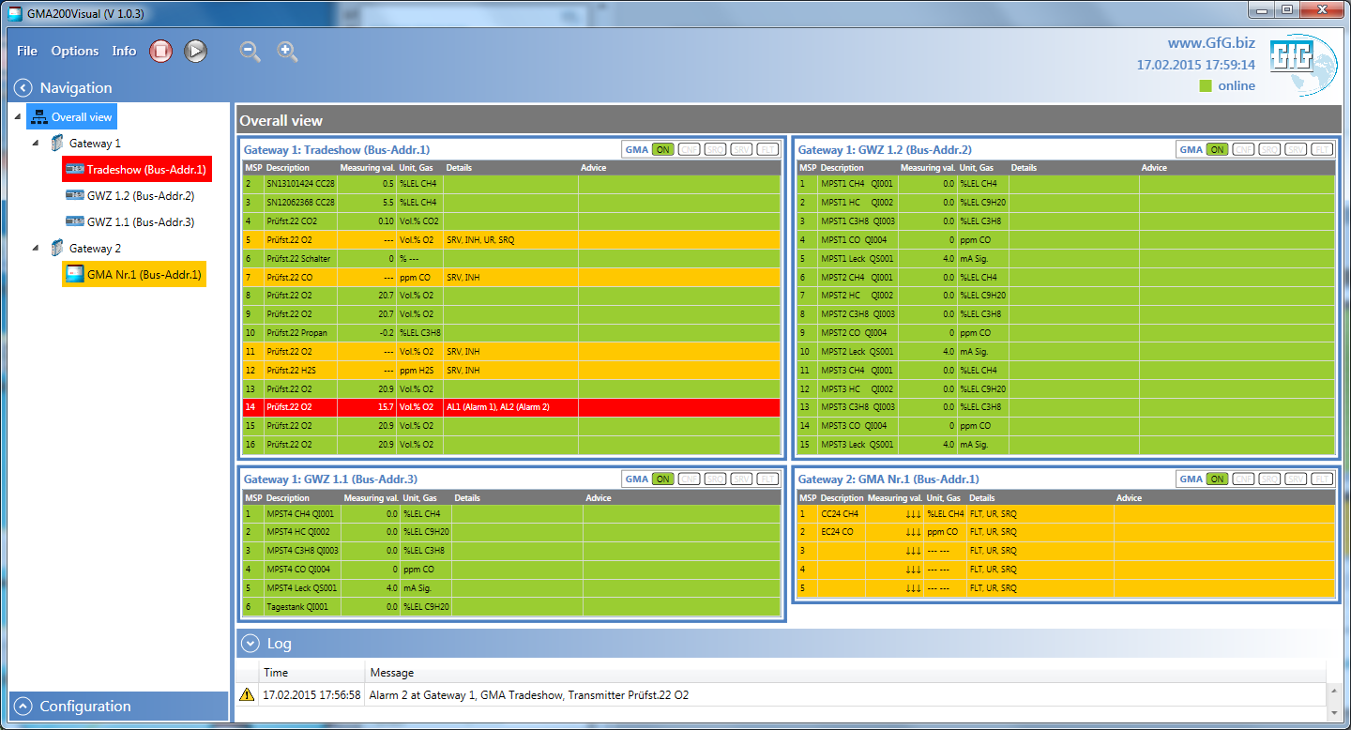
GMA200 Visualization Software
Overall system view with high alarm (alarm 2) condition

Slide 16
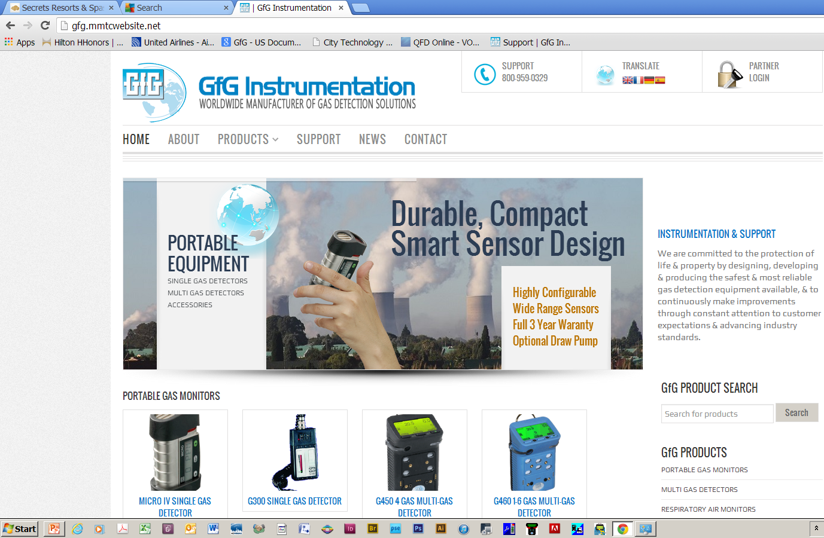
www.Goodforgas.com website

Slide 17

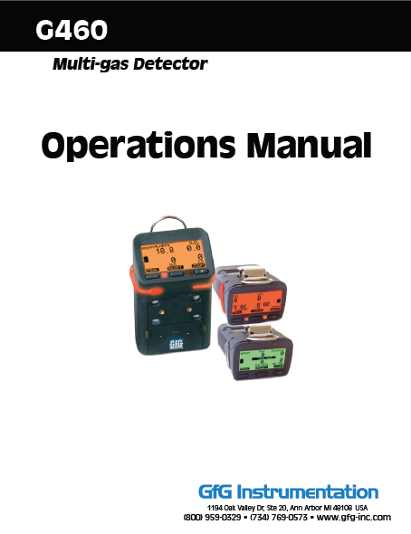
Sales Support: www.Goodforgas.com
Data sheets
Price lists
Manuals
Application Notes
Product images
Print ads...and more!

Slide 18
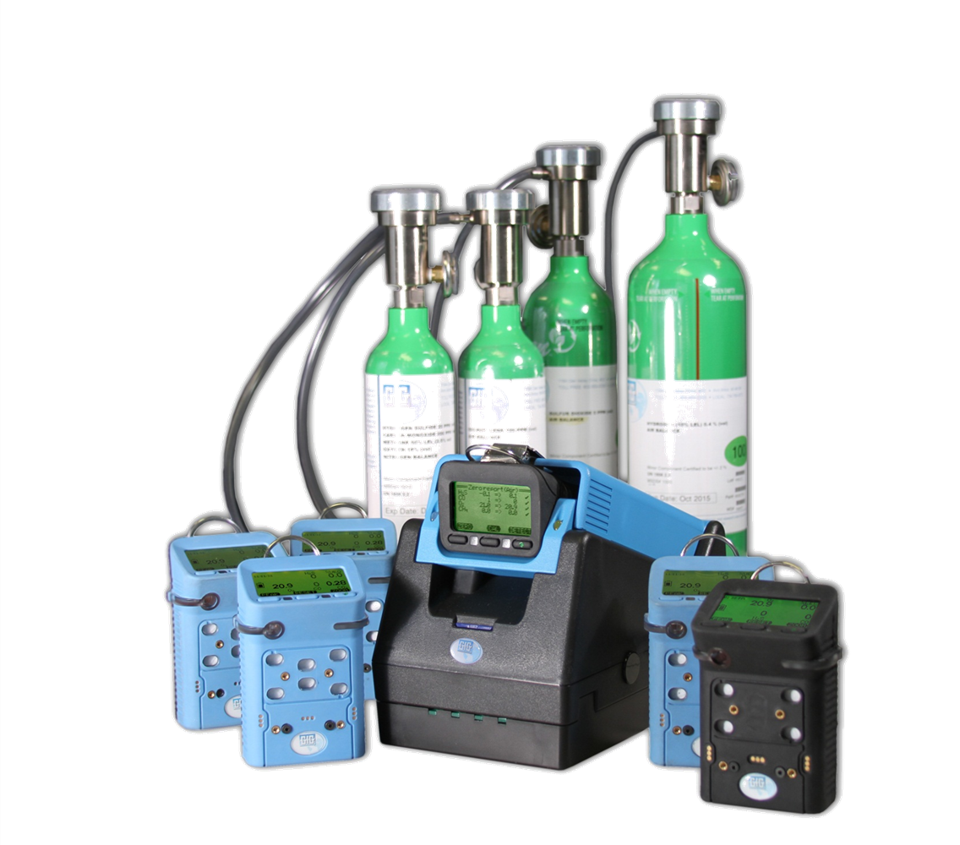
Questions?
Thank you!

