Slide 1


®

Slide 2

Series
Agenda
D-ReX features overview
New releases (accessories, sensors, software)
Review of all documentation released to date
Software Training
Bluetooth App Training
Webportal Training

Slide 3
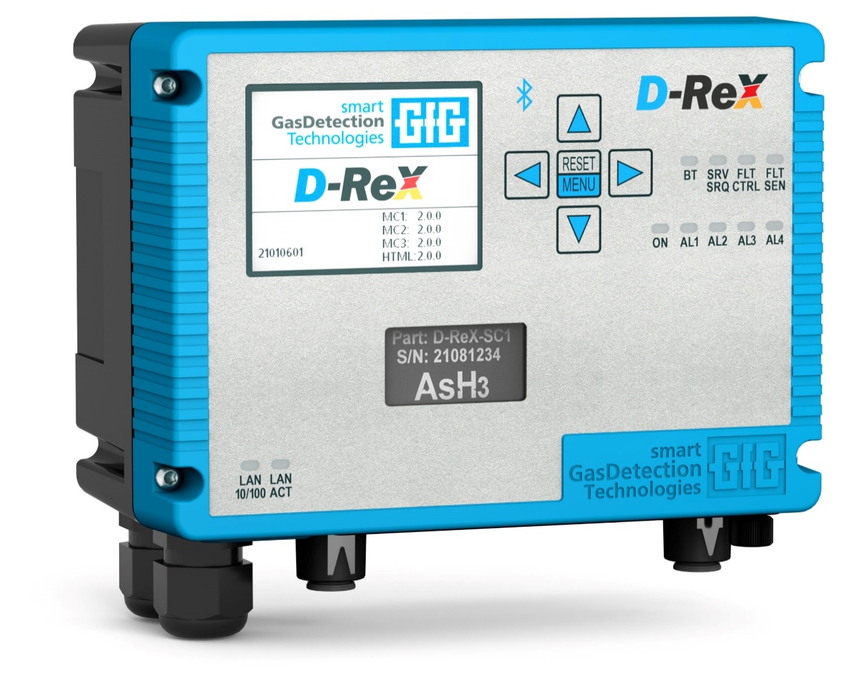
Concept
Versatility was the goal
Depending on the requirements on site, you can choose the right D-ReX to suit your needs.
Diffusion mode for ambient air monitoring with the D-ReX PoU (Point-of-Use)
Remote detection up to 30 meters in diffusion mode utilizing the D-ReX PoI (Point-of-Installation)
eXtraction mode operation up to 30 meters using the D-ReX PoS (Point-of-Sampling)

Slide 4
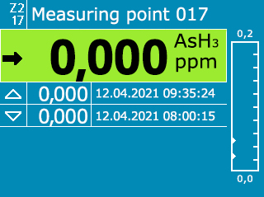
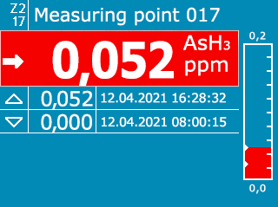
Features:
Sensors for more than 50 gases
High-resolution, full-color 2.4” TFT display
Hot-swappable smart sensor cartridge
Reusable sensor cartridge
Power over Ethernet (PoE) or 24 V DC
Addressable via a web portal- Datalogging
Bluetooth App with service capabilities
Software configuration tool
Interface: All Standard Now
  analog 4–20 mA output
  RS-485 (Modbus/RTU)
  0/100 Mbit Ethernet (Modbus/TCP)
  PoE Ethernet Communication
  5 Relays
LonWorks Option
Pyrolyzer available now
PID VOC sensor available
* Electrochemical and catalytic combustion sensors

Slide 5
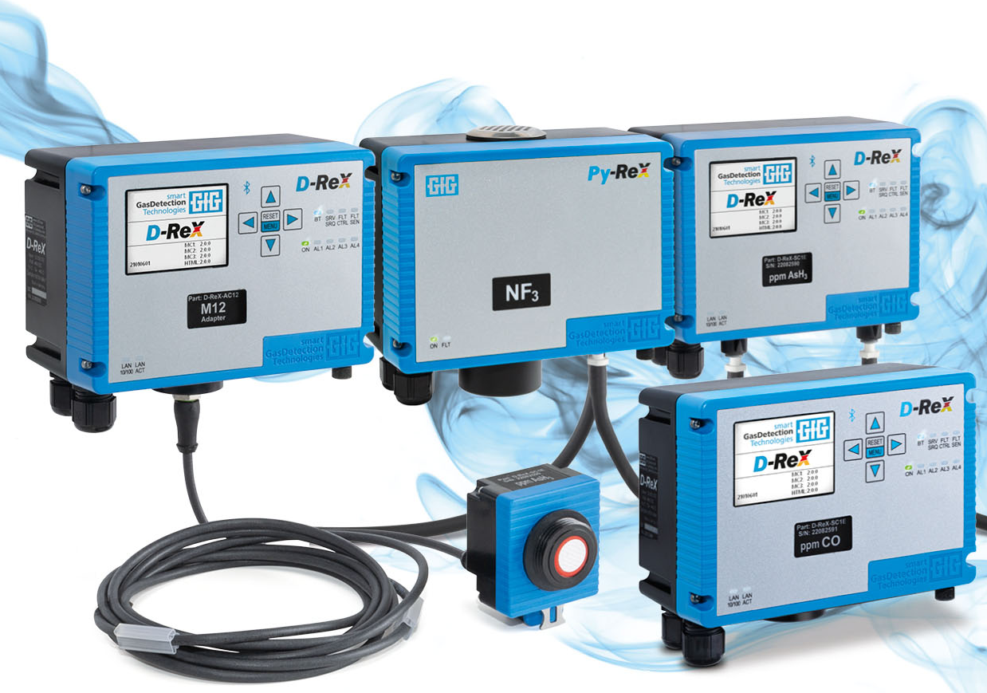
Series
Designed for Versatility
There is no one device for all requirements, but there is one device series to fit all the application needs and communication requirements you might have: the D-ReX.

Slide 6
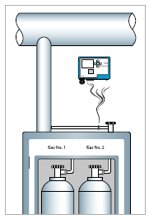
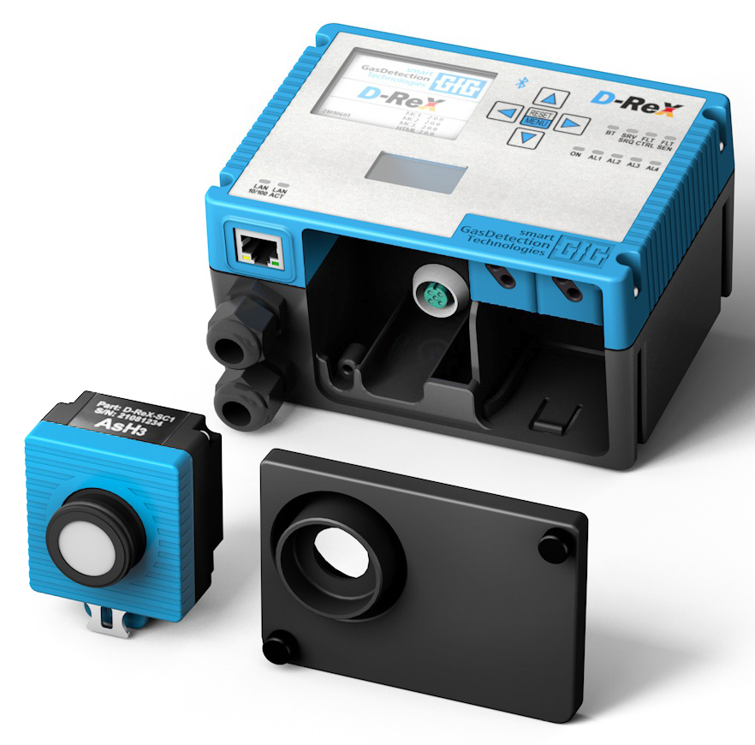
PoU
Diffusion Mode Gas Detection at the Point of Use (PoU)
USPs:
High-resolution full-color display
Plain text information
Power over Ethernet
(PoE) communication
Bluetooth®
5x internal relays
Options:
LonWorks®

Slide 7
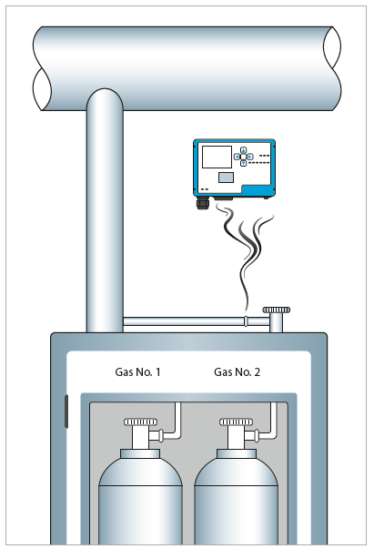
PoU
Features:
Sensors for more than 40 gases
Hot-swappable smart sensor cartridge
Sensor cartridges for EC, CC, IR and PID sensors*
Tool-free maintenance
Addressable via a web portal
Password protected menu
Interface: All Standard Now
  analog 4–20 mA output
  RS-485 (Modbus/RTU)
  0/100 Mbit Ethernet (Modbus/TCP)
  5 Relays
Bright status and alarm LEDs
Data logger to review sensor history and alarms
* Electrochemical and catalytic combustion sensors

Slide 8
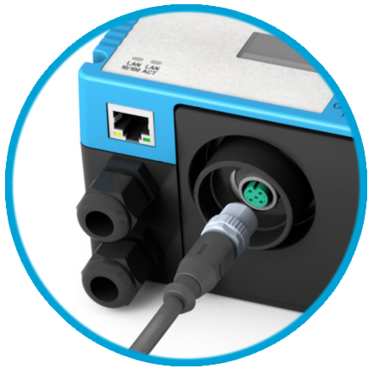
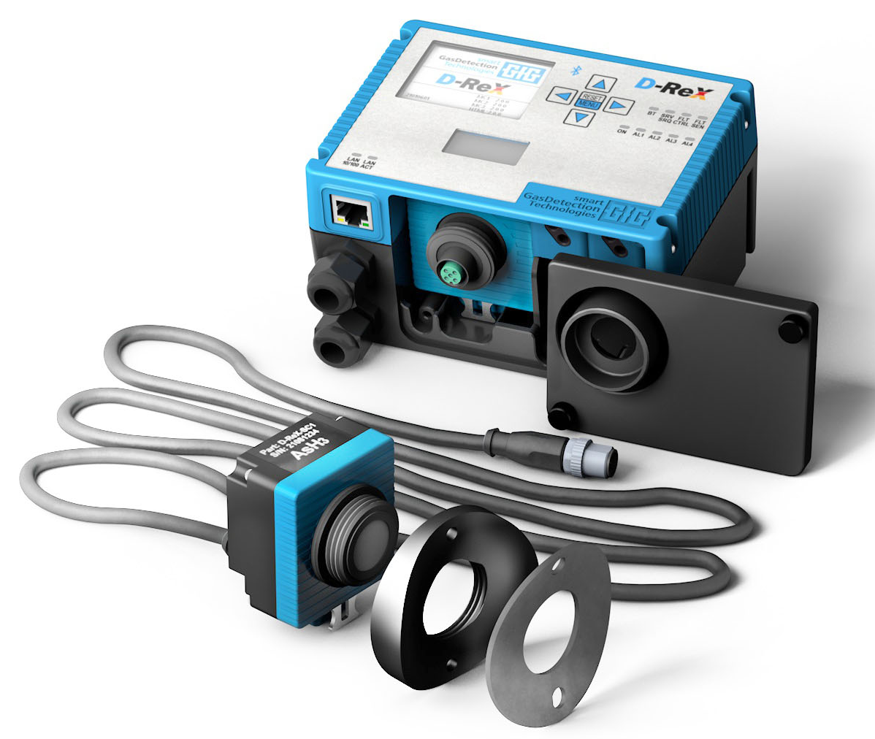
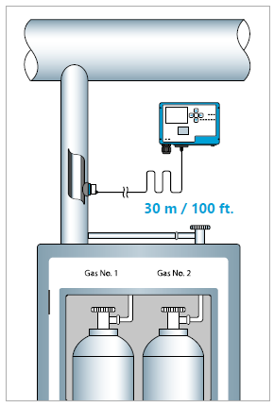
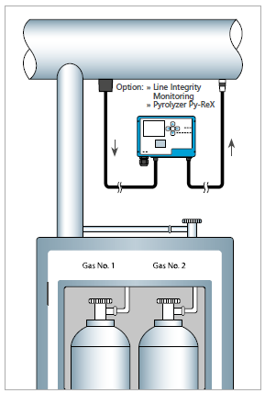
PoI
Remote Gas Detection at the Point of Installation (PoI)
USPs:
Cable length up to 30 m / 100 ft
Easy to install duct adapter
High-resolution full-color display
Plain text information
Power over Ethernet
(PoE) communication
Bluetooth®
Same sensor cartridge
Options:
LonWorks®

Slide 9
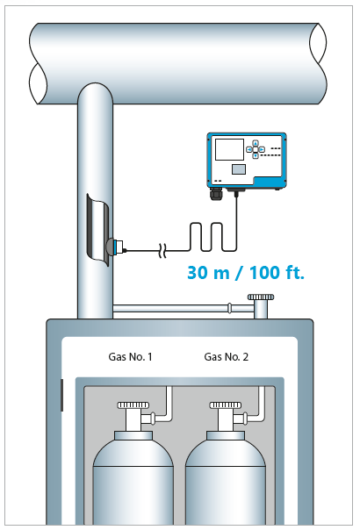
PoI
Features:
Sensors for more than 30 gases
Sensors manufactured in Germany by sensoriX the original manufacturer of Satellite XT sensors
Sensor cartridges for EC and CC sensors*
Hot-swappable smart sensor cartridges
Tool-free maintenance
Power over Ethernet (PoE) communication
Addressable via a web portal
Password protected menu
Interface: All Standard Now
  analog 4–20 mA output
  RS-485 (Modbus/RTU)
  0/100 Mbit Ethernet (Modbus/TCP)
  5 relays
Bright status and alarm LEDs
Data logger to review sensor history and alarms
* Electrochemical and catalytic combustion sensors

Slide 10
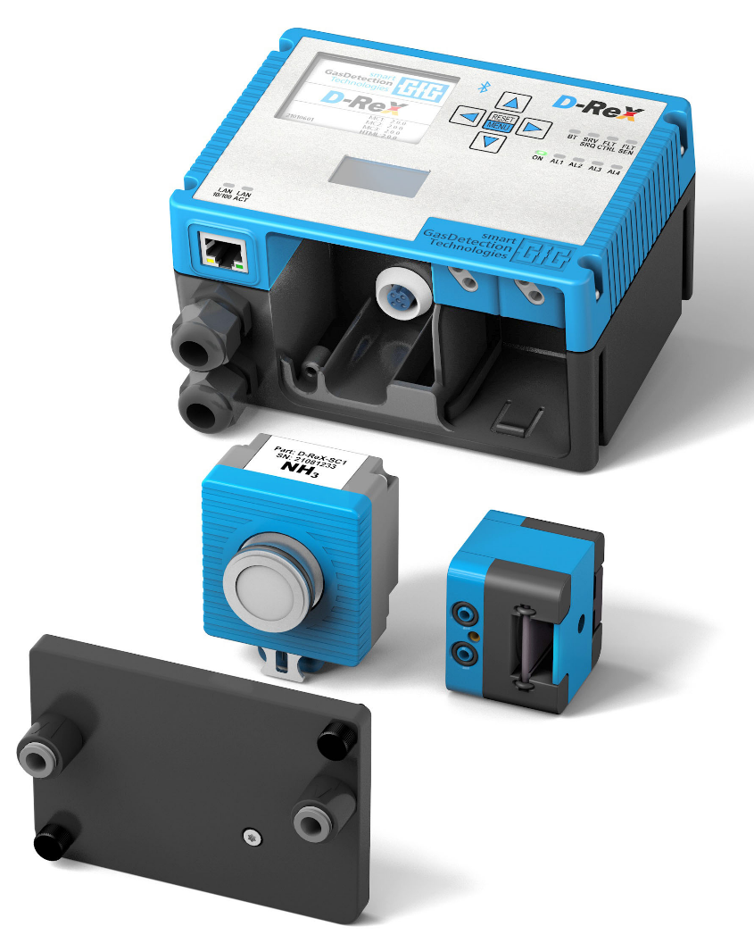
PoS
eXtraction Mode Gas Detection at the Point of Sampling (PoS)
USPs:
Tube length up to 30 m / 100 ft
Internal pump is easy to replace
(only mechanical component)
High-resolution, full-color display
Plain text information
Bluetooth®
Same sensor cartridge
5 internal relays
Options:
LonWorks®
Line Integrity Monitoring (LIM)
Py-ReX pyrolyzer module

Slide 11
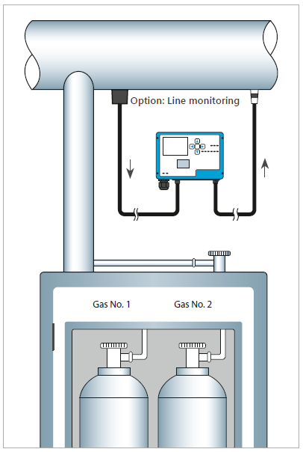
PoS
Features:
Line Integrity Monitoring (option)
Sensors for more than 30 gases
Sensors manufactured in Germany by sensoriX the original manufacturer of Satellite XT sensors
Sensor cartridges for EC and CC sensors*
Hot-swappable smart sensor cartridges
Tool-free maintenance
Power over Ethernet (PoE) communication
Addressable via a web portal
Password protected menu
Interface: All Standard Now
  analog 4–20 mA output
  RS-485 (Modbus/RTU)
  0/100 Mbit Ethernet (Modbus/TCP)
  5 relays
Bright status and alarm LEDs
Data logger to review sensor history and alarms
* Electrochemical and catalytic combustion sensors

Slide 12

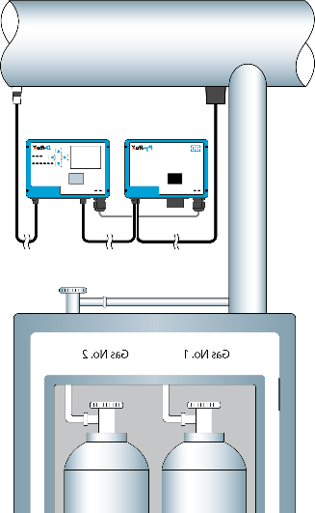
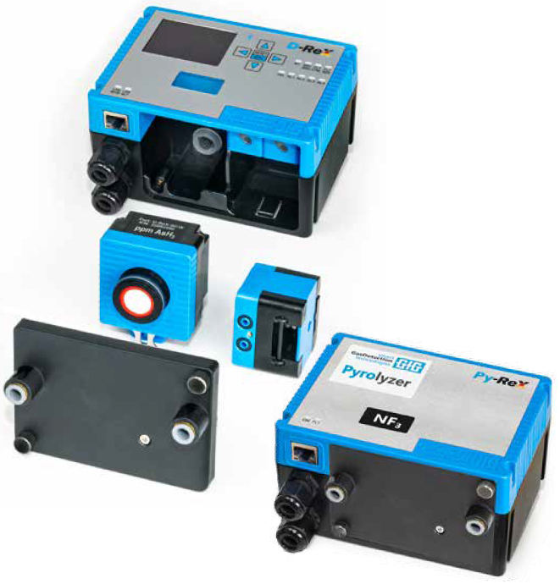
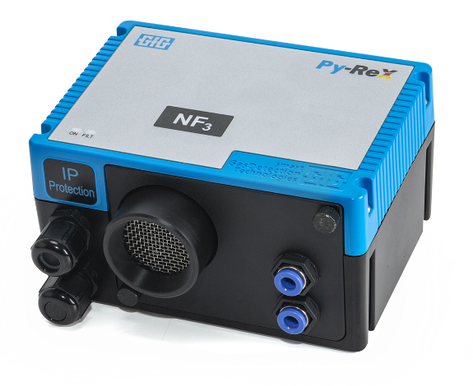
PoS +
eXtraction Mode Gas Detection utilizing pyrolysis
USPs:
Detect electrochemically inactive gases
Tube length still up to 30 m / 100 ft
Easy to replace internal pump
High-resolution, full-color display
Plain text information
Bluetooth®
Same sensor cartridge
Options:
LonWorks®
Line Integrity Monitoring (LIM)

Slide 13
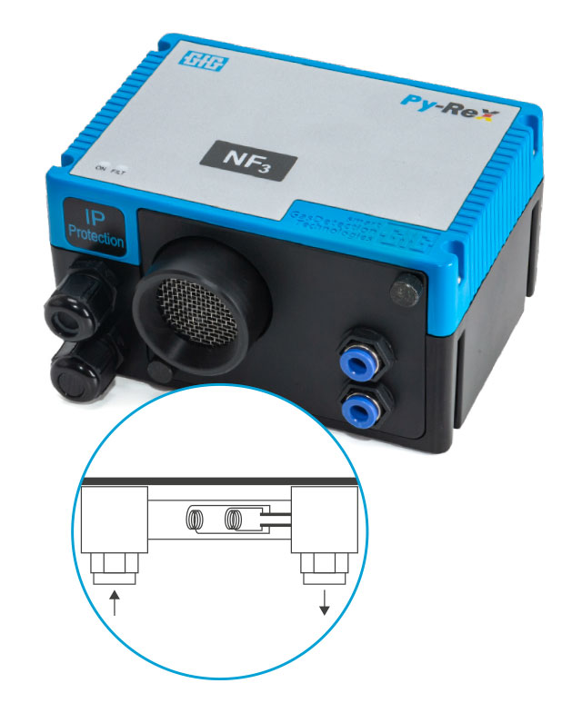

eXtraction Mode Gas Detection utilizing pyrolysis
USPs:
Detect electrochemically inactive gases
Safe, tested and reliable technology
No need for external pump
No exposure to radiation
Options:
Line Integrity Monitoring (LIM)
Requirement!
Py-ReX pyrolyzers are designed
for the detection of a specific gas!

Slide 14
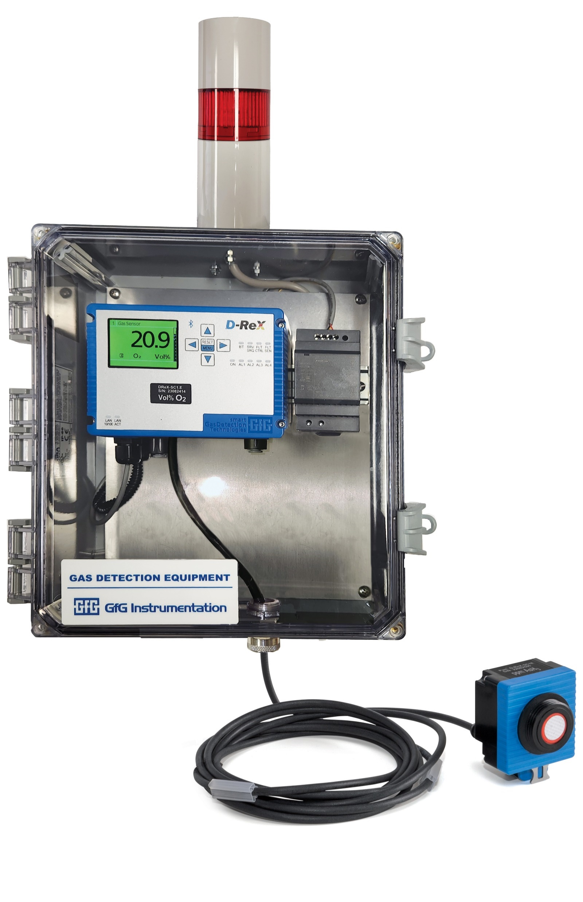
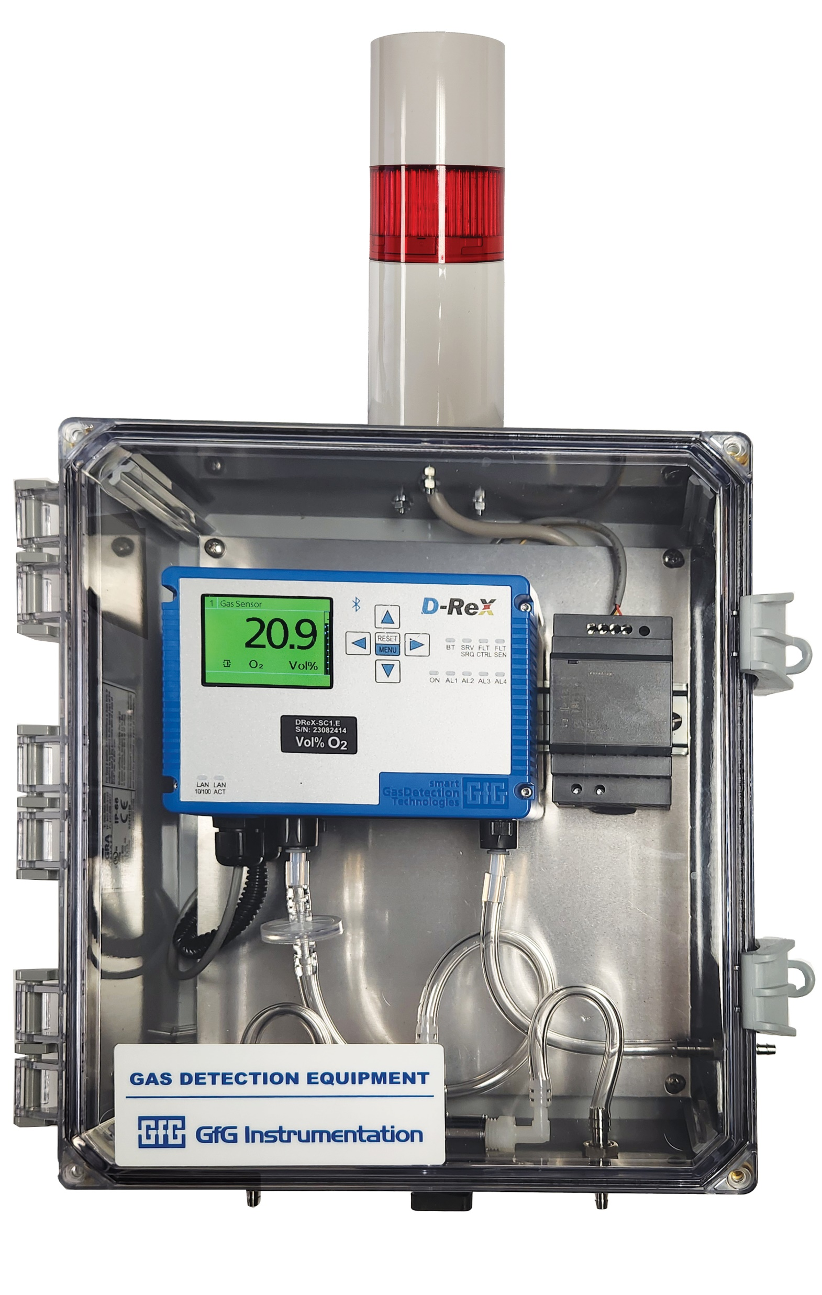
New enclosure options for PoI and PoS

Slide 15
News 2024
Accessories
Stainless steel knurled screws since 03.2024
Push-pull hose plug-in adapter from ¼”OD to 6mm for D-ReX and Py-ReX
Particle filter 1 with one-sided connection for 6mm hose
Particle filter 2 with connections on both sides for 6mm hoses
Replacement filter elements for particle filter 2
Particle filter PTFE with connections on both sides for 6mm or ¼” hoses
Touch protection insert for D-ReX Sensors

Slide 16
New 2024
EC Sensors
MK487-10 GeH4- Germanium Hydrogen
MK486-10 N2H4- Hydrazine
MK485-10 H2Se- Hydrogen Selenide
MK481-11 TMB- Trimethyl Borate
MK401-10 H2 ppm
MK407-10 H2 Vol%
MK349-10 COCl2- Phosgene
PID Sensors- VOCs
MK463-10 iC4H8 and others
IR Sensors
MK252-10 CO2 25(50) Vol%

Slide 17
New 2024
D-ReX Firmware
Internal Data logger (access via WEB-Interface)
Online Test for the Iout 4-20mA output (via DReX-Config software)
GMA400 Controller compatibility-Modbus
Additional functions and more safety for the DReX-App
Login for DReX-Config software and DReX-App
Optimization of the configuration via Modbus and LonWorks
Optimization of the WEB-Interface
Optimization of fault and service request messages
Optimization of displays in the service menu and info screens
Electrical EC sensor tests- Reflex- Every 16 hours

Slide 18
Series
Released Documents
Sensor Table
Manuals for PoU and PoI- PoS by end of September
Modbus Manual
LonWorks Manual
Bluetooth App Manual
Configuration Software installation guide
(no configuration manual released yet)
Individual Sensor Datasheets- 10 released to date
(if you need a specific one let us know and SensoriX will put it together)

Slide 19
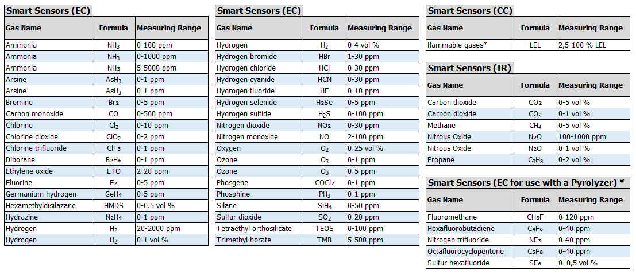
- Detectable Gases
* Available as soon as the corresponding pyrolyzer is available.

Slide 20
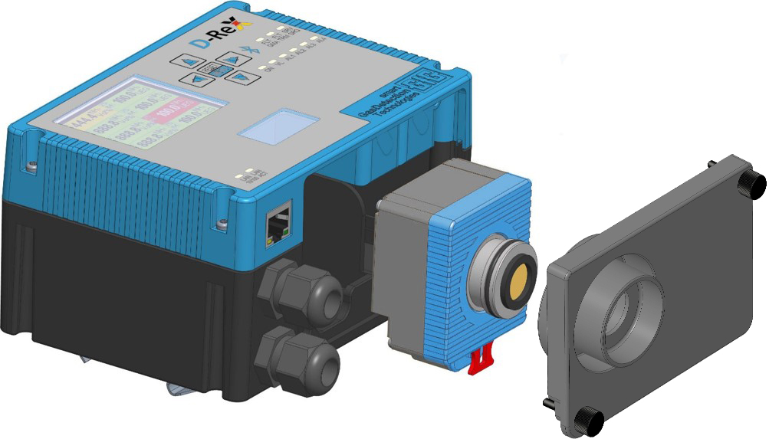
Technical Details
Assemblies PoU
Housing lid
Housing
Sensor cartridge
Lower housing cover

Slide 21
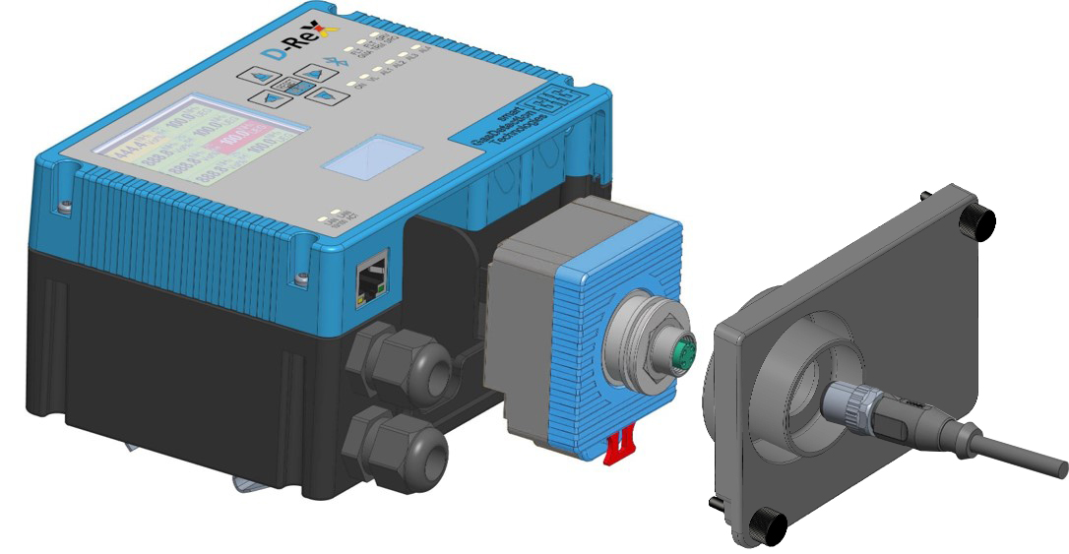
Technical Details
Assemblies PoI
Housing lid
Housing
Connector cartridge
Lower housing cover
Cable to remote sensor

Slide 22
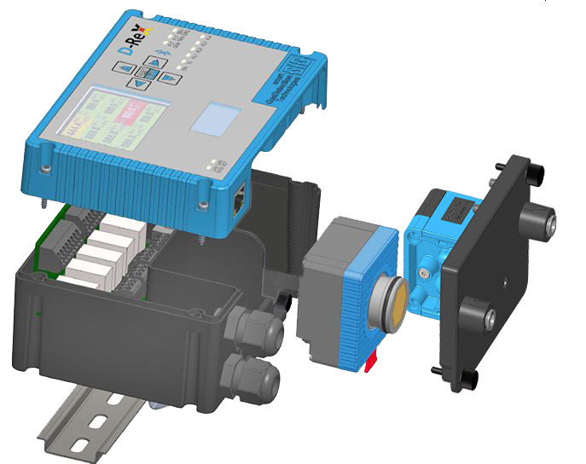
Technical Details
Assemblies PoS
Housing lid
Housing
Connector PCB
Relay PCB
Pump
Sensor cartridge
Lower housing cover

Slide 23
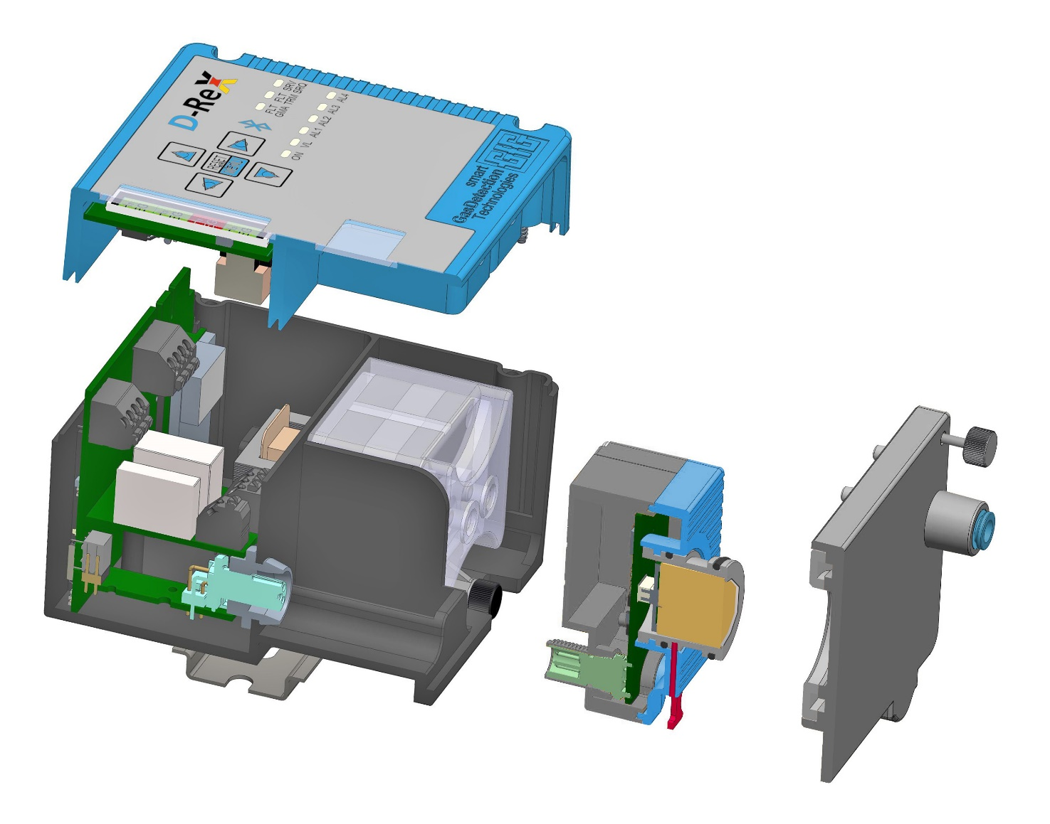
Technical Details
Assemblies and connectors
Housing lid
Housing
Main PCB
Connector PCB
Relay PCB
Pump
Sensor cartridge
M12 connector (female)
M12 connector (male)
Lower housing cover with gas channel

Slide 24
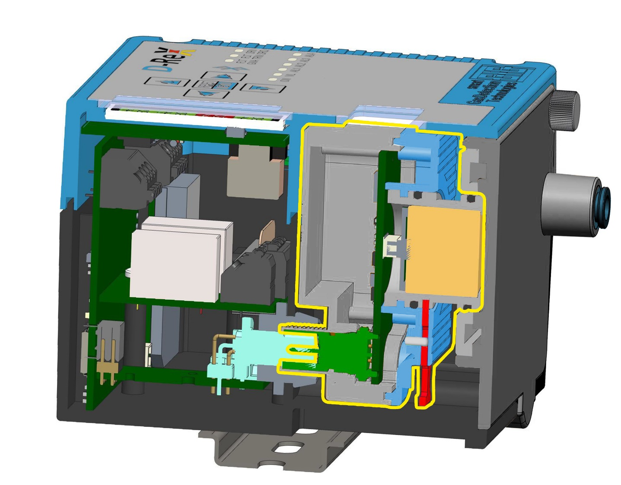
Technical Details
Longitudinal section
Housing lid
Housing
Main PCB
Sensor PCB
Connector PCB
Relay PCB
Sensor Cartridge
M12 Connector (female)
M12 Connector (male)
Lower housing cover with gas channel

Slide 25
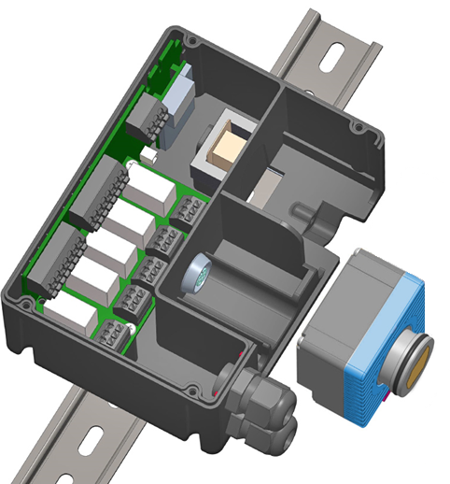
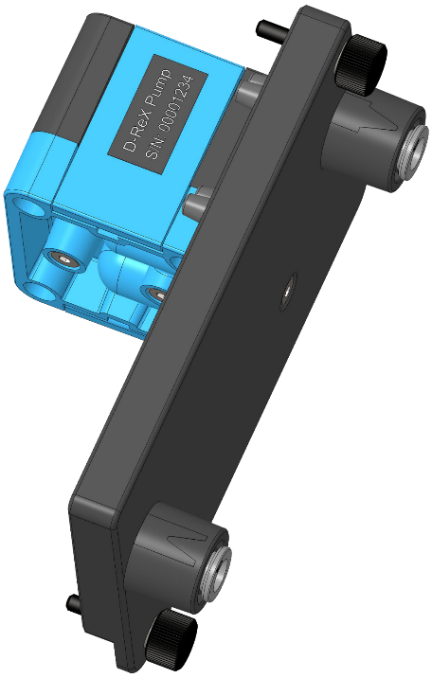
Technical Details
Horizontal Section
Housing
Connector PCB
Relay PCB
Pump
Sensor cartridge
M12 Connector (female)
Lower housing cover with gas channel

Slide 26
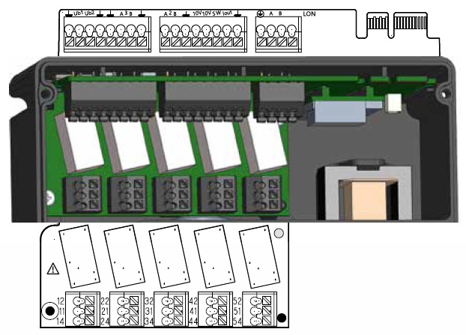
Technical Details
Terminal allocation

Slide 27
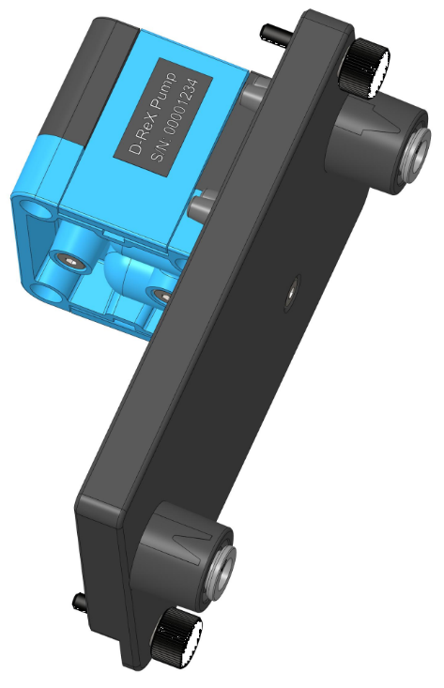
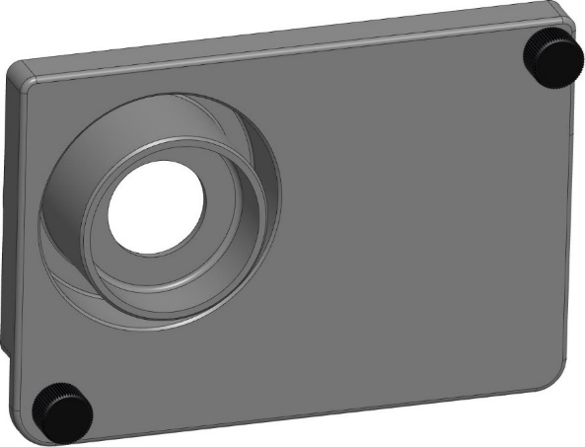
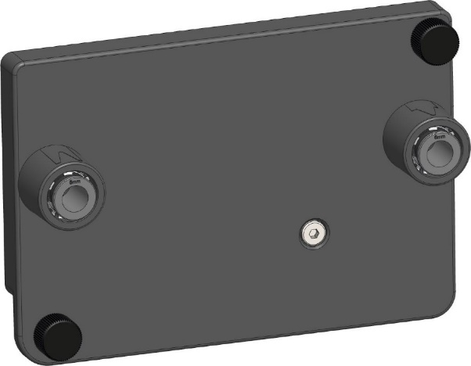
Technical Details
Lower housing covers
Diffusion mode and remote sensor
Extraction mode

Slide 28
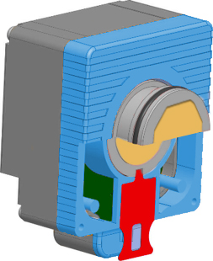
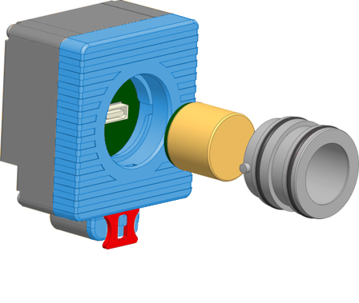
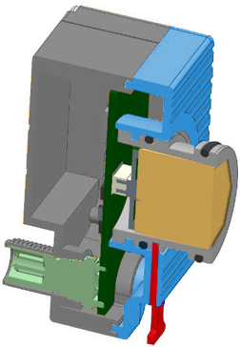
Technical details
Sensor Cartridge
Sensor
Pipe flange adapter (bayonet lock, removable)
Lock pin of bayonet lock
O-ring
Sensor cartridge
M12 connector (male)

Slide 29
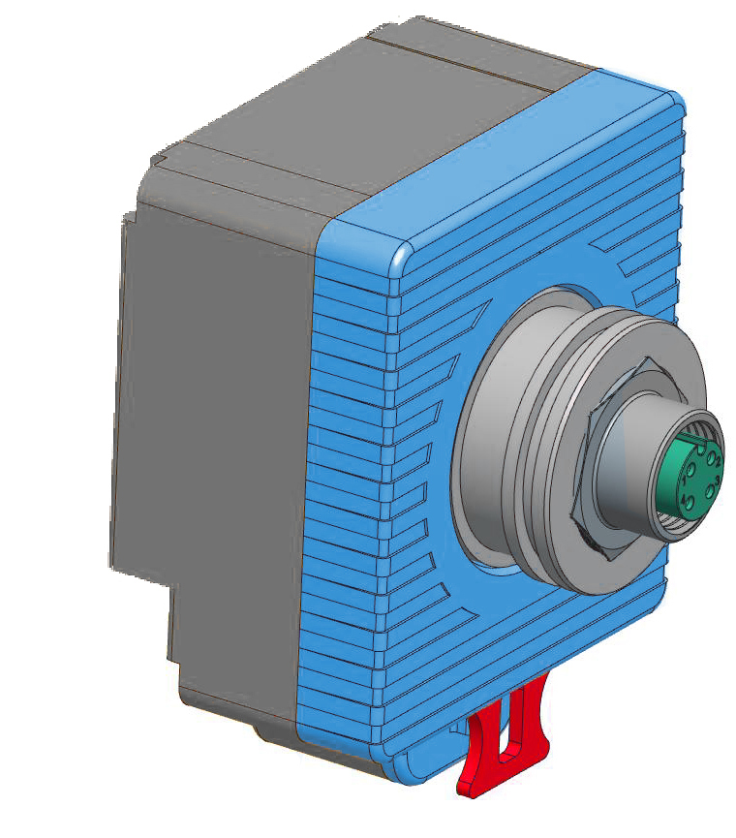
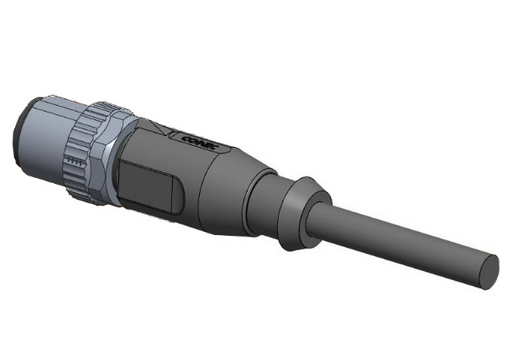
Technical Details
Connector cartridge
Connector cartridge
M12 connector (female)
Lock pin of bayonet lock
Cable with M12 connector (male)

Slide 30
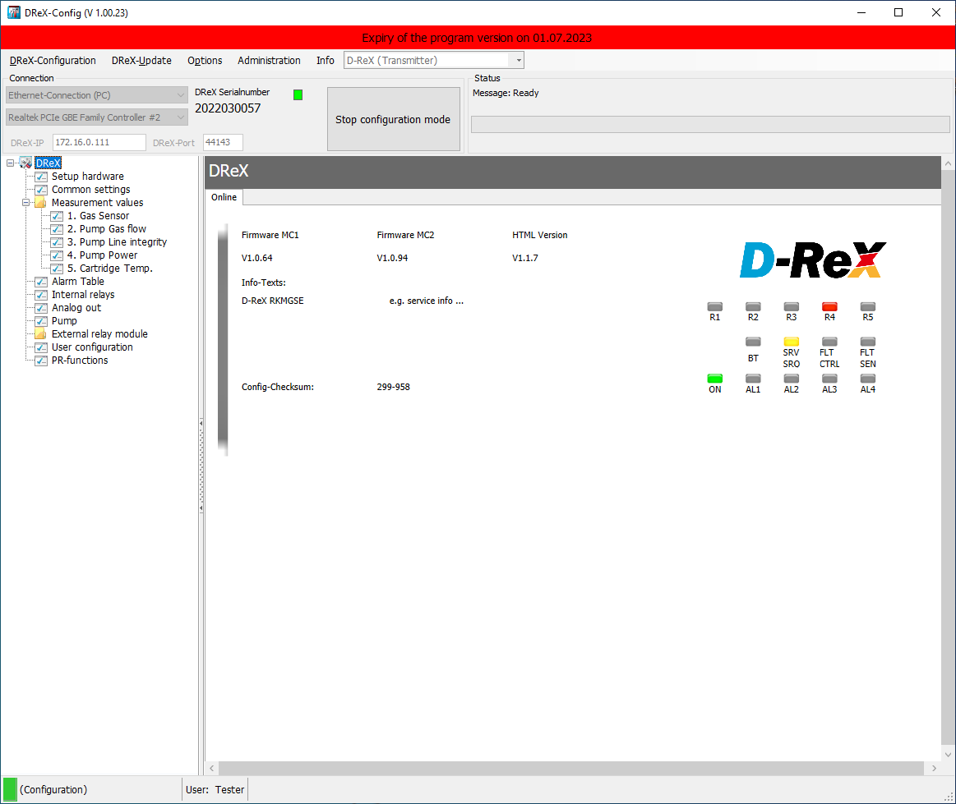
-Config
Home:
Real-time information on the D-ReX currently connected to the computer

Slide 31
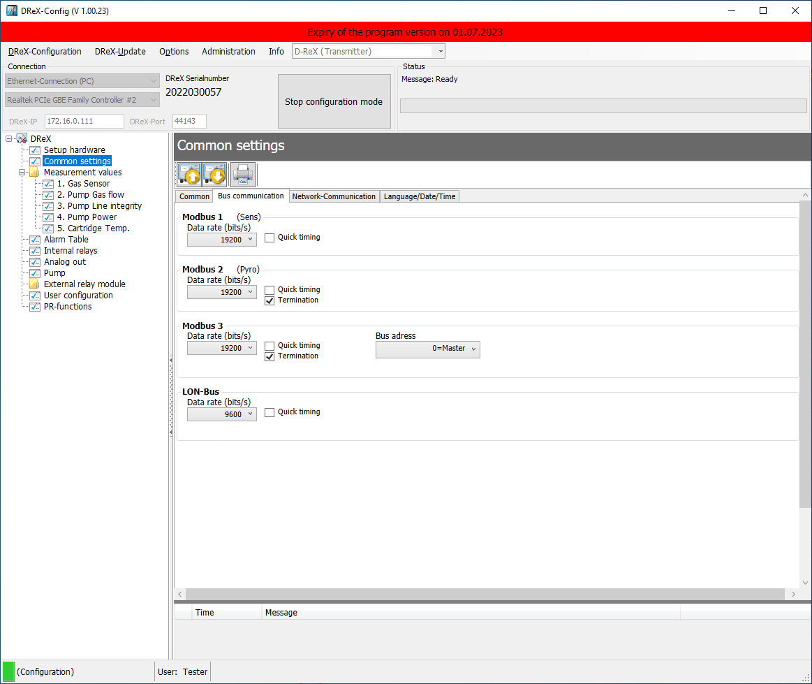
-Config
Common settings
e.g. bus and connection settings…

Slide 32
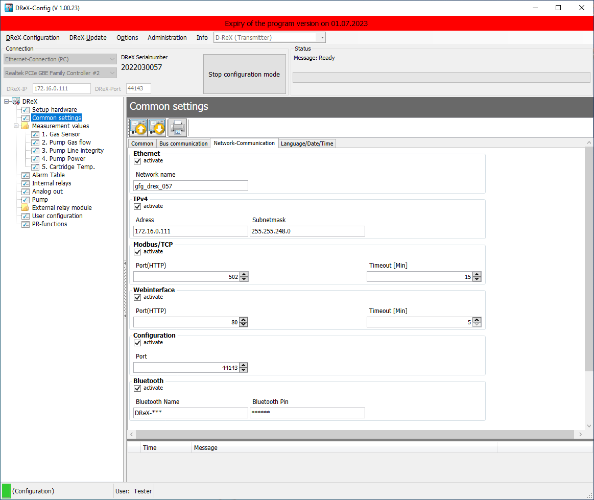
-Config
… the network communication …

Slide 33
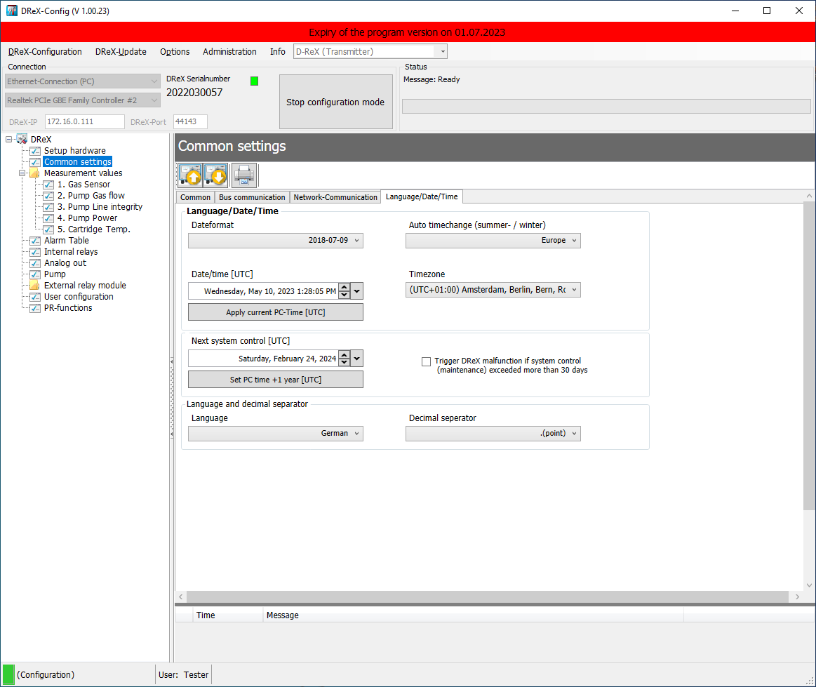
-Config
… and the language and date/time settings.

Slide 34
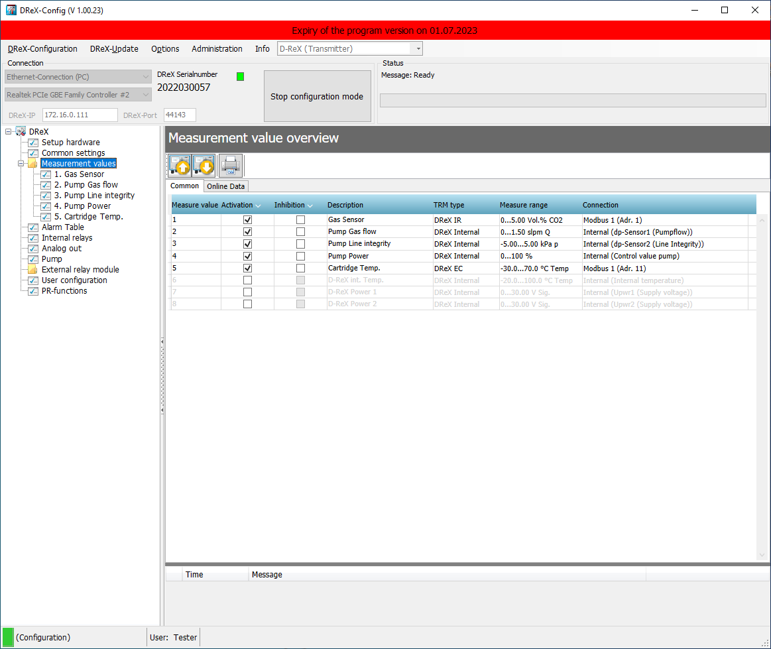
-Config
Overview of all measuring points with sub-menu to configure each one individually.

Slide 35
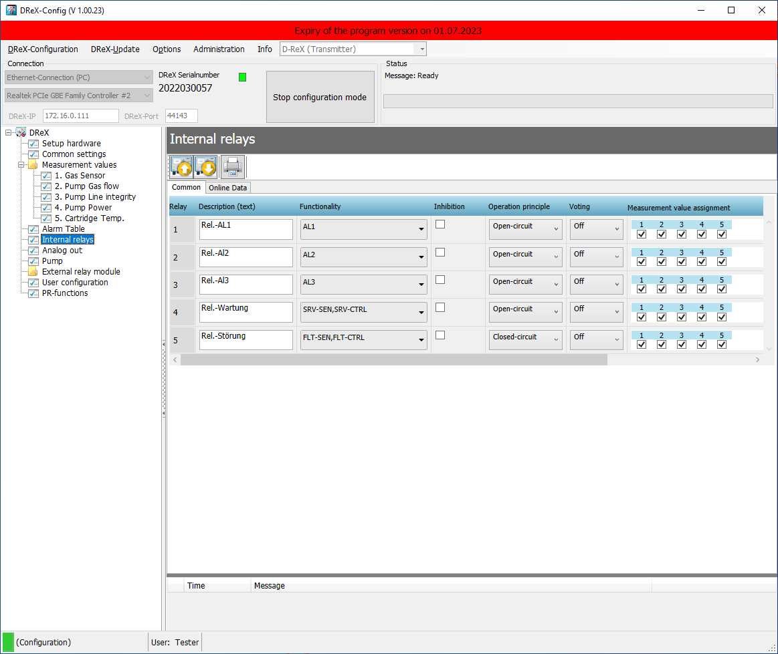
-Config
Menu for configuring and assigning the internal relays.

Slide 36
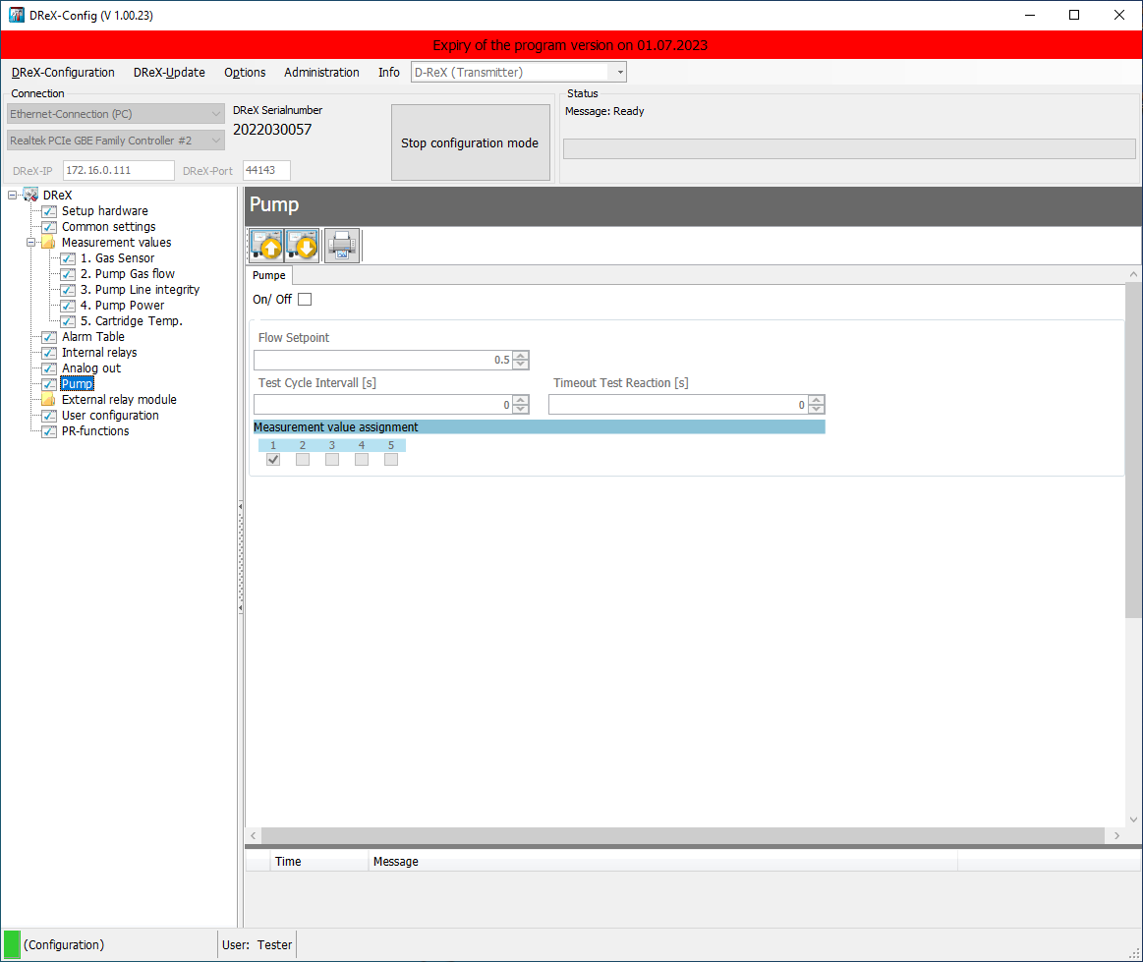
-Config
Pump configuration

Slide 37
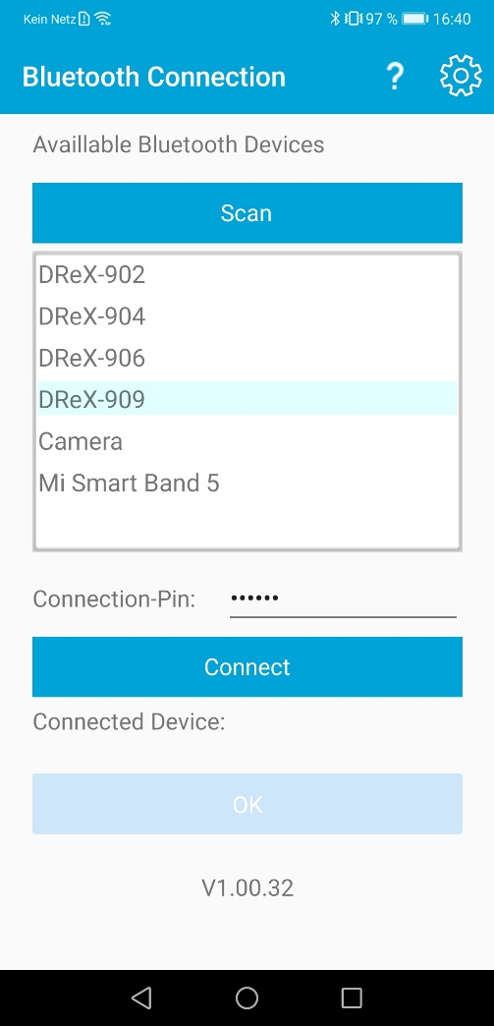
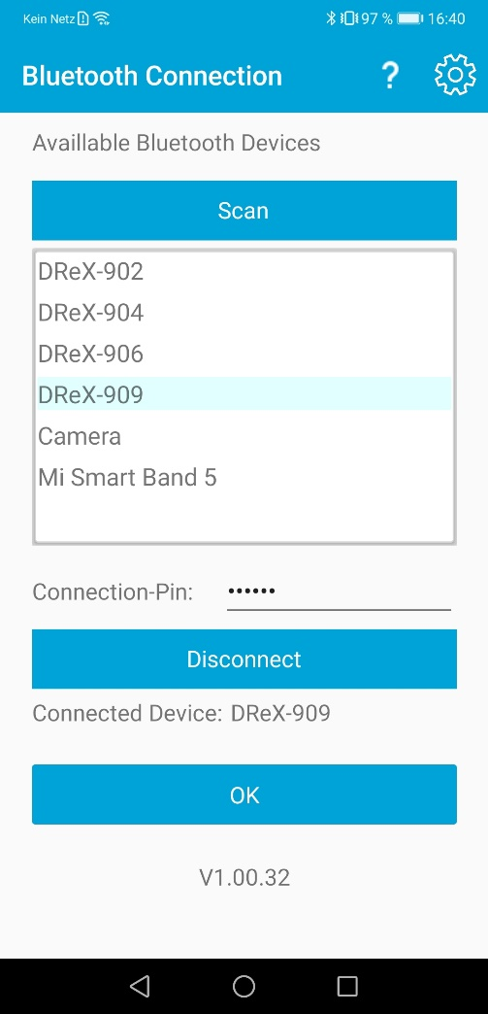
App
Bluetooth
Device Connection

Slide 38
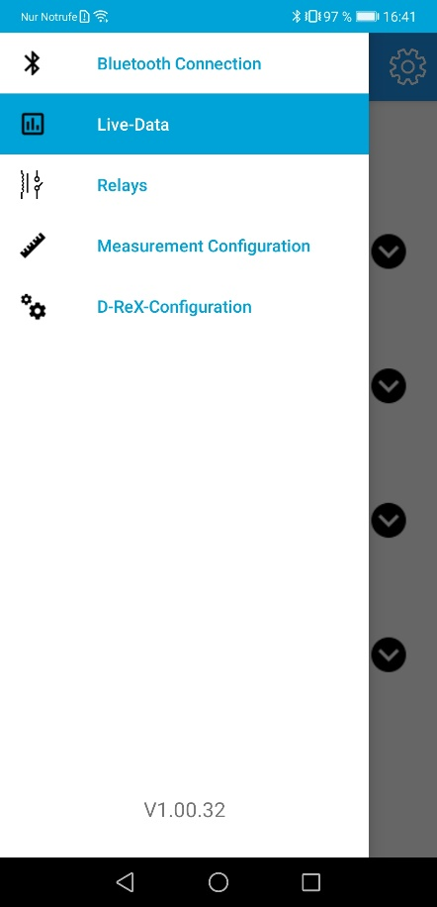
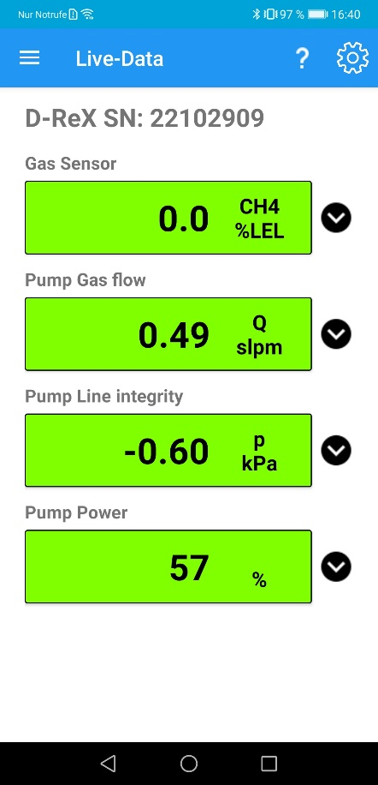
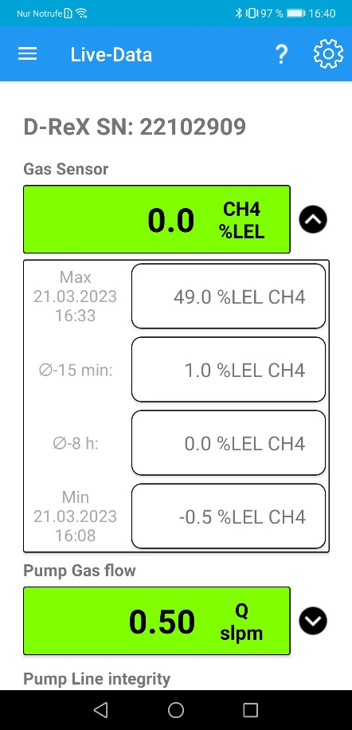
App
Live data
Measurement values

Slide 39
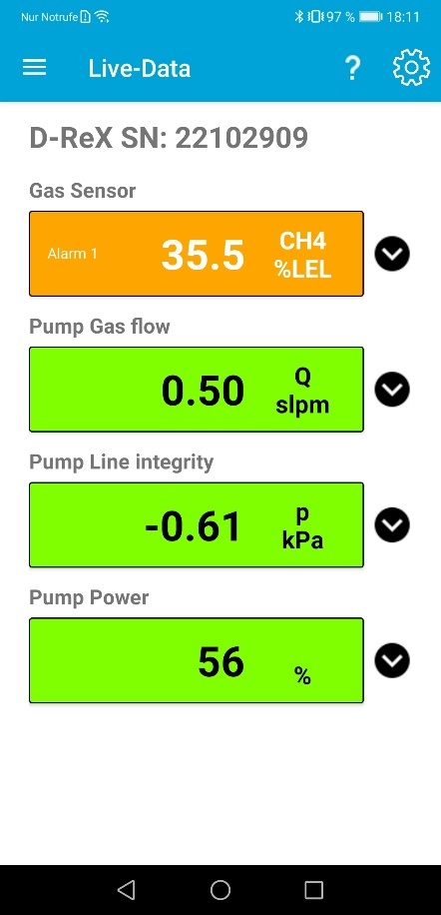

App
Live data
Measurement values

Slide 40




App
Relays
Status and tests

Slide 41




App
Measurement configuration
ZERO and SPAN

Slide 42


App
Measurement configuration
Alarms and measurement ranges

Slide 43





App
D-ReX Configuration
System, network and bus settings

Slide 44


App
App
Settings and manual

Slide 45

Web interface

Slide 46

Web interface

Slide 47

Thank you for your attention
GfG – Gesellschaft für Gerätebau mbH
Klönnestraße 99
44143 Dortmund, Germany
Phone: +49 231 56400-0
E-Mail: info@gfg-mbh.com

